Slide 1
Sprinkler protection for rack storage occupancies

Slide 2
Copyright
This presentation is protected by US and international copyright laws. Any reproduction, recording, distribution, display, or use of the presentation without written permission of the National Fire Sprinkler Association is prohibited. ​
©National Fire Sprinkler Association 2021​

Slide 3
THE KEYS TO STORAGE SOLUTIONS
What are we trying to protect?
Where do we start?
Let your fingers do the walking…
Notes:
Explain that the first question to be answered is “what are we trying to protect?”. Explain how the Owner’s Certificate plays such a critical role in this process. It requires the owner to make some decisions as to what will be stored in the building and how it will be stored. This info is required to be submitted with the plans. The answer to this question will dictate where we start in the standard, as to which chapter and appropriate tables/figures, etc. we will use to determine a design solution.
By “letting your fingers do the walking” I am referring to the old yellow pages ad. If we can find the right starting point, the standard is pretty good at leading us completely through a solution. It is good to explain that the good news is, the more dangerous something becomes, the fewer options we have and therefore, the design choices actually get easier because there are fewer of them.

Slide 4
Table of Contents
Commodity Classifications
Definitions/Rules for all storage
Definitions/Rules for Miscellaneous storage
Definitions/Rules for General storage
  Solid piled, palletized, bin box, shelf, back-to-back shelf
  Class I-IV & Plastics

Slide 5
Table of Contents
Definitions/Rules for Rack storage
  Class I-IV & Plastics
  Single, Double & Multi Row racks
  Up to and including 25’
  Over 25’
Definitions/Rules for Rubber Tire Storage
Definitions/Rules for Roll Paper Storage
Definitions/Rules for Baled Cotton Storage
Definitions/Rules for Special Designs

Slide 6
Module 1
Commodity Classification

Slide 7
Commodity Classification
What are we trying to protect?
Notes:
This leads us to the discussion regarding the classification of commodities. It is important to note that the annex in 13 is to be used as a GUIDE to illustrate the basic differences among commodity classifications, and not to be used as a replacement for a definitive engineering study or decision.

Slide 8
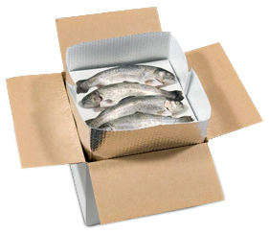
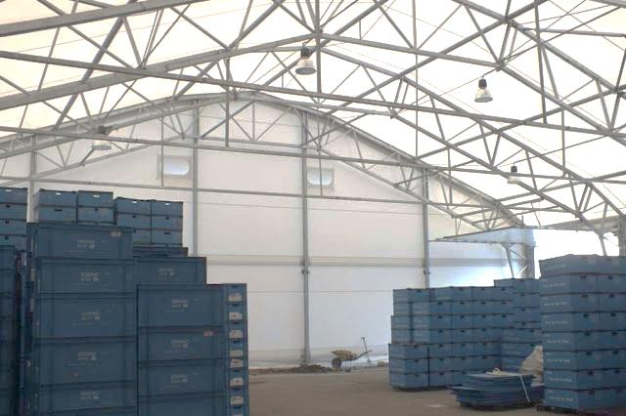
What is the Commodity?

Slide 9
Commodity Classification
Seven classes of commodities
  Class I
  Class II
  Class III
  Class IV
  Group C Plastics (Class III)
  Group B Plastics (Class IV)
  Group A Plastics
Notes:
This shows the seven basic classifications, Note that they will be compressed in to 5 classifications in a short while.

Slide 10
FACTORS AFFECTING COMMODITY CLASSIFICATION
Product (will it burn or not burn)
Packing material (does it help or hinder fire growth)
Storage method (pallets, solid piles,
single/double/multi row racks)
Rates of heat release
Data from a nationally recognized testing agency
Notes:
Bullet 5-5.6.1.1.2

Slide 11
Commodity classifications
Non combustible
Class I
Class II
Glass jars in a box
Metal lined dbl triwall
Combustible
Class III
Class IV
Paper cups in a box
Paper & polystyrene cups in a box
Notes:
I show these in this form for a reason. Commodities above the line are non combustible and those below are combustible. This illustrates the point that if something will burn, it is at least a Class III.

Slide 12
CLASS 1 COMMODITY
A non-combustible product that meets one of the following criteria:
Placed directly on a wooden pallet
Placed in a single layer corrugated box with or without dividers, with or without pallets
Shrink-wrapped or paper-wrapped with or without pallets
Notes:
5.6.3.1

Slide 13
CLASS 1 COMMODITIES
Alcoholic beverages up to 20% alcohol
Batteries - Dry cells
Bottles and jars
Frozen foods , non-waxed, non-plastic packaging
Transformers - dry or oil filled
Latex paint
Major appliances (no cartons, no appreciable plastic trim)
Metal desks w/plastic tops & trim
Bare wire on metal spools on wood skids
Plastic containers w/non combustible liquids < 5 gal. capacity
Notes:
A.5.6.3.1

Slide 14
FM Global’s Benchmark for Class I Commodity
Glass jars in compartmented cardboard cartons.

Slide 15
CLASS II COMMODITY
(same as Class I, but in more substantial packaging)
A non-combustible product in slatted wooden crates, solid wood boxes, multiple-layered corrugated cartons, or equivalent combustible packaging material with or without pallets
Notes:
Point out that the basic difference between a Class I and a Class II is the packaging.
5.6.3.2

Slide 16
CLASS II COMMODITIES
Alcohol products up to 20% in wood containers
Frozen food in waxed-paper containers
Light fixtures (non-plastic) in cartons
Wire on wooden spools
Wood products solid piled
Major appliances in corrugated cartons w/no appreciable plastic trim
Plastic containers w/non combustible liquids < ¼” wall thickness and > 5 gal capacity
Notes:
Note that it is the same alcohol product, just in different packaging. Same with a number of the other examples.
A.5.6.3.2

Slide 17
FM Global’s Benchmark for Class II Commodity
Coated metal cans in double tri-wall cartons
Notes:
An aluminum box inside a cardboard box inside another cardboard box.

Slide 18
CLASS III COMMODITY
A product of wood, paper, natural fiber or Group C plastic with or without cartons, boxes or crates, with or without pallets.
Such a product shall be allowed to contain a limited amount (5% or less by weight or volume) of Group A or B plastic
Notes:
This is a good place to introduce the concept of the limited amount and what it means. You can say there are actually two terms, and the other will be explained shortly.
5.6.3.3

Slide 19
CLASS III COMMODITIES
Aerosols - Level 1
Bread
Candy
Cloth
Diapers (cotton, linen)
Mattresses
Photographic Film
Charcoal, bagged (not self starting)
Furniture, wood (no plastic coverings or foam cushioning)
Paper, rolled in racks or on side (medium or heavyweight)
Textiles, natural fibers, synthetics (except rayon & nylon) - 50/50 blend or less
Wood products
Notes:
A.5.6.3.3

Slide 20
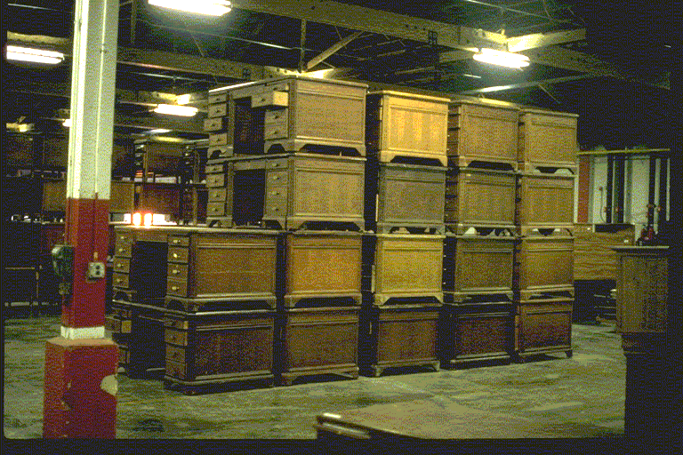
Notes:
Example of a Class III commodity.

Slide 21
FM Global’s Benchmark for Class III Commodity
Paper cups in compartmented cartons
Notes:
The benchmark is basically a box of paper cups.

Slide 22
CLASS IV COMMODITY
A product with or without pallets that meets one of the following criteria
Group B plastics
Free-flowing Group A plastics
Contains within itself or its packaging an appreciable amount (5% to 15% by weight or 5% to 25% by volume) of Group A plastic
Remaining materials may be Class I, II or III, or Group B plastic
Notes:
This is where a discussion of an appreciable amount may fit in well.
5.6.3.4

Slide 23
CLASS IV COMMODITIES
Diapers with plastic (cartoned)
Furniture (wood with plastic covering)
Matches
Rubber
Shingles, Asphalt
Skis (foam core)
Cloth (synthetic, cartoned or not)
Ammunition, small arms
Liquor (< 100 proof, < 1 gal containers, glass or plastic, cartoned)
Paper, rolled in racks (lightweight)
Nail polish, 1-2 oz., glass, cartoned
Notes:
A.5.6.3.4

Slide 24
FM Global’s Benchmark for Class IV Commodity
Polystyrene and paper cups in compartmented cardboard cartons
Notes:
You can note that the benchmark is basically the benchmark from Class III (a box of paper cups) with an appreciable amount of the paper cups being replaced with polystyrene cups.

Slide 25
PLASTICS CLASSIFICATIONS
Group “C” Plastic
Group “B” Plastic
Group “A” Plastic
Notes:
I list the plastics in reverse order to line up with the matrix in a couple of slides.

Slide 26
Original Benchmarks
Burning plastic’s peak heat release rates
  Under 1000 (190 kW/m²) BTU/ft²/min were considered Group C.
  Between 1000 (190 kW/m²) and 1500 BTU/ft²/min (283kW/m²) were considered Group B
  Exceeded 1500 BTU/ft²/min (283kW/m²) were considered Group A

Slide 27
Commodity Classification
Non combustible
Class I
Class II
Glass jars in a box
Metal lined dbl triwall
Combustible
Class III
Class IV
Paper cups in a box
Paper & polystyrene cups in a box
Plastics
Group C
Group B
Group A
Polystyrene cups in a box
Notes:
This is why I did the plastics in reverse order. It shows that a Group C plastic burns like a Class III commodity, so if it “walks like a duck, etc.”
The Group B plastic burns like a Class IV commodity, so if it “walks like a duck, etc.”

Slide 28
GROUP C PLASTICS
Design for Class III Commodity
Some fluoroplastics (PCTFE- polychlorotrifluoroethylene PTFE- polytetrafluoroethylene)
Melamine formaldehyde
PVC (polyvinyl chloride, flexible, PVC’s w/up to 20% plasticizer)
PVF- polyvinyl fluoride
Urea formaldehyde
Phenolic
PVDF- polyvinylidene fluoride
PVCF- polyvinylidene chloride
Notes:
5.6.4.3

Slide 29
GROUP B PLASTIC
Class IV Commodity
Cellulose (cellulose acetate, cellulose acetate butyrate, ethyl cellulose)
Chloroprene rubber
Some fluoroplastics ( ECTFE- ethylene-chlorotrifluoro-ethylene copolymer
ETFE- ethylene-tetrafluoroethylene-copolymer
FEP- fluoronated ethylene-propylene copolymer
Natural rubber- not expanded
Nylon (nylon 6, nylon 6/6)
Silicone rubber
Notes:
5.6.4.2

Slide 30
GROUP A PLASTIC
(Free Flowing Design for Class IV Commodity)
ABS plastic
Butyl rubber
Natural rubber- expanded
Polystyrene
Lighters (butane- blister pack or cartoned)
Margarine (50-80% oil, in any packaging)
Polyurethane
PVC (polyvinyl chloride – highly plasticized > 20% plasticizer- rare)
Candles, (packaged, cartoned)
Mattresses (foam)
Milk (containers in plastic crates)
Vinyl floor covering (rolled)
Notes:
5.6.4.1

Slide 31
FM Global’s Benchmark for Group A Plastic Commodity
Polystyrene cups in compartmented cardboard cartons
Notes:
Basically they took the rest of the paper cups out of the box and replaced them all with polystyrene cups.

Slide 32
Under two conditions, Group A plastics can be treated as Class IV
First Condition - Free Flowing
  Small objects
  Fall out of the box
  Fill the flue space
  Smother the fire
  Examples of free flowing plastics are powder, pellets, flakes, and random packed objects.
Notes:
A very delicate decision, one that should require the approval of ALL parties, the owner, the AHJ. The engineer/architect, the contractor, etc.
3.9.1.15

Slide 33
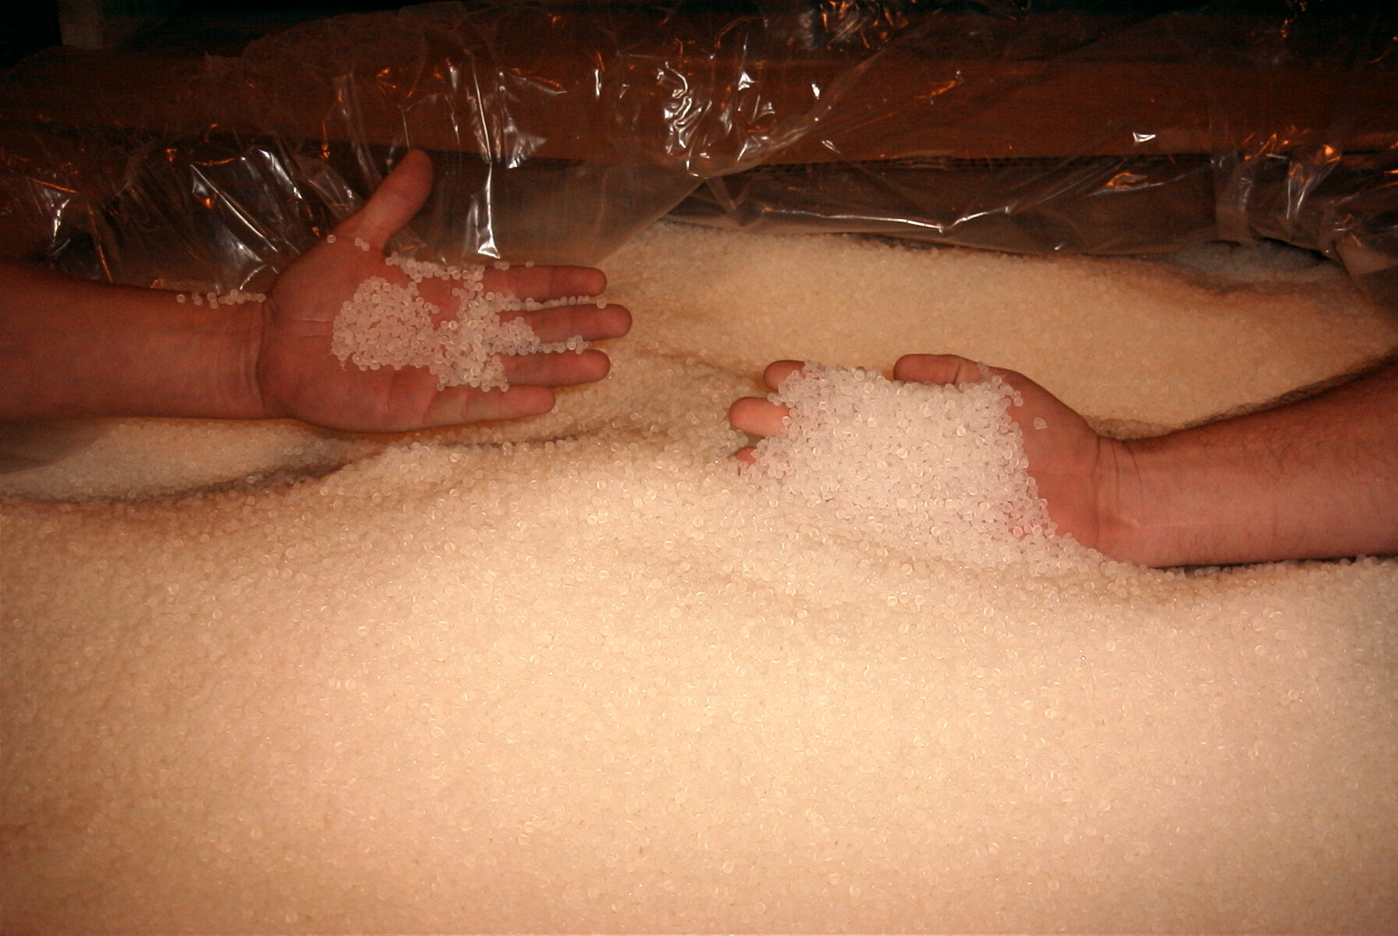

Slide 34
Under two conditions, Group A plastics can be treated as Class IV
Second condition - Multiple layers of cardboard or equivalent outer material which would significantly delay the involvement of plastics in the fire, and where the arrangement and the amount of material within the carton would not significantly increase the fire hazard
  This is actually contained in a footnote to the decision tree
Notes:
A very delicate decision, one that should require the approval of ALL parties, the owner, the AHJ. The engineer/architect, the contractor, etc.
This is not actually in the rules, but is a footnote to the decision tree Figure 15.2.2.

Slide 35
What if I don’t know its classification
Commodity fire test with 24 Pallet Loads (1974 Swedish Test Criteria)
3 fire tests, 8 pallets of commodity per test
FM Global, Underwriters, and South West Laboratories can perform this test
Compare the heat release characteristics to the benchmarks

Slide 36
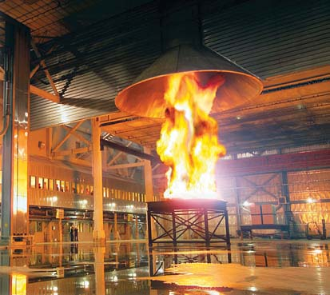
WHAT IF I DON’T KNOW ITS CLASSIFICATION?
Notes:
Burn it
Fire Products Collector

Slide 37
Fire Products Collector
WHAT IF I DON’T KNOW ITS CLASSIFICATION
Orifice
8.5 feet
20 feet
22 feet
31.4 feet
FLOOR

Slide 38
Convective Heat Release Rate
(in thousands of BTU’s/ft²/min)
(BTU)
500
450
A Plastic
400
Class IV
350
Class III
300
250
Class II
200
Class I
150
100
50
0
O
2.5
5
10
15
17.5
20
(TIME)

Slide 39
Generic FMRC Benchmark Commodities
Class Commodity
Glass Jars Compartmented Cartons (GJCC)
Metal Lined Double Triwall (MLDT)
Paper Cups Compartmented Cartons (PCCC)
Polystyrene & Paper Cups in Compartmented Cartons (PSPC)
Plastics:
A Polystyrene Cups in Compartmented Cartons (PSCC)
Notes:
Explain that the results of the test are compared to the benchmarks. Whichever it burns like, that is how it is classified. You can explain that a manufacturer always has the option of redesigning their product and re testing it to get a lower classification rating.

Slide 40
Mixed Commodities
Option 1 - protect the entire building for the highest (or most demanding) commodity
Option 2 - Confine the higher hazard material to a designated area
Option 3 - Randomly space a few pallet loads of the higher commodity without changing the classification
Notes:
The 3 options for dealing with mixed commodities. Option 1 is probably the most expensive, but affords the most flexibility.
Option 2 is more cost effective but is very difficult to enforce.
Option 3 is probably the most impractical, since we usually want to store like things together. This makes enforcement practically impossible.
5.6.1.2

Slide 41
Mixed Commodities - Randomly Spaced Option
Up to 10 pallet loads of a higher hazard commodity in any 40,000 ft² area are allowed in most circumstances
  randomly spaced
  no adjacent pallet loads in any direction, including
  diagonally
When the fire protection system is designed for Class I or Class II protection, the number of pallet loads of Class IV or Group A Plastics shall be reduced to 5.
Notes:
Interesting to note that the way the standard is written, we could actually store 20 pallet loads in a 50,000 ft² area as long as they were divided correctly, with no more than 10 in any 40,000 area.
5.6.1.2.3-5.6.1.2.4

Slide 42
Plastic Pallets
Commodity classification rules assume wooden or metal pallets
Plastic pallets are permitted
  Unreinforced
    classification shall be increased by one class (e.g. Class I to Class II)
    Must have a permanent symbol marking them
  Reinforced
    Classification shall be increased by two classes (e.g. Class II to Class IV)
Notes:
You can discuss how the original concept in 2007 put the onus on the pallet manufacturers to mark their pallets as being reinforced so as to identify whether the commodity should be bumped once or twice. This didn’t work so 2010 requires the default to be reinforced unless otherwise proven.
5.6.2

Slide 43
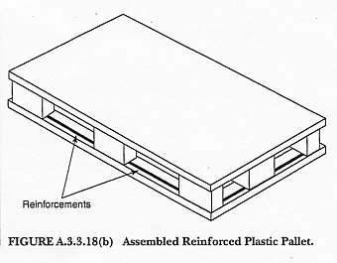
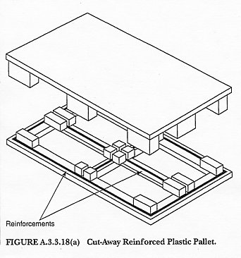
Plastic Pallets
Example of reinforced pallets
R
Notes:
Figure A.3.9.1.22

Slide 44
Plastic Pallets
No increase is required for Group A plastics stored on plastic pallets
Pallets are assumed to be reinforced unless permanently marked or certified by manufacturer
No increase is required where the sprinkler system uses ceiling only protection and uses sprinklers with a minimum k-factor of k-16.8
No increase is required where non wood pallets have demonstrated a hazard < wood & are listed as such
Notes:
You can discuss how the original concept in 2007 put the onus on the pallet manufacturers to mark their pallets as being reinforced so as to identify whether the commodity should be bumped once or twice. This didn’t work so 2010 requires the default to be reinforced unless otherwise proven.
Note bullet three (5.6.2.5), which avoids the problem of various type pallets.
5.6.2

Slide 45
Exercise Commodity Classification
Aerosol Level 1 ______
Metal File Cabinets on unreinforced
Plastic Pallets ______
Rigid PVC Pipe ______
Major Appliance in a Cardboard Box ______
Wax Coated Paper Plates in cartons ______
Milk in Plastic Container ______
Cartoned Diapers (Disposable) ______
Syrup in Wood Barrels ______
Boxed Frozen Fish ______
Canned Coffee on High-Density
Reinforced Plastic Pallets ______
Notes:
This exercise can be taken with or without a break. Stress that it is simply to show the basic differences in classifications. Some of the questions require more information before they can be answered.
Class III (Group C) 2. Class II (Class I bumped one class)
3. Class III (Group C) 4. You can discuss this- if the doors are on a refrigerator, probably a Class II (due to reinforced packaging because of weight); if the doors are off, it is a box of plastic and probably a Group A (many refrigerators are shipped with doors off so they will fit through a doorway); If a range, probably Class II (due to packaging for weight)
5. Class IV 6. How large are the containers? If < 5 gallons, Class I; if > 5gallons, Class II
7. Class IV- discuss the importance of being in a carton (if not, they are a Group A plastic; explain how the standard specifically states certain parameters, like cartons 8. Class II
9. Class II 10. Class III (Class I bumped two classes)
Explain how the pallet changes the Classification, and relate it to the requirements of Chapter 4 in NFPA 25 to note that a change in pallets requires a an evaluation of the system.

Slide 46
Module 2
Definitions & Rules Specific to All Storage

Slide 47
DEFINITIONS
General Definitions for Storage
Notes:
This is a good place to discuss how the definitions chapters are expanding in all NFPA documents due as much to litigation as anything else. Discuss how, since the industry has spread out so much, there is a need to specifically define terms. Also, in case of lawsuits, the court will use the dictionary if terms are not defined in the standard. It is also important to note that different standards, and even different chapters of the same standard may have different definitions. Because of that, we ill discuss definitions applicable to each major division of this program.

Slide 48
GENERAL DEFINITIONS FOR STORAGE
Available height for storage- max. height commodities can be stored above the floor & maintain clearance to sprinklers
Cartoned record storage- Class III commodity predominantly paper records in cardboard cartons
Catwalk- a storage aid of open metal grate or solid horizontal barriers supported from racks that is used as a walkway for access on elevated levels
  Accessed via stairs
  Not separate floors of a building
Notes:
By bullet
3.9.1.1
3.9.1.3
3.9.1.4
You can explain that the definitions are simply putting in place terms that will be used later in determining design solutions.

Slide 49
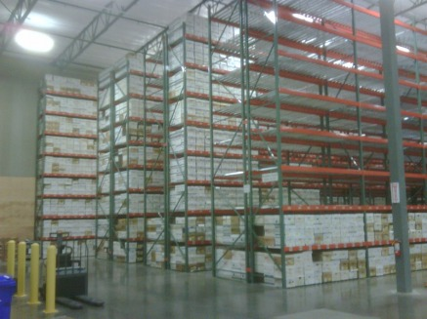
Carton Record Storage
Rock Solid Record Mgmt

Slide 50
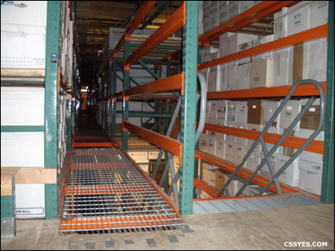
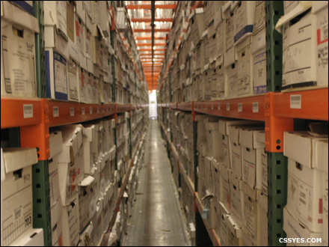
Catwalk
50

Slide 51
GENERAL DEFINITIONS FOR STORAGE
Clearance- distance from top of storage to sprinkler deflectors
Compact storage- storage on solid shelves < 36” in depth, arranged as part of a compact storage module, with < 30” between shelves vertically & no internal vertical flue spaces other than those between individual shelving sections
Compact Storage module- units move to allow storage to be pushed together creating a storage unit with no flues or minimal spaces between units
  Aisles are created by moving shelving units
  Manual or electric in operation
Notes:
By bullet
3.9.1.5
3.9.1.7
3.9.1.8
You can explain that the definitions are simply putting in place terms that will be used later in determining design solutions.

Slide 52
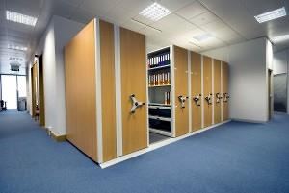
Compact Storage
Storwell Storage Systems

Slide 53
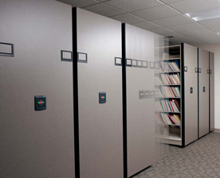
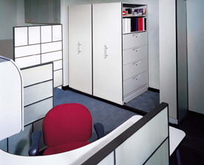
Compact Storage (Mobile Shelves)
Pictures courtesy of Spacesaver
Notes:
An example of compact record storage. Supposedly the major manufacturers of these type devices have agreed to install them maintaining the 18” clearance to the sprinklers.

Slide 54
GENERAL DEFINITIONS FOR STORAGE
Encapsulation- method of packaging consisting of a plastic sheet completely enclosing sides & top of a pallet load containing a combustible commodity or a group of combustible packages
  Also applies to individually plastic wrapped commodities stored exposed on a pallet
  Does NOT apply to totally noncombustible commodities on wood pallets wrapped in plastic
  Does NOT apply to plastic- enclosed products inside a large, non plastic container
Banding- stretch wrapping around sides only
  not considered encapsulation where the top > 50% open
Notes:
3.9.1.12
Note that encapsulation does not change the classification of the commodity, but may change the density required to properly protect it. Since we cannot pre wet the package, we usually must provide extra water to serve as a type of water blanket around the exposed materials.

Slide 55
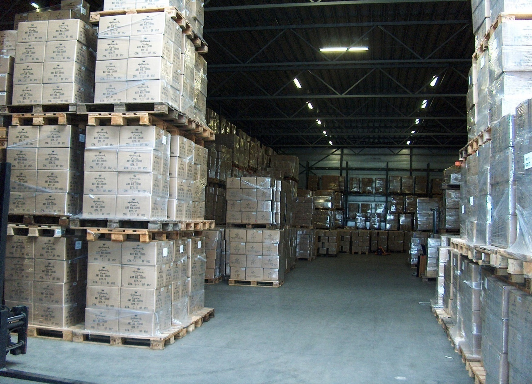
Encapsulation
Encapsulated completely enclosed on sides & top
www.shiva-logistics.nl

Slide 56
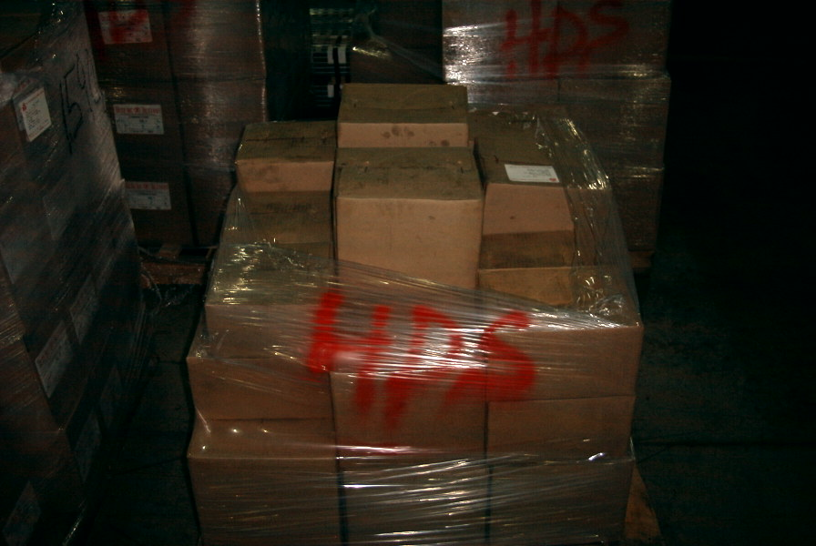
Banded (stretch wrapped)
Enclosed on sides with top at least 50% open

Slide 57
GENERAL DEFINITIONS FOR STORAGE
Miscellaneous storage- storage that meets the following criteria (note differences for rubber tires)
  Does not exceed 12’ in height
  Is incidental to another occupancy use group
  Does not constitute more than 4,000 ft² or 10% of the building area, whichever is GREATER
  Individual piles must be < 1000 ft²
  Each pile or area must be separated from other piles/areas by at least 25’
Notes:
3.9.1.18
Explain the history of miscellaneous storage as a way of dealing with store rooms and such found in almost every occupancy. The rules provide a means of deciding when we change from a storage that is incidental to use to an actual storage facility.
Point out that the rules for Miscellaneous Tire storage are a bit more restrictive.

Slide 58
MISCELLANEOUS STORAGE
1,000 sq. ft
> 25
1,000 sq. ft
> 25
> 25
> 25
1,000 sq. ft
1,000 sq. ft
Notes:
Simply a picture version of miscellaneous storage. Explain that other activities can be ongoing in the 25’ space, just not storage.

Slide 59

GENERAL DEFINITIONS FOR STORAGE
High piled storage- storage > 12’ high
Open top container- any shape container that is entirely or partially open on the top & arranged so as to allow for the collection of sprinkler water cascading through the storage array
Roof height- distance from floor to underside of roof deck within the storage area
Notes:
By bullet
3.9.1.17
3.9.1.19
3.9.1.23

Slide 60
GENERAL DEFINITIONS FOR STORAGE
Pallets
  Wood- constructed entirely of wood with metal fasteners
  Plastic pallet- pallet with any portion of its construction consisting of plastic
  Reinforced plastic pallet- incorporates a secondary reinforcing material like steel or fiberglass
Notes:
By bullet
3.9.1.27
3.9.1.21
3.9.1.22

Slide 61
General Rules for All Storage

Slide 62
GENERAL RULES FOR ALL STORAGE
(Except misc. & as modified by specific chapters)
Roof vents/draft curtains
  Only allowed if manual or automatic with higher temp. links than the sprinklers
  No vents with ESFR unless hi-temp, standard response operating mechanism
  No draft curtains with ESFR except where used to separate hazards or control mode sprinklers
Notes:
12.1.1
For many years, the rules of storage assumed that draft curtains and heat vents were not being used. This was based on testing that showed the use of such devices could significantly alter sprinkler performance. Still, many building codes required their use. These new rules at least seem to develop some “middle ground” between the two conflicting issues. Most building codes have now eliminated the requirement for draft curtains when ESFR sprinklers are used, except as noted in the standard.

Slide 63
GENERAL RULES FOR ALL STORAGE
NERAL RULES FOR ALL STORAGE
Ceiling slope of 2:12 or less
Design based on the height that routinely or periodically exists in the building (storage above doors measured from the base of storage above the door)
Notes:
By bullet
12.1.2
12.1.3.3

Slide 64
Storage Occupancies and Clearance to Ceilings with Insulation
Sag <6 inches
Sag > 6 inches
Clearance
to Ceiling
Measured
To Underside
Of Insulation
Clearance
to Ceiling
Measured
To Mid Point
Of Sag
Clearance
to Ceiling
Measured to
High Point of Sag
Notes:
Storage Occupancies and Clearance to Ceilings (12.1.3.4). A standardized method for determining the clearance from the top of the storage to the ceiling was written using the same set of rules as the sprinkler deflector distance to the ceiling measurements in Chapter 8. The rules are:
· For corrugated deck with up to 3 inch depth, measure to the bottom of the deck
· For corrugated deck greater than 3 inches deep, measure to the highest point of the deck
· Measure to the underside of insulation
o Average the sag
o If sag is more than 6 inches, measure to highest point

Slide 65
GENERAL RULES FOR ALL STORAGE
High ceiling rules apply to spray sprinklers
  For general storage of I-IV & Plastics, design must be based on max. ceiling clearance of 20’
  For rack storage of I-IV < 25’
    Design based on max. ceiling clearance of 20’, or
    Provide 1 level in-racks directly under top tier of storage at every flu space intersection
  For I-IV > 25’ on racks & Plastics on racks < 25’
    Design based on max. ceiling clearance of 10’, or
    Provide 1 level in-racks directly under top tier of storage at every flu space intersection
Notes:
Be sure to note that these “high ceiling” rules apply only to Standard Spray sprinklers (12.1.3.4.2). This was clarified in the 2010 edition of the standard. In 2007 this section indicated these rules applied to all sprinklers.
By bullet
12.1.3.4.2
12.1.3.4.3- chapters 14 & 15 deal with general storage of Class I-IV & Plastics
12.1.3.4.4- Rack storage of Class I-IV < 25’ high
12.1.3.4.5- Section 176.3 = Rack storage of Class I-IV > 25’; Section 17.2= Plastics < 25’

Slide 66
GENERAL RULES FOR ALL STORAGE
High ceiling rules apply to spray sprinklers (cont)
  For Plastics on racks > 25’
    Design based on max. ceiling clearance of 10’, or
    Provide 1 level in-racks directly under top tier of storage at every flu space intersection
Notes:
Be sure to note that these “high ceiling” rules apply only to Standard Spray sprinklers (12.1.3.4.2). This was clarified in the 2010 edition of the standard. In 2007 this section indicated these rules applied to all sprinklers.
By bullet
12.1.3.4.2
12.1.3.4.6- Section 17.3 = Plastics on racks > 25’

Slide 67
High Volume Low Speed(HVLS) Fans
Installation shall comply with the following
  Max fan diameter shall be 24’ (7.3m)
  Fan shall be centered approximately between 4 sprinklers
  Clearance from HVLS fan to deflector at least 3’ (0.9m)
  All fans interlocked to shut down on water flow signal according to NFPA 72
Notes:
These rules were put in to the 2013 edition after testing was done with HVLS fans.
By bullet:
12.1.4.1
12.1.4.1(1)
12.1.4.1(2)
12.1.4.1(3)
12.1.4.1(4)

Slide 68
GENERAL RULES FOR ALL STORAGE
Hose connections
  Only installed where required by the AHJ
  Not required for any I-IV storage < 12’
Options of separating adjacent hazards or
design methods
  Extend more demanding area 15’ beyond its perimeter
  Separate with a barrier partition
  No need for separation from a more demanding criteria at an upper ceiling level to a lower ceiling level where ceiling height differences are at least 2’
Notes:
Hose connections 12.2
12.3-The last bullet, the 2’ change in ceiling elevation, is new to 2010.

Slide 69
GENERAL RULES FOR ALL STORAGE
Wet pipe systems only, unless subject to
freezing
  ALL dry & preaction require 30% area increase
  Densities/areas shall be selected so that after the 30% increase, the final area does not exceed 6,000ft²
Density limits on use of standard spray
sprinklers
  O.20gpm/ft² may use k-5.6 or greater
  0.20-0.34 must use k-8.0 or greater
  Greater than 0.34 must use k-11.2 or greater
  K-11.2 or greater used for storage must be listed as such
Notes:
By bullet
12.4-12.5
12.6
Note that the density limitations on standard spray sprinklers (Main bullet 2) applies only to std spray sprinklers, and only to storage applications. The reason for requiring special listing for sprinklers > K-11.2 is that there is typically a requirement to use a minimum pressure of 10psi instead of the normal 7psi if used for storage.

Slide 70
GENERAL RULES FOR ALL STORAGE
QR sprinklers are allowed if listed for storage
Ordinary & Intermediate Temp. sprinklers shall use design densities for OT sprinklers
  OT & Intermediate K > 11.2 listed for storage may use hi-temp densities
Hi-temp sprinklers shall use HT design densities
Notes:
By bullet
12.6.6
12.6.8.1-12.6.9
12.6.8.2
There are not any QR sprinklers currently listed for storage. Although ESFR’s have a fast response link, they are not a QR sprinkler (QR = standard spray sprinkler with a fast rsponse link).

Slide 71
GENERAL RULES FOR ALL STORAGE
ESFR sprinklers designed to meet any storage criteria may protect LH & OH
Quick response CMSA sprinklers designed to meet any storage criteria may also protect LH & OH
Standard response CSMA sprinklers designed to meet any storage criteria may also protect OH
Notes:
ESFR Sprinklers and Light Hazard (12.6.7.1). While ESFR sprinklers are overkill protection for light hazard occupancies, situations have arisen where their use might be requested. The most common example is a large open spec building that is protected with ESFR sprinklers that then gets turned into a gym, fitness, and weight lifting space. There is no reason to change out the sprinklers in this case. In the past, NFPA 13 did not anticipate the use of ESFR in light hazard, so it was not expressly stated that it was okay. After repeated inquiries into the subject, the committee decided that expressly state that ESFR sprinklers could be used for light hazard.
CMSA Sprinklers and Light Hazard (12.6.7.1). Similar to the discussion above for ESFR sprinklers, CMSA sprinklers can also be used with light hazard occupancies. However, since faster response times are desirable in light hazard occupancies, only the quick response CMSA sprinklers are permitted to be used in light hazard spaces.

Slide 72
GENERAL RULES FOR ALL STORAGE
Designers may use
  Standard spray sprinklers
  CMSA sprinklers
  ESFR sprinklers
Rules were carried into the storage rules for
  Multiple adjustments where required
  Hose demand allowances
  Restrictions on design area for unprotected
  combustible concealed spaces
  Room design method
High ex foam systems may be used with sprinklers
Notes:
Rules for expanding the design area when we eliminate sprinklers from combustible concealed spaces (see 8.15.1.2) were carried over in to chapter 12 in 12.9. These are simply repeating the rules of 8.15.1.2.
The use of hi expansion foam is in 12.11

Slide 73
Hose Stream Demand and Water Supply Duration
Consolidated all of the hose demand and water supply duration requirements into one table.
Made the requirements consistent based on how many sprinklers are needed for fire control
The more sprinklers needed for fire control, the more hose demand and duration you need
Notes:
Hose Stream Demands and Water Supply Durations for Storage (12.8.6.1). All of the hose stream demands and water supply duration requirements, which were scattered around nine chapters, have been consolidated into one table and modified based on how many sprinklers are needed for fire control. In situations where more sprinklers are needed for fire control, larger hose stream demands and longer durations are needed

Slide 74
PROTECTION OF IDLE WOOD PALLETS
  May be stored outside
  May be stored in a separate building
  Options for storing them indoors
    Protect with SS sprinklers according to the Tables
    Protect with CMSA sprinklers according to the Tables
    Protect with ESFR sprinklers according to the Tables
Notes:
12.12.1.2 Note this is for WOOD pallets. These options require an adjustment to the normal protection scheme of the building.

Slide 75
PROTECTION OF IDLE WOOD PALLETS
  Options for storing them indoors
    Make no change to building sprinkler design if all of the following are used
      SS sprinklers using OH2 curve
      Hose stream demand of 250 gpm (946L/min)
      At least a 60 min. water supply duration
      Piles of pallets stored < 6’ high
      No more than 4 stacks in a pile
      Piles separated by either > 8’ clear space or > 25’ of commodity
      High ceiling clearance does not apply
Notes:
12.12.1.2(4) This allows wooden pallets to be stored in the building without any adjustments to the protection scheme in the building.

Slide 76
PROTECTION OF IDLE PLASTIC PALLETS
  May be stored outside
  May be stored in a separate building
  Options for storing them indoors
    Protected as wood pallets if listed as such
    Protected according to specific test data
    Protected with ESFR according to the Table
    Protected with SS sprinklers under one of three options
Notes:
Note this is for PLASTIC pallets. 12.12.2
By bullet:
12.12.2
12.12.2.1(1)
12.12.2.1(2)
12.12.2.1(3)
12.12.2.2.1
12.12.2.2.2
12.12.2.2.3
12.12.2.2.4 we will show the three options on the following slides

Slide 77
PROTECTION OF IDLE PLASTIC PALLETS
  Options for storing them indoors with SS sprinklers OPTION 1- Cutoff Room
    At least one exterior wall
    Separated from rest of building with have 3 hr rated walls
    Sprinkler protection options
      0.6 gpm/ft² for the entire room or hi-expansion foam with 0.3 gpm/ft² over the entire room
    Piled storage < 12’
    Steel columns protected by fireproofing or sidewall sprinkler on one side at top or 15’ level, whichever is lower (may be omitted from system demand)
Notes:
This is option 1 for protecting plastic pallets inside the building using SS sprinklers- using a cut off room
12.12.2.2.4.1

Slide 78
Typical Cutoff Room for Plastic Pallet Storage
Cutoff 3 hr rated fire walls
Room

Slide 79
PROTECTION OF IDLE PLASTIC PALLETS
  Options for storing them indoors with SS sprinklers OPTION 2- Specific design
    Max. storage height is 10’ (3.05m)
    Max. ceiling height is 30’ (9.1m)
    Density of 0.60 gpm/ft² over 2,000 ft²
    Min k-factor 16.8 (240)
Notes:
This is option 2 for protecting plastic pallets inside the building using SS sprinklers- specific design
12.12.2.2.4.2

Slide 80
PROTECTION OF IDLE PLASTIC PALLETS
  Options for storing them indoors with SS sprinklers OPTION 3- No change to building sprinkler design
    Max. pile height is 4’ (1.2m)
    Must use hi temp sprinklers
    Each pile of < 2 stacks shall be separated by either > 8’ clear space or > 25’ of commodity
    Minimum ceiling design of OH2
Notes:
This is option 3 for protecting plastic pallets inside the building using SS sprinklers- no change to building sprinkler design
12.12.2.2.4.3

Slide 81
PROTECTION OF IDLE PLASTIC PALLETS
Idle plastic pallets are only stored in racks where protected with ESFR sprinklers
  May use specific test data to protect idle plastic pallets in racks
Where idle pallet storage is above a door, the height is calculated from the base of the storage above the door
When using hi-expansion foam, ceiling densities may be reduced by 50% but not below 0.15 gpm/ft²
Notes:
By bullet
12.12.2.3- Table 12.12.2.3 is for protection of idle plastic pallets with ESFR sprinklers.
12.12.2.3.1
12.12.3.3
12.12.4

Slide 82
Module 3
Definitions & Rules Specific to
Rack Storage

Slide 83
DEFINITIONS
Definitions Specific to Rack Storage

Slide 84
DEFINITIONS SPECIFIC TO RACK STORAGE (CONT)
Rack- Any combination of vertical, horizontal & diagonal structural members that supports stored materials
  Single row- no longitudinal flue spaces
  Depth < 6’ (1.8m)
  Aisles > 3.5’ (1.1m) wide between loads
  Double row-
  Racks < 12’ (3.7m)in depth or single row racks placed back to back with < 12’ (3.7m)aggregate depth
  Aisles > 3.5’ (1.1m)wide between loads
  Multi row-
  Racks > 12’ (3.7m)wide or single or double row racks separated by aisles < 3.5’ (1.1m)with total depth > 12’ (3.7m)
Notes:
3.9.3.7

Slide 85
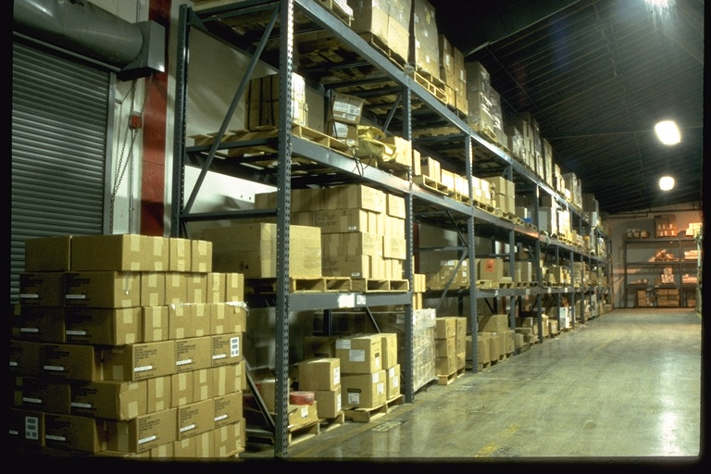
Single Row Rack
Notes:
You can point out the nice little touch of the solid piled commodity blocking the door.

Slide 86
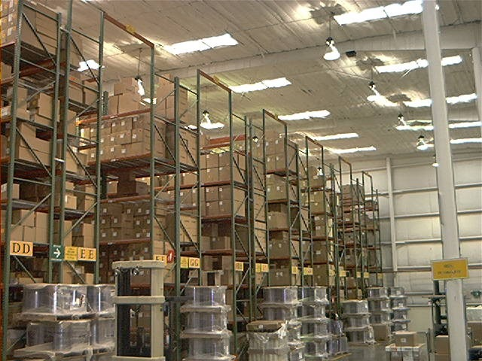
Double Row Racks
Notes:
Note the spacers at the top that maintain the aisle width between the racks.

Slide 87
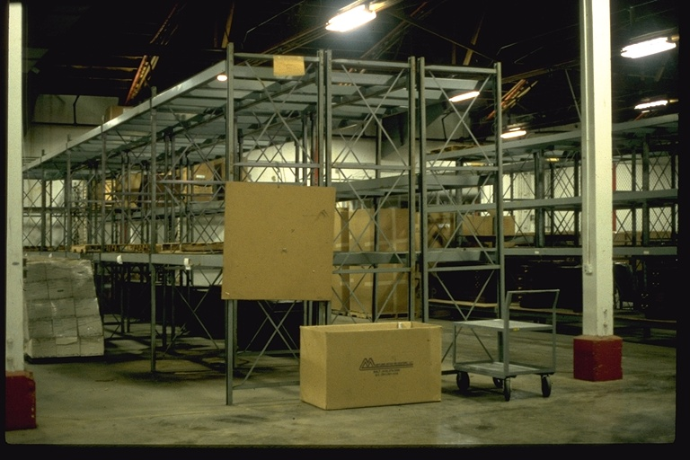
Multi Row Racks

Slide 88
DEFINITIONS SPECIFIC TO RACK STORAGE
Rack- (cont)
  Movable- racks on fixed rails or guides that can move back & for the in the horizontal plane creating a moving aisle as abutting racks are loaded/unloaded
  Protected as multiple-row racks
  Portable- racks not fixed in place
    Can be arranged in any number of configurations
Rack shelf area- the area of the horizontal surface of a shelf in a rack defined by either
  Perimeter aisles or 6” (152mm)flu spaces on all 4 sides
  Placement of loads that block openings that would otherwise serve as required flue spaces
Notes:
By bullet
Movable-3.9.3.7.2
Portable- 3.9.3.7.4
Rack shelf area-3.9.3.7.6

Slide 89
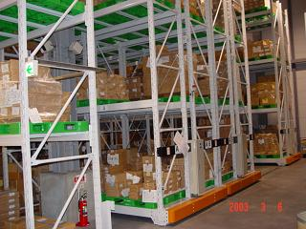
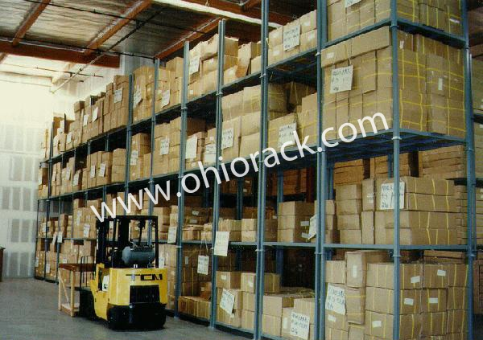
Moveable & Portable Racks

Slide 90
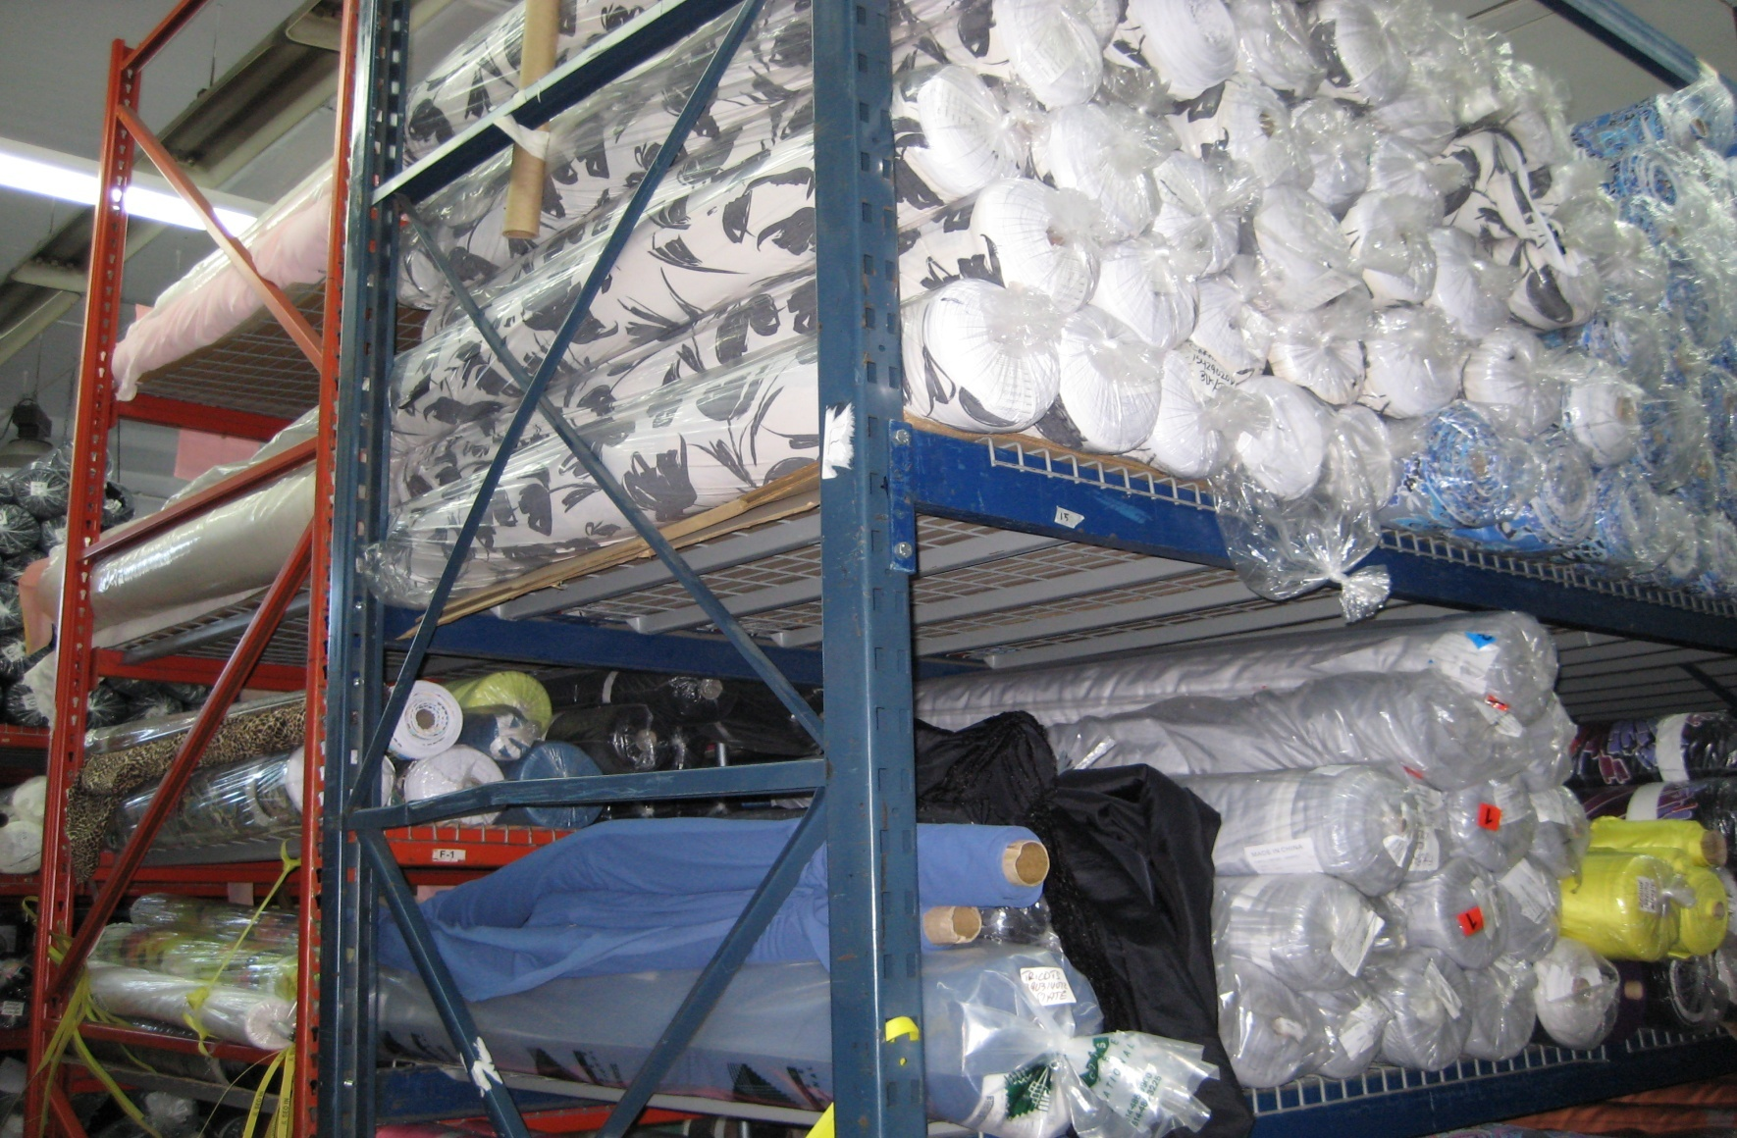
Rack Shelf Area

Slide 91
DEFINITIONS SPECIFIC TO RACK STORAGE
Open rack- one of the following:
  Without shelving
  Solid surface shelves with surface area < 20ft² (1.9m²)
  Shelves with wire mesh, slatted surface or other material with openings > 50% of the shelf area including horizontal area of rack members & flue spaces
Slatted shelf rack- shelves are fixed in place with a series of narrow individual solid supports spaced apart with regular openings
Notes:
By bullet
Open rack- 3.9.3.7.7
Slatted shelf rack-3.9.3.7.8. NOTE THAT IN SPANISH THERE IS NO REAL WORD FOR SLATTED SHELF SO IT MAY TAKE A BIT OF EXPLAINING.

Slide 92
DEFINITIONS SPECIFIC TO RACK STORAGE
Solid shelf rack- shelves are fixed in place with a solid, slatted or wire mesh barrier used as the shelf material with limited openings
Solid shelving- shelving is fixed in place, slatted, wire mesh or other type of shelves located within racks. The area of a solid shelf is defined by perimeter aisle or flue space on all 4 sides
  Solid shelves < 20ft² (1.9m²) are considered open racks
  Shelves of wire mesh, slats or other materials > 50% open & where flue spaces are maintained are considered open racks
Notes:
Solid shelf-3.9.3.7.9
Solid shelving3.9.3.8
This is a good opportunity to discuss the fact that the predominate difference between a shelf and a barrier (defined later) is the flu spaces. Shelves stop at the flu spaces and barriers do not.

Slide 93
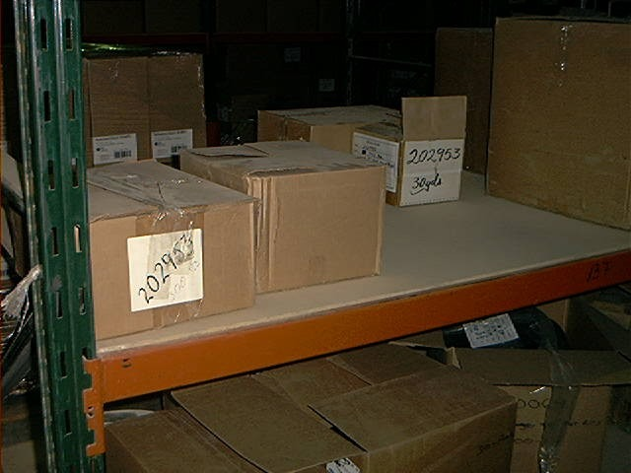
Solid Shelves

Slide 94
DEFINITIONS SPECIFIC TO RACK STORAGE
Aisle width- horizontal dimension between the face of the loads
Bulkhead- a vertical barrier across the rack
Horizontal barrier- solid barrier in the horizontal plane covering the entire rack, INCLUDING all flue spaces at certain height increments
Notes:
Aisle width-3.9.3.1- point out that the aisle is measured between load faces, not necessarily between the rack structure. So if someone has a lot of stuff hanging out in to the aisle, that becomes the point for measuring.
Bulkhead-3.9.3.3
Horizontal barrier-3.9.3.5

Slide 95
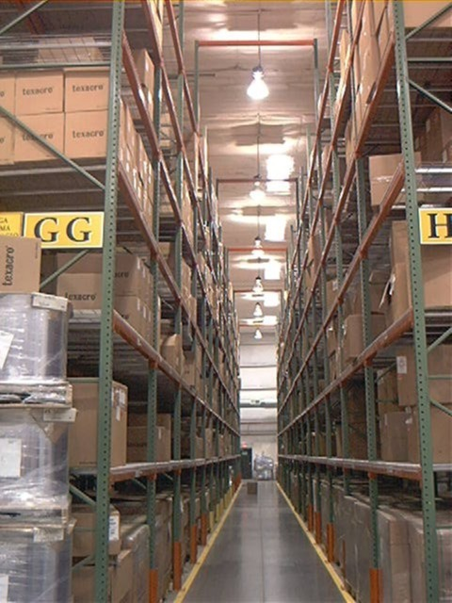
Aisles 3 ½ ft (1.1m)or Greater

Slide 96
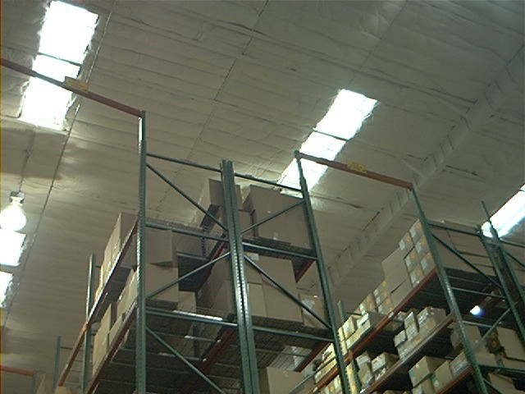
Maintain aisle width
Notes:
IN addition to maintaining stability of the racks, these spacers also serve to help maintain aisle width.

Slide 97
DEFINITIONS SPECIFIC TO RACK STORAGE
Longitudinal flue space- space between rows of storage perpendicular to the direction of loading
  Width between storage < 24” (610mm)
Transverse flue space- space between rows of storage parallel to direction of loading
Face sprinklers- standard sprinklers located in transverse flue spaces along aisles or in the rack
  Within 18” (0.46m)of the aisle face of the storage
  Used to prevent vertical fire travel on the face of the storage
Notes:
Longitudinal flue space-3.9.3.6
Transverse flue space-3.9.3.9
Face sprinklers-3.9.3.4- face sprinklers really become an issue when we get over 25’ (7.6m)of storage height.

Slide 98
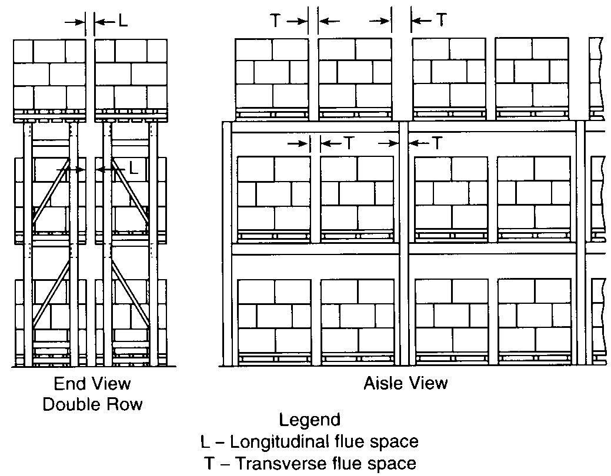

Notes:
A.3.9.3.7(a)

Slide 99
Rules Specific to Rack Storage of Class I-IV Commodities

Slide 100
RULES SPECIFIC TO RACK STORAGE
I-IV COMMODITIES
Sprinkler protection for plastics can be used for the same height & configuration of Class I-IV (if it was designed for plastic, it can protect I-IV)
Movable racks are treated as multi row racks
Adjustments allowed for using hi- ex foam
Notes:
By bullet
16.1.2.2
16.1.3
16.1.5

Slide 101
RULES SPECIFIC TO RACK STORAGE
I-IV COMMODITIES
Sprinkler protection for steel columns with no fireproofing & storage > 15’ (4.6m), the columns or vertical rack members supporting the ceiling shall be protected by one of the following:
  Sidewall sprinklers @ 15’ (4.6m)pointing toward one side (not included in calculations)
  Provision of CMSA’s, ESFR’s or in racks
  Ceiling density using minimum 2000ft² (186m²)with OT or HT for heights > 15’ (4.6m)up to 20’ 6.1m)according to Table
Table 16.1.4.1 Ceiling Sprinkler Densities for Protection of Steel Building Columns
Commodity Classification | Aisle Width
 | 4 ft (1.2m) |  | 8 ft. (2.4m)
 | gpm/ft² | Lpm/m² | gpm/ft² | Lpm/m²
Class I | 0.37 | 15.1 | 0.33 | 13.5
Class II | 0.44 | 17.9 | 0.37 | 15.1
Class III | 0.49 | 20.0 | 0.42 | 17.1
Class IV | 0.68 | 27.7 | 0.57 | 23.2
Notes:
16.1.4.1
These are the options for protecting steel columns in the storage area. Note that additional protection is not needed if we use CMSA’s, ESFR’s or in-racks.

Slide 102
RULES SPECIFIC TO RACK STORAGE
I-IV COMMODITIES
Solid shelving
  Shelves < 20ft² (1.8m²), or >50% open with flue spaces maintained are considered open shelves
  Shelving in SRR, DRR & MRR > 20ft² (1.8m²) but < 64ft² (5.95m²)
    Ceilings sprinklers
    In- rack sprinklers shelves at intermediate levels < 6’ (2m) apart vertically
  Shelving > 64ft² (5.95m²)or where levels of storage > 6’ (2m)
    Ceiling sprinklers
    In- rack sprinklers below each level of storage
Notes:
By sub bullet
Section 3.9.3.8 defines open shelves
Shelving 20-64-16.1.6.1
Shelving > 64 -16.1.6.2

Slide 103
RULES SPECIFIC TO RACK STORAGE
I-IV COMMODITIES
Solid shelving (cont)
    DRR < 25’ (7.6m) & MRR of any height that have no longitudinal flue are not considered as solid shelves
      Transverse flues exist at max 5’ (1.5m)
      No additional in rack sprinklers are required at 6’ (2m) intervals or under each shelf
    In rack sprinklers
      Max horizontal spacing at 10’ (3.1m)
      Based on 30 gpm (114L/m)
      Number of sprinklers to calculate depending on Commodity & number of levels of in racks
      Shall be balanced with ceiling sprinklers unless additional face sprinklers are installed
Notes:
DRR & MRR-16.1.6.3 Where blocked areas exceed 20ft² on DRR, they are not to be treated as solid shelves if transverse flues are located at 5’ intervals & racks are < 25’ in height. The justification for this is that it is roughly the equivalent of MRR.
In racks- 16.1.6.4 & 16.1.6.5

Slide 104
RULES SPECIFIC TO RACK STORAGE
I-IV COMMODITIES
In- rack sprinklers
  Number & pipe sizing by hydraulic calculations
  Where necessary to protect a higher hazard that occupies a portion of a rack
    Shall extend at least 8’ (2.44m) or one bay, whichever is greater, in each direction along the rack, on either side of the higher hazard
    Does not have to extend across the aisle
  Shall be
    Ordinary temperature
    Standard or quick response
    K-5.6, 8.0 or 11.2, pendent or upright
Notes:
16.1.8
8.13.2.1

Slide 105
RULES SPECIFIC TO RACK STORAGE
I-IV COMMODITIES
  In- rack sprinklers (cont)
  Water shields (or listed intermediate level sprinklers)
    For Class I-IV
      Required when more than one level of in-racks if not shielded by barriers
    For Plastic
      Required on all in-racks where not shielded by barriers
  Minimum 6’ spacing does not apply to in-rack sprinklers
  Where the length of the rack requires less than the number of in-racks specified, only those in a single rack need to be included in the calculations
Notes:
Water shields- 8.13.2.3
Plastic always requires in racks to have shields or barriers, where Class I-IV only requires them when there are more than one level of in racks.
Min 6’ spacing- 8.13.4.1
Rack length does not accommodate number of in racks needed-16.2.4.3.2

Slide 106
RULES SPECIFIC TO RACK STORAGE
I-IV COMMODITIES
  In- rack sprinklers (cont)
    In- rack sprinklers do not have to meet the obstruction rules of normal installations
    May be installed without regard to rack uprights
Horizontal Barriers & in- racks
  Shall be constructed of sheet metal, wood or similar material & shall extend the full length & depth of the rack
  Shall be fitted within 2” horizontally around rack uprights
Notes:
Obstruction rules- 8.13.2
16.2.4.2.7 regarding clearance to rack uprights
16.1.9.1 regarding horizontal barriers & in racks.

Slide 107
RULES SPECIFIC TO RACK STORAGE
I-IV COMMODITIES
Flu space requirements
  Up to and including 25’
    Longitudinal flue spaces
      None required in DRR & MRR w/o solid shelves
    Transverse flue spaces
      6” required between all loads & rack uprights
    Random width in flue spaces or alignment is OK
Notes:
16.1.10 regarding flu spaces for Class I-IV commodities < 25’.

Slide 108
RULES SPECIFIC TO RACK STORAGE
I-IV COMMODITIES
Flu space requirements (cont)
  Over 25’ (7.6m)
    Transverse flue spaces
      6” (152mm)required between all loads & rack uprights
      Random width in flue spaces or alignment is OK
    Longitudinal flue spaces
      6” (152mm)required in all DRR
      6” (152mm)minimum vertical clearance between deflector & top of storage in all racks
      Located at intersection of transverse & longitudinal flue spaces with deflector below horizontal load beams or rack members
      > 3” (76mm)from rack uprights
      Face sprinklers > 3” (76mm) from uprights & < 18” (460mm)from aisle
Notes:
16.1.11 regarding flu spaces for Class I-IV commodities > 25’.

Slide 109
RULES SPECIFIC TO RACK STORAGE
I-IV COMMODITIES
Design rules for Rack Storage
Class I-IV Commodities
Up to & including 25’ in height

Slide 110
RULES SPECIFIC TO RACK STORAGE
I-IV COMMODITIES STANDARD SPRAY SPRINKLERS
For storage < 25’ in height
  Less than or equal to 12’, (3.7m) use protection criteria for misc. storage
  Find correct starting point
    SRR, DRR or MRR
    Aisle width for SRR & DRR
      Less than 3’5’, (1.07m) treat as MRR
      For 3.5’, (1.07m) use 4’ (1.2m)
      4’-8’ (1.2-2.4m)use 4’ (1.2m)or interpolate
      8’ (2.4m)or larger, use 8’ (2.4m)
Notes:
16.2.1.2 for storage 0-12’
16.2.1.3.2.1 for aisle widths

Slide 111
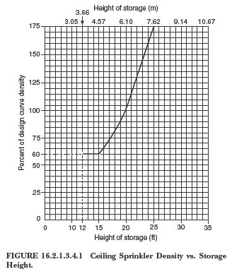
RULES SPECIFIC TO RACK STORAGE
I-IV COMMODITIES STANDARD SPRAY SPRINKLERS
For storage < 25’ (7.6m)in height (cont)
  Make ceiling sprinkler density adjustments
For height > 12’ (3.7m) < 25’ (7.6m) with ceiling sprinklers only, & for height 12-20’ (3.7-6.1m) with minimum in-racks, adjust density according to Figure 16.2.1.3.4.1
    For storage height > 20’ (6.1m) up to 25’ (7.6m) with ceiling sprinklers & minimum in-racks, do not adjust according to Figure 16.2.1.3.4.1
Notes:
16.2.1.3.4
The figure stops at 12’ because below that we would use misc. storage densities. It stops at 25’ because we are only in the rules for storage < 25’

Slide 112
RULES SPECIFIC TO RACK STORAGE
I-IV COMMODITIES STANDARD SPRAY SPRINKLERS
For storage < 25’ in height (cont)
  Make ceiling sprinkler density adjustments (cont)
    For storage height > 12’ < 20’ (>3.7 < 6.1m) with more than 1 level in-racks (but not every tier), reduce density 20% plus height adjustment
    For storage height > 20’ < 25’ (>6.1 < 7.6m) with more than 1 level in-racks (but not every tier), reduce density 20% but without height adjustment
    For storage height > 12’ < 20’ (3.7 < 6.1m) with in-racks in every tier, reduce density 40% plus height adjustment
    For storage height > 20’ < 25’ (> 6.1 < 7.6m) with in-racks in every tier), reduce density 40% but without height adjustment
Notes:
16.2.1.3.4-16.2.1.3.4.6
This will all be shown in a Table on the next slide

Slide 113
RULES SPECIFIC TO RACK STORAGE
I-IV COMMODITIES STANDARD SPRAY SPRINKLERS
Table 16.2.1.3.4.3 Adjustment to Ceiling Sprinkler Density for Storage Height & In Rack Sprinklers
Storage Height | In Rack Sprinklers | Apply Fig. 16.2.1.3.4.1 for Storage Height Adjustment | Permitted Ceiling Sprinklers Density Adjustments where in rack sprinklers are installed
>12’(3.7m) through 25’ (7.6m) | None | Yes | None
>12’(3.6m) through 20’(6.1m) | Minimum required | Yes | None
 | More than minimum but not every tier | Yes | Reduce density 20% from that of minimum in rack sprinklers
 | In every tier | Yes | Reduce density 40% from that of minimum in rack sprinklers
>20’(6.1m) through 24’ (7.5m) | Minimum required | No | None
 | More than minimum but not every tier | No | Reduce density 20% from that of minimum in rack sprinklers
 | In every tier | No | Reduce density 40% from that of minimum in rack sprinklers
Notes:
Table 16.2.1.3.4.3
This table is used to illustrate the same things as covered in the previous slide

Slide 114
RULES SPECIFIC TO RACK STORAGE
I-IV COMMODITIES STANDARD SPRAY SPRINKLERS
For storage < 25’ (7.6m) in height (cont)
  Make ceiling sprinkler density adjustments (cont)
    Where solid, flat bottom combustible pallets (slave pallets) are used at storage height < 25’ (7.6m), densities shall be increased 20%
      Applied to density determined after height adjustment
      The density increase shall not apply where in-racks are installed according to Table 16.2.1.3.4.3
Notes:
16.2.1.3.4.7

Slide 115
RULES SPECIFIC TO RACK STORAGE
I-IV COMMODITIES IN-RACK SPRINKLERS
For storage < 25’ (7.6m) in height
  Location
    1 level- at 1st tier at or above ½ storage height
    2 levels- at 1st tier at or above 1/3 & 2/3 height
  Maximum horizontal spacing
    SRR & DRR according to Table {8-12’ (2.4-3.7m)}depending upon commodity class & aisle width
    MRR according to Table
      Class I-III- 12’ (3.7m)
      Class IV- 8’ (2.4m)
Notes:
Location- 16.2.1.4.1.4, 16.2.4.1.5
Spacing- 16.2.1.4.2.1 & 16.2.1.4.2.2
Note that Table 16.2.1.4.2.1 only applies to SRR & DRR.
The rules for MRR are in Table 16.2.1.4.2.2
Installation rules for in racks are in 8.13

Slide 116
RULES SPECIFIC TO RACK STORAGE
I-IV COMMODITIES IN-RACK SPRINKLERS
For storage < 25’ in height (cont)
  Maximum coverage area using plan view
    MRR only
      Class I-III- 100ft² (9.3m²)
      Class IV- 80ft² (7.4m²)
      Aisles not included in area calculation
  Shall be located at transverse/longitudinal flue intersections
    Not to exceed maximum spacing
    Where flues exceed max. spacing, add extra in-rack sprinklers to meet spacing requirements
    Where no transverse flues exist, space < maximum limits
Notes:
Max coverage area MRR-16.2.1.4.2.2-rules requiring the plan view in MRR & the area limitations
Location- 16.2.1.4.2.3
Installation rules for in racks are in 8.13

Slide 117
RULES SPECIFIC TO RACK STORAGE
I-IV COMMODITIES IN-RACK SPRINKLERS
For storage < 25’ in height (cont)
  Sprinkler deflector clearances to rack
    Shall not be obstructed by horizontal rack members
    Spaced without regard to rack uprights
  Sprinkler deflector clearances to storage
    No requirement
      SRR & DRR < 20’
    Minimum 6” clearance between in-rack deflector & top of storage tier
      SRR & DRR w/o solid shelves > 20’
      SRR & DRR with solid shelves < 25’
      All MRR
Notes:
Clearances to the rack- 16.2.1.4.2.5 (A), 16.2.1.4.2.7
Clearances to Storage- 16.2.1.4.2.4, 16.2.1.4.2.5, 16.2.1.4.2.6
Installation rules for in racks are in 8.13
Rather than try to guess about the sprinkler clearance to the loads as indicated in the second bullet, where sometimes the 6” clearance is required and sometimes it is not, it may be easier to just always, as a practice, maintain the 6” clearance to the storage.

Slide 118
RULES SPECIFIC TO RACK STORAGE
I-IV COMMODITIES IN-RACK SPRINKLERS
For storage < 25’ in height (cont)
  Water demand-
    One level- I-III
      6 most remote sprinklers
    One level- IV
      8 most remote sprinklers
    More than one level- I-III
      10 most remote sprinklers (5 on each 2 top levels)
    More than one level- IV
      14 most remote sprinklers (7 on each 2 top levels)
Notes:
Water demand is in 16.2.1.4.3

Slide 119
RULES SPECIFIC TO RACK STORAGE
I-IV COMMODITIES IN-RACK SPRINKLERS
For storage < 25’ in height (cont)
  Where a rack, because of its length, has fewer sprinklers than the number required, only include those in the rack for calculations
  Discharge pressure requirements
    15 psi for all classifications
Notes:
Not enough rack length for required sprinklers- 16.2.1.4.3.2
16.2.1.4.4- you may want to just point out that the “under 25” people require a minimum pressure for the in racks, where the “over 25” people require a minimum flow for the in racks as we will see later.

Slide 120
RULES SPECIFIC TO RACK STORAGE
I-IV COMMODITIES CMSA SPRINKLERS
For storage < 25’ in height
  CMSA protection may be used for SRR, DRR & MRR
  Hose stream allowance & water supply duration are included in the complete Table in Chapter 12 (Table 12.8.6.1)
  Where in-racks are required
    Installed at tier level at or above ½ storage height
    Min 6” (152mm) clearance between top of storage & deflector
    Located at intersection of transverse/ longitudinal flue
    Max horizontal spacing is 8’ (1.5m) (if flue spaces exceed spacing, install extra sprinklers- if no transverse flues, do not exceed spacing)
    Calculate most demanding 8 sprinklers @ 15psi each
Notes:
For protection allowance-16.2.2.1
All of the hose stream demand/ water supply durations are in one Table 12.8.6.1
For in racks- 16.2.2.7.1-16.2.2.7.8

Slide 121
RULES SPECIFIC TO RACK STORAGE
I-IV COMMODITIES CMSA SPRINKLERS
For storage < 25’ in height (cont)
  When using CMSA under open wood joists
    Joist channels must be fire stopped to its full depth at intervals < 20’ or must have minimum pressures
      50psi for k-11.2
      22psi for k-16.8
  All preaction systems are treated as dry systems
  Building steel does not require special protection
Starting point
Notes:
Wood joists-16.2.2.4
Preaction- 16.2.2.5
Building steel 16.2.2.6

Slide 122
RULES SPECIFIC TO RACK STORAGE
I-IV COMMODITIES ESFR SPRINKLERS
For storage < 25’ in height
  ESFR protection may be used for SRR, DRR & MRR but does not apply to
    Solid shelves unless they are protected with in racks under the solid shelves according to solid shelf rules in 16.1.6
    Combustible open top containers or cartons
  Design shall be most hydraulically demanding 12 sprinklers, 4 per branch, 3 branch, with pressures according to the Table
Notes:
For ESFR design for storage < 25’- 16.2.3
Solid shelf design- (new in 2013) 16.2.3.2 allows solid shelves if there are in racks under each shelf. They did not continue this allowance for storage over 25’
Design criteria for 12 sprinklers- 16.2.3.4
Note that in 2013, the requirement to include ESFR sprinklers installed under obstructions has been removed.

Slide 123
RULES SPECIFIC TO RACK STORAGE
I-IV COMMODITIES ESFR SPRINKLERS
  Special rules for in-racks with ESFR sprinklers
    Installed at first tier level at or above ½ storage height
    One level of k-8.0 (115) or k-11.2 (160), QR, OT
    Min 6” (152mm) clearance from deflector to top of storage
    Located at transverse/longitudinal flue space but not to exceed max 5’ (1.5m) horizontal spacing (max spacing if no transverse flue spaces)
    Design criteria- Most remote 8 sprinklers @ 60 gpm (227 L/m)
  Starting point
Notes:
Special in rack rules for use when required for ESFR < 25’- 16.2.3.6

Slide 124
RULES SPECIFIC TO RACK STORAGE
I-IV COMMODITIES SPECIAL DESIGN
For storage < 25’ (7.6m)in height (cont)
  Slatted shelves shall be considered as solid shelves unless ALL of the following are met to protect SRR & DRR with slatted shelves
    Wet pipe system designed for 0.6gpm/ft² over 2000ft² (24.5mm/min over 186 m²)or
      K-14 (200) ESFR @ 50psi (3.4bar) minimum
      K-16.8 (240) @ 32psi (2.2bar) minimum
      K-22.4 (320) ESFR @ 25psi (1.7bar) minimum
      K-25.2 (360) ESFR @ 15psi (1bar) minimum
    Sprinklers must be OT, intermediate or HT K-11.2 (160), 14.0 (200) or 16.8 (240) standard spray sprinklers listed for storage, or must be K-14 (200), 16.8 (240), 22.4 (320) or 25.2 (360) ESFR
Notes:
Special “Home Depot” rules in 16.2.4

Slide 125
RULES SPECIFIC TO RACK STORAGE
I-IV COMMODITIES SPECIAL DESIGN
For storage < 25’ in height (cont)
    Commodities limited to Class I-IV, Group B & C plastics, cartoned (expanded & unexpanded) Group A & exposed (unexpanded) Group A plastics
    Slats shall be minimum 2” (51mm)x maximum 6” (152mm) held in place by spacers that maintain a minimum 2” (51mm) opening between each slat
    Where K-11.2 (160), 14.0 (200) or 16.8 (240) orifice sprinklers are used, no slatted shelves above 12’ (3.7m)
      May use open rack wire mesh shelving above 12’ (3.7m)
Notes:
Special “Home Depot” rules in 16.2.5

Slide 126
RULES SPECIFIC TO RACK STORAGE
I-IV COMMODITIES STANDARD DESIGN
For storage < 25’ in height (cont)
    Transverse flue spaces min. 3” (76mm) wide shall be maintained minimum 10’ (3.1m) horizontally
    Longitudinal flue spaces min. 6” (152mm) required for DRR
      Not required with ESFR sprinklers
    Minimum aisle width of 7 ½’ (2.3m)
    Max. roof height 27’ (8.2m) or 30’ (9.1m) if ESFR
    Max. storage height 20’ (6.1m)
    No solid plywood or similar material may be used to block the 2” (51mm)space between slats or wire mesh
Notes:
Special “Home Depot” rules in 16.2.5

Slide 127
Problem
Determine a solution using std spray sprinklers, CMSA & ESFR
Wet pipe system
Class III Commodity
Stored 21 feet (6.4m) high
Double Row Racks
Not encapsulated
Aisles 3 1/2 feet (1.1m)

Slide 128
Problem
Determine a solution using std spray sprinklers, CMSA & ESFR
Wet pipe system
Commodity Class II
Multi-Row Racks
Storage height 18 feet (5.5m)
Rack depth 16 feet (4.9m)
Aisle 4 feet (1.2m)
Encapsulated
Notes:
You can point out the two different starting points for MRR’s. The important point is in the title of the Tables, where Table 16.2.1.3.3.1 has depth < 16’ AND aisles > 8’, and Table 16.2.1.3.3.2 has depth > 16’ OR aisles < 8’.

Slide 129
RULES SPECIFIC TO RACK STORAGE
I-IV COMMODITIES
Design rules for Rack Storage
Class I-IV Commodities
Over 25’ in height

Slide 130
RULES SPECIFIC TO RACK STORAGE
I-IV COMMODITIES STANDARD SPRAY SPRINKLERS
For storage > 25’ in height
  Emphasis is on in- racks vs. ceiling sprinklers
  No more than 10’ (3.1m) clearance from storage to sprinklers and minimum 4’ (1.2m) aisles
  For encapsulated, increase density 25%
  Hose stream allowance & water supply duration are included in the complete Table in Chapter 12 (Table 12.8.6.1)
  Starting point
Notes:
You can see the emphasis on in racks since the ceiling density is fairly prescriptive in the Tables.
16.3.1.1 & 16.3.1.2 both state that clearance above storage is limited to 10’ and aisles at least 4’ wide. Annex notes give us some guidance in cases where there is more than 10’ clearance from the top of storage and the sprinklers.
For SRR/DRR encapsulated- 16.3.1.1.1: for MRR encapsulated- 16.3.1.2.1

Slide 131
RULES SPECIFIC TO RACK STORAGE
I-IV COMMODITIES IN-RACK SPRINKLERS
For storage > 25’ in height
  In rack sprinklers installed according to appropriate Tables/Figures
    Staggered vertically & horizontally according to Figures
  Shall be located at transverse/longitudinal flue intersections
    Not to exceed maximum spacing
    Where flues exceed max. spacing, add extra in-rack sprinklers to meet spacing requirements
    Where no transverse flues exist, space < maximum limits
Notes:
According to Tables/ Figures- 16.3.1.3
Location & spacing DRR- 16.3.1.3.1.1
SRR mixed w/DRR- 16.3.1.3.1.1
SRR- 16.3.1.3.1.2
16.3.1.3.1.3
Spacing in transverse/longitudinal flues- 16.3.1.3.2.4, (A) & (B)

Slide 132
RULES SPECIFIC TO RACK STORAGE
I-IV COMMODITIES IN-RACK SPRINKLERS
For storage > 25’ in height (cont)
  Water demand-
    One level- Class I-III
      6 most remote sprinklers
    One level- Class IV
      8 most remote sprinklers
    More than one level- Class I-III
      10 most remote sprinklers (5 on each 2 top levels)
    More than one level- Class IV
      14 most remote sprinklers (7 on each 2 top levels)
  Discharge requirements
    Not less than 30 gpm (113L/min)
Notes:
Water demand- 16.3.1.3.3
Discharge- 16.3.1.3.3.1

Slide 133
RULES SPECIFIC TO RACK STORAGE
I-IV COMMODITIES CMSA SPRINKLERS
For storage > 25’ in height
  CMSA protection may be used for SRR, DRR & MRR without solid shelves
  Hose stream allowance & water supply duration are included in the complete Table in Chapter 12 (Table 12.8.6.1)
  Where in-racks are required, use criteria for in-racks in storage > 25’
Notes:
SRR/DRR/MRR- 16.3.2.1
16.3.2.2- the reference section 16.3.1.3 is the section for in racks for storage > 25’ when using SS sprinklers

Slide 134
RULES SPECIFIC TO RACK STORAGE
I-IV COMMODITIES CMSA SPRINKLERS
For storage > 25’ in height (cont)
  When using CMSA under open wood joists
    Joist channels must be fire stopped to its full depth at intervals < 20’ or must have minimum pressures
      50psi for k-11.2
      22psi for k-16.8
  All preaction systems are treated as dry systems
  Building steel does not require special protection
Starting point
Notes:
Wood joists- 16.3.2.4
Preaction- 16.3.2.5
Building steel-16.3.2.6

Slide 135
RULES SPECIFIC TO RACK STORAGE
I-IV COMMODITIES ESFR SPRINKLERS
For storage > 25’ in height
  ESFR protection may be used for SRR, DRR & MRR but does not apply to
    Solid shelves
    Combustible open top containers or cartons
  Design shall be most hydraulically demanding 12 sprinklers, 4 per branch, 3 branch according to design Table
  Hose stream allowance & water supply duration are included in the complete Table in Chapter 12 (Table 12.8.6.1)
Notes:
No solid shelves-16.3.3.2. Note this is more restrictive than the rules for <25’ that allow the use of solid shelves with in racks below. But not for storage >25’.
Design criteria-16.3.3.4
Note that 2013 eliminated the need to include sprinklers installed below obstructions.

Slide 136
RULES SPECIFIC TO RACK STORAGE
I-IV COMMODITIES ESFR SPRINKLERS
For storage > 25’ in height
  Special rules for in-racks with ESFR sprinklers
    One level of k-8.0 (115) or k-11.2 (160), QR, OT
    Installed at tier closest to but NOT exceeding ½ maximum storage height
    Design criteria
      Most remote 8 sprinklers @ 60 gpm (227 L/min)
  Shall be located at transverse/longitudinal flue intersections
    Not to exceed maximum spacing of 5’ (1.5m)
    Where flues exceed max. spacing, add extra in-rack sprinklers to meet spacing requirements
    Where no transverse flues exist, space < maximum limits
  Starting point
Notes:
16.3.3.5
You can note that the rules for the height at which in racks with ESFR’s are installed is the exact opposite of how they are installed with SS sprinklers. SS sprinklers take ½ the height and go UP to the next tier, where in racks with ESFR’s take ½ the height and go DOWN to the next tier.
In racks with ESFR’s are also limited on the type of sprinkler used & the pressure.

Slide 137
Problem
Determine a solution using standardd spray sprinklers, CMSA & ESFR
Wet Pipe system
Class III Commodity
Stored 65 feet high
Double Row Rack
Aisle 4 feet wide
Clearance to ceiling 8 feet
High temperature sprinklers
Notes:
Obviously, when looking at a solution with SS sprinklers, we could pick from a number of solutions from Table 16.3.1.1. I have always tended to pick the 2nd option in the section that shows Class I, II, III. It is the option that shows longitudinal sprinklers spaced vertically @ 10’, horizontally @ 10’ and shows the face sprinklers spaced vertically @ 30’; horizontally @ 10’. It also says they should be staggered. It references Figure 16.3.4.1.1.1(d). This is a great example to use to show how to read the figure for the x’s & delta’s in the elevation & plan views. You can use this to demonstrate how to build a system of in racks by taking one level at a time as shown in the next series of slides.
You can discuss how what confuses most people is that the figure is trying to show a 3 dimensional picture in only 2 dimensions. The handbook has a much better depiction of this type arrangement because they included an isometric drawing in the Annex to depict how the in racks are installed.
You can point out how, if we follow the diagram in the figures, the standard will place the in racks so they are staggered correctly.

Slide 138
Rack Storage Example
65 feet (19.8 m) high
Double-Row Racks with 4-ft (1.2m) Aisles
Class III Commodity
Notes:
Table 16.3.1.1
Figure 16.3.4.1.1.1(h)

Slide 139
Rack Storage Example
View Figure 16.3.4.1.1.1(d)
65 feet (19.8 m) is level “H”
Notes 5, 8, and 9 apply

Slide 140
Level 1 – 5 feet (1.5 m)
65
End of Rack
60
55
50
45
None required at this level
40
35
30
25
20
Rack Continues
15
10
5
Elevation View
Plan View

Slide 141
Level 2 – 10 feet (3 m)
H
End of Rack
G
F
E
D
C
X
B
A
5
4
X
Rack Continues
3
1
X
2
1
Elevation View
Plan View

Slide 142
Level 3 – 15 feet (4.5 m)
H
End of Rack
G
F
E
D
None required at this level
C
B
A
5
4
Rack Continues
3
X
2
1
Elevation View
Plan View

Slide 143
Level 4 – 20 feet (6.1 m)
H
End of Rack
G
F
E
D
C
B
A
5
1
4
Rack Continues
3
1
X
2
1
Elevation View
Plan View

Slide 144
Level 5 – 25 feet (7.6 m)
H
End of Rack
G
F
E
D
None required at this level
C
B
A
5
4
Rack Continues
3
X
2
1
Elevation View
Plan View

Slide 145
Level A – 30 feet (9.1 m)
H
End of Rack
G
F
X
E
D
C
X
X
B
2
X
X
X
A
X
5
1
4
X
X
Rack Continues
3
1
X
2
1
Plan View
Elevation View

Slide 146
Level B – 35 feet (10.7 m)
H
End of Rack
G
F
E
D
None required at this level
C
B
2
X
X
X
A
5
1
4
Rack Continues
3
1
X
2
1
Plan View
Elevation View

Slide 147
Level C – 40 feet (12.2 m)
H
G
End of Rack
F
E
D
3
C
B
B
2
X
X
X
A
5
1
4
Rack Continues
3
1
X
2
1
Plan View
Elevation View

Slide 148
Level D – 45 feet (13.7 m)
H
G
End of Rack
F
E
D
3
None required at this level
C
B
B
2
X
X
X
A
5
1
4
Rack Continues
3
1
X
2
1
Elevation View
Plan View

Slide 149
Level E – 50 feet (15.2 m)
H
G
End of Rack
F
4
X
E
D
3
X
C
B
B
2
X
X
X
A
5
1
4
X
Rack Continues
3
1
X
2
1
Plan View
Elevation View

Slide 150
Level F – 55 feet (16.8 m)
H
G
End of Rack
F
4
X
E
D
3
None required at this level
C
B
B
2
X
X
X
A
5
1
4
Rack Continues
3
1
X
2
1
Plan View
Elevation View

Slide 151
Level G – 60 feet (18.3 m)
Elevation View
H
5
End of Rack
G
F
4
X
E
D
3
C
B
B
2
X
X
X
A
5
Rack Continues
1
4
3
1
X
2
Plan View
1

Slide 152
Level H – 65 feet (19.8 m)
Elevation View
H
5
End of Rack
G
F
4
X
E
D
None required at this level
3
C
B
B
2
X
X
X
A
5
Rack Continues
1
4
3
1
X
2
Plan View
1

Slide 153
All the layers from the top…
Elevation View
H
5
End of Rack
G
X
F
4
X
E
D
X
X
3
C
B
B
X
2
X
X
X
A
5
X
X
Rack Continues
1
4
3
1
X
2
Plan View
1

Slide 154
Rules Specific to Rack Storage of Group A Plastic

Slide 155
Plastic Decision Tree for Rack Storage corrected
Plastics
Group A
Group B
protect as Class IV
Group C
protect as Class III
Cartoned
protect using Ch. 17
Exposed
Free flowing
protect as Class IV
Non expanded
protect using only the portions of Ch. 17 applicable to exposed nonexpanded plastics
Expanded
outside the scope of Ch. 17
Notes:
For those that have a copy of NFPA 13, you may want to have them check to see if they have the corrected version of the decision tree that was done in later printings of the standard.
While this decision tree is used for the rack storage of plastics, it is an opportune time to point that it is a significantly reduced version of the tree used for general storage. It is also a little misleading in the sense that it appears this tree could be used for the rack storage of all plastics, but that is not exactly correct. For example, the left leg of the tree under group A implies that the tree is used for Cartoned, expanded or unexpanded, & exposed, unexpanded. One would think this would apply all plastics stored on racks. However, be sure to point out section 17.2.1.2.1. It states that for plastics < 25’ high, they must be in cartons.
In essence, the tree is used to incorporate all rack storage of plastics, but it does not necessarily work for all arrangements.
This new decision tree was accepted by the committee to clarify that not every portion of Chapter 17 applies to exposed plastics. Only those portions of Chapter 17 that specifically say they are for exposed plastics can be used to protect exposed plastics. This change was not printed in early printings of the 2013 edition.
While the tree clearly states that exposed, expanded is outside the scope of Ch. 17, point out that for exposed unexpanded, see 17.2.1.4.

Slide 156
Notes to Decision Tree
Note: Cartons that contain Group A plastic material can be treated as Class IV commodities under the following conditions
There shall be multiple layers of corrugation or equivalent outer material that would significantly delay fire involvement of the Group A plastic
The amount & arrangement of Group a plastic material within an ordinary carton would not be expected to significantly increase the fire hazard
Notes:
Good luck on figuring out what this means.

Slide 157
RULES SPECIFIC TO RACK STORAGE
GROUP A PLASTIC
Sprinkler protection for steel columns not provided with fireproofing & storage > 15’, (4.6m) the columns or vertical rack members supporting the ceiling shall be protected by one of the following
  Sidewall sprinklers @ 15’ (4.6m) pointing toward one side (not included in calc’s)
  Provision of CMSA’s, ESFR’s or in racks
  Ceiling density of minimum 2000ft² (186m²)with OT or HT for heights > 15’ (4.6m)up to 20’ (6.1m) according to Table
Table 17.1.4.1 Ceiling Sprinkler Densities for Protection of Steel Building Columns
Commodity Classification | Aisle Width
 | 4 ft. (1.2m) |  | 8 ft. (2.4m)
 | gpm/ft² | L/min/m² | Gpm/ft² | L/min/m²
Plastic | 0.68 | 27.7 | 0.57 | 23.2
Notes:
17.1.4
These are the same options as allowed in the storage of Class I-IV commodities.

Slide 158
RULES SPECIFIC TO RACK STORAGE
GROUP A PLASTIC
Solid shelving- Shelving that is fixed in place, slatted, wire mesh, or other type of shelves located within racks. The area of a shelf is defined by perimeter aisle or flue space on all 4 sides.
  Shelves < 20ft², or >50% open with flue spaces maintained are considered open racks
  Shelving > 20ft² but < 64ft²
    Ceilings sprinklers
    In- rack sprinklers below shelves at intermediate levels not more than 6’ apart vertically
  Shelving > 64ft² or where levels of storage > 6’
    Ceiling sprinklers
    In- rack sprinklers below each level of shelving
Notes:
Solid shelving is defined in 3.9.3.8
By sub bullet
Section 3.9.3.8 defines open racks
17.1.5.1
17.1.5.2

Slide 159
RULES SPECIFIC TO RACK STORAGE
GROUP A PLASTIC
Solid shelving (cont)
  MRR, regardless of height, & DRR < 25’ with no longitudinal flue spaces shall not be considered solid shelves if
    Transverse flue spaces are maintained at 5’ max
    Additional in rack sprinklers are not required due to shelf areas
      > 20ft² but < 64ft²
      > 64ft² or where levels of storage > 6’
  In- rack sprinklers, where required, shall be spaced at a maximum of 5’
Protection of open top containers is outside the scope of Ch. 17
Notes:
17.1.5.3. DRR racks that have blocked areas are not to be treated as solid shelves if transverse flue spaces are located at 5’ intervals & racks do not exceed 25’ in height. The justification for this change is that it is roughly equivalent to MRR. The change was intended to help users deal with large objects on racks.
17.1.6- The standard was clarified to state that the protection criteria in Chapters 16 & 17 is not intended for the storage of Class I-IV commodities or plastics in open top contains. At the same time the committee made this clarification, they also made a change to the definition of "Open Top Container” (section 3.9.1.19) with a long annex note (A.3.9.1.19) that contains some suggestions on dealing with open top containers such as putting lids on the open top containers or putting the open top containers only on the bottom level of the racks so that the collection of water isn't a problem.

Slide 160
RULES SPECIFIC TO RACK STORAGE
GROUP A PLASTIC
In- rack sprinklers
  Number & pipe sizing by hydraulic calculations
  Where necessary to protect a higher hazard that occupies a portion of a rack
    Shall extend at least 8’ or one bay, whichever is greater, in each direction along the rack, on either side of the higher hazard
    Does not have to extend across the aisle
  Where a rack, because of its length, has fewer sprinklers than the number required, only include those in the rack for calculations
Notes:
By sub bullet
17.1.7.1
17.1.7.2-17.1.7.2.1
17.1.7.3

Slide 161
RULES SPECIFIC TO RACK STORAGE
GROUP A PLASTIC
In- rack sprinklers (cont)
  Shall be located at transverse/longitudinal flue intersections
    Not to exceed maximum spacing
    Where flues exceed max. spacing, add extra in-rack sprinklers to meet spacing requirements
    Where no transverse flues exist, space < maximum limits
Notes:
By sub bullet
17.1.7.4-17.1.7.4.2

Slide 162
RULES SPECIFIC TO RACK STORAGE
GROUP A PLASTIC
Horizontal Barriers & in- racks
  Shall be constructed of sheet metal, wood or similar material & shall extend the full length & depth of the rack
  Shall be fitted within 2” horizontally around rack uprights
Notes:
By sub bullet
17.1.8.1
17.1.8.2

Slide 163
RULES SPECIFIC TO RACK STORAGE
GROUP A PLASTIC
Flu space requirements
  Up to and including 25’
    Longitudinal flue spaces
      None required in DRR & MRR w/o solid shelves
    Transverse flue spaces
      6” required between all loads & rack uprights
    Random width in flue spaces or alignment is OK
Notes:
17.1.9

Slide 164
RULES SPECIFIC TO RACK STORAGE
GROUP A PLASTIC
Flu space requirements (cont)
  Over 25’
    Transverse flue spaces
      6” required between all loads & rack uprights
      Random width in flue spaces or alignment is OK
    Longitudinal flue spaces
      6” required in all DRR
      6” minimum vertical clearance between deflector & top of storage in all racks
      Face sprinklers > 3” from uprights & < 18” from aisle
      Located at intersection of transverse & longitudinal flue spaces with deflector below horizontal load beams or rack members
      > 3” from rack uprights
Notes:
17.1.10

Slide 165
RULES SPECIFIC TO RACK STORAGE
GROUP A PLASTIC
Design rules for Rack Storage
Group A Plastic
< 25’ in height
Notes:
17.2

Slide 166
RULES SPECIFIC TO RACK STORAGE
GROUP A PLASTIC STANDARD SPRAY SPRINKLERS
For storage < 25’ in height (cont)
  For storage < 5’, use the protection criteria for misc. storage
  Ceiling sprinkler water demand in terms of area/density to be taken from Figures
    Linear interpolation for areas/densities is allowed between storage heights with same clearances
    No interpolation between clearances
    For storage between 5 & 12’, the installation requirements for EH systems applies
Notes:
By sub bullet
17.2.1.1
17.2.1.2-17.2.1.2.3
12.8.6.1

Slide 167
RULES SPECIFIC TO RACK STORAGE
GROUP A PLASTIC IN-RACK SPRINKLERS
For storage < 25’ in height (cont)
  Clearance
    Minimum 6” clear space maintained between deflector & top of storage tier
  Location
    Installed according to the Figures
  Located at transverse/longitudinal flue intersections
    Not to exceed maximum spacing
    Where flues exceed max. spacing, add extra in-rack sprinklers to meet spacing requirements
    Where no transverse flues exist, space < maximum limits
Notes:
17.2.1.5.2- 17.2.1.5.7

Slide 168
RULES SPECIFIC TO RACK STORAGE
GROUP A PLASTIC IN-RACK SPRINKLERS
For storage < 25’ in height (cont)
  Design based on (all at minimum of 15psi)
    Most remote 8 for 1 level
    Most remote 14 (7 on each top 2 levels) if more than one level
Notes:
17.2.1.5.2- 17.2.1.5.7

Slide 169
RULES SPECIFIC TO RACK STORAGE
GROUP A PLASTIC STANDARD SPRAY SPRINKLERS
For storage < 25’ in height (cont)
  Hose stream demand & water supply duration from Table 12.8.6.1
  Starting points
Notes:
17.2.1.3

Slide 170
RULES SPECIFIC TO RACK STORAGE
GROUP A PLASTIC CMSA SPRINKLERS
For storage < 25’ in height (cont)
  CMSA protection may be used for SRR, DRR & MRR of unexpanded plastics w/o solid shelves
  Where required, in-rack rules are included in this section
  Hose stream allowance & water supply duration are taken from Table 12.8.6.1
Notes:
By sub bullet
17.2.2.1
17.2.2.6- described in the next slide.
Hose stream demand & water supply duration are incorporated into Table 12.8.6.1

Slide 171
RULES SPECIFIC TO RACK STORAGE
GROUP A PLASTIC CMSA SPRINKLERS
For storage < 25’ in height (cont)
  When using CMSA under open wood joists
    Joist channels must be fire stopped to its full depth at intervals < 20’ or must have minimum pressures
      50psi for k-11.2
      22psi for k-16.8
  All preaction systems are treated as dry systems
  Building steel does not require special protection
Notes:
By sub bullet
17.2.2.3- repeat of rules for wood joists used with CMSA’s
17.2.2.4
17.2.2.5

Slide 172
RULES SPECIFIC TO RACK STORAGE
GROUP A PLASTIC CMSA SPRINKLERS
For storage < 25’ in height (cont)
  Special rules for in-racks with CMSA sprinklers
    Installed at first tier at or above ½ storage height
    Minimum 6” vertical clear space between deflector & top of storage
    Installed at transverse/longitudinal flue intersections
      If distance between flues exceeds spacing, additional sprinklers shall be installed
      If no transverse flues, max. spacing shall be maintained
    Demand based on most hydraulically remote sprinklers @ minimum 15 psi each
  Starting Point
Notes:
17.2.2.6

Slide 173
RULES SPECIFIC TO RACK STORAGE
GROUP A PLASTIC ESFR SPRINKLERS
For storage < 25’ in height (cont)
  ESFR protection may be used for SRR, DRR & MRR of cartoned or exposed nonexpanded plastic, and cartoned expanded plastic, neither may have
    Solid shelves
    Combustible open top containers or cartons
  Design shall be most hydraulically demanding 12 sprinklers, 4 per branch, 3 branch
Notes:
By sub bullet
17.2.3.1-17.2.3.1.1.
17.2.3.3
Mention the fact that in the 2013 edition, there is no longer any requirement to add any ESFR sprinkler that are under obstructions to the ceiling demand.

Slide 174
RULES SPECIFIC TO RACK STORAGE
GROUP A PLASTIC ESFR SPRINKLERS
For storage < 25’ in height (cont)
  Special rules for in-racks with ESFR sprinklers
    Must be k-8.0 or k-11.2, QR, OT
    Installed at the first tier at or above ½ storage height
    Design based on most remote 8 sprinklers @ 60 gpm
    Spacing must not exceed 5’ horizontal
    Installed at transverse/longitudinal flue intersections
      If distance between flues exceeds spacing, additional sprinklers shall be installed
      If no transverse flues, max. spacing shall be maintained
  Starting Point
Notes:
17.2.3.4

Slide 175
RULES SPECIFIC TO RACK STORAGE
GROUP A PLASTIC ESFR SPRINKLERS
For storage < 25’ in height (cont)
  Special rules for in-racks with ESFR sprinklers
    Must be k-8.0 or k-11.2, QR, OT
    Maintain 6” min clearance between deflector & top of a tier of storage
    Installed at the first tier level at or above ½ storage height
    Design based on most remote 8 sprinklers @ 60 gpm
    Spacing must not exceed 5’ horizontal
    Installed at transverse/longitudinal flue intersections
      If distance between flues exceeds spacing, additional sprinklers shall be installed
      If no transverse flues, max. spacing shall be maintained
  Starting Point
Notes:
17.2.3.4- 17..3.4.9

Slide 176
RULES SPECIFIC TO RACK STORAGE
GROUP A PLASTIC SPECIAL DESIGN
For storage < 25’ in height (cont)
  Slatted shelves shall be considered as solid shelves unless ALL of the following are met to protect SRR & DRR with slatted shelves
    Wet pipe system designed for 0.6gpm/ft² or
      K-14 ESFR @ 50psi min.
      K-16.8 @ 32psi min.
      K-25.2 ESFR @ 15psi min
    Sprinklers must be OT, intermediate or HT K-11.2, 14.0 or 16.8 standard spray sprinklers listed for storage, or must be K-14, 16.8, or 25.2 ESFR
Notes:
17.2.4 Repeat of Special “Home Depot” rules in 16.2.4 since Home Depot also stores plastics.

Slide 177
RULES SPECIFIC TO RACK STORAGE
GROUP A PLASTIC SPECIAL DESIGN
For storage < 25’ in height (cont)
    Commodities limited to Class I-IV, Group B & C plastics, cartoned (expanded & unexpanded) Group A & exposed (unexpanded) Group A plastics
    Slats shall be minimum 2” x maximum 6” held in place by spacers that maintain a minimum 2” opening between each slat
    Where K-11.2, 14.0 or 16.8 orifice sprinklers are used, no slatted shelves above 12’
      May use open rack wire mesh shelving above 12’
Notes:
Repeat of Special “Home Depot” rules in 17.2.5 since Home Depot also stores plastics.

Slide 178
RULES SPECIFIC TO RACK STORAGE
GROUP A PLASTIC SPECIAL DESIGN
For storage < 25’ in height (cont)
    Transverse flue spaces min. 3” wide shall be maintained minimum 10’ horizontally
    Longitudinal flue spaces min. 6” required between DRR
      Not required with ESFR sprinklers
    Minimum aisle width of 7 ½’
    Max. roof height 27’
    Max. storage height 20’
    No solid plywood or similar material may be used to block the 2” space between slats or wire mesh
Notes:
Repeat of Special “Home Depot” rules in 17.2.5 since Home Depot also stores plastics.

Slide 179
Example Problem
Determine a solution using std spray sprinklers (how many options), CMSA & ESFR
“A” Plastic, unexpanded, stored in cartons 18 feet high
Multi row racks
Ceiling clearance of 7 feet
Notes:
This is a very good example to show the value of the footnotes in the design options offered in Figure 17.2.1.2(d). In each of the 4 options, it indicated that in racks are required. However, by reading the footnotes, we find that, because of the clearances indicated in the example, we may eliminate in racks by using a larger sprinkler and increasing the density.

Slide 180
RULES SPECIFIC TO RACK STORAGE
GROUP A PLASTIC
Design rules for Rack Storage
Group A Plastic
> 25’ in height

Slide 181
RULES SPECIFIC TO RACK STORAGE
GROUP A PLASTIC STANDARD SPRAY SPRINKLERS
For storage > 25’ in height
Standard Spray Sprinklers are permitted to protect Group A plastics in cartons
  Expanded or nonexpanded
  Encapsulated or nonencapsulated
Plastics that are exposed & nonexpanded, whether encapsulated or nonencapsulated, shall be permitted to only when using in rack sprinkler arrangements specifically permitted to be used with exposed nonexpanded plastics
Notes:
17.3.1.1
17.3.2 A set of rules were put into the standard for protection of exposed unexpanded plastics on racks for storage up to 25 ft in height in buildings up to 35 ft high. The protection includes rules for single row racks, double row racks, and multiple row racks.
Exposed unexpanded plastics are only allowed in arrangements that have proven to be successful in protecting this type of arrangement. Currently these schemes are in the following : 17.3.1.7 & Figure 17.3.1.7 for SRR & DRR. 17.3.1.8 & Figure 17.3.1.8 (a)- (f) for MRR.

Slide 182
RULES SPECIFIC TO RACK STORAGE
GROUP A PLASTIC STANDARD SPRAY SPRINKLERS
(standard spray sprinklers)
For storage > 25’ in height
  Emphasis is on in-racks/barriers
  Ceiling demand taken from Table
Table 17.3.1.1 Control Mode Density/ Area Sprinkler Discharge Criteria for Single, Double & Multi Row Racks of Plastic Commodities w/ Storage over 25’ (7.6m)
ft. | m | gpm/ft² | mm/min
5 ft. or less | 1.5m or less | 0.30/2000 ft² | 12.2/186 m²
over 5 ft. up to 10 ft. | over 1.5m up to 3.5m | 0.45/2000 ft² | 18.3/186 m²
Notes:
17.3.1.3

Slide 183
RULES SPECIFIC TO RACK STORAGE
GROUP A PLASTIC STANDARD SPRAY SPRINKLERS
For storage > 25’ in height (cont)
  In-rack sprinklers and/or barriers installed according to appropriate Tables/Figures
Hose stream & water supply duration are in a separate Table in this section
Starting point
Notes:
17.3.1.4- applies to SRR cartoned; 17.3.1.6 applies to SRR exposed mixed with DRR; 17.3.1.7 applies to SRR exposed nonexpanded
17.3.1.5 applies to DRR cartoned; 17.3.1.7 applies to DRR exposed nonexpanded
17.3.1.8 applies to MRR cartoned, and MRR exposed nonexpanded
It is important to note there are still no discharge criteria for exposed expanded.
In 2010 there was a design in section 17.3.4.1.4- this is a special design for SRR’s & DRR’s without solid shelves & aisles > 4’ in width. This design was specifically for cartoned (expanded & unexpanded) and exposed (unexpanded). Since these designs are now incorporated into the rules above, this special section was no longer needed.
Hose stream/ water supply duration are in Table 17.3.1.15

Slide 184
RULES SPECIFIC TO RACK STORAGE
GROUP A PLASTIC CMSA SPRINKLERS
For storage > 25’ in height (cont)
  CMSA protection may be used for SRR, DRR & MRR of cartoned, unexpanded plastics w/o solid shelves
  Hose stream allowance & water supply duration are taken from Table
  Building steel does not require special protection
  Starting point
Notes:
By sub bullet
17.3.2-17.3.2.3. In 2013 protection was limited to cartoned commodities. It id not specify in the rules in 2010 but did so in theTable.
Hose stream & water duration are incorporated into Table 17.3.2.1
17.3.2.4
The section for in racks is currently reserved since there are no requirements for in racks due to limited application of CMSA for storage > 25’

Slide 185
RULES SPECIFIC TO RACK STORAGE
GROUP A PLASTIC ESFR SPRINKLERS
For storage > 25’ in height (cont)
  ESFR protection may be used for SRR, DRR & MRR of cartoned or exposed, nonexpanded plastics but does not apply to
    Combustible open top containers or cartons
  Design shall be most hydraulically demanding 12 sprinklers, 4 per branch, 3 branch
Notes:
By sub bullet
17.3.3.1-17.3.3.2 In the 2010, and previous editions, ESFR sprinklers have been prohibited for use in protecting Group A plastics on solid shelves. In the 2013 edition, ESFR sprinklers will be permitted to protect Group A plastics on racks with solid shelves if in-rack sprinklers are installed under the solid shelves.
17.3.3.3

Slide 186
RULES SPECIFIC TO RACK STORAGE
GROUP A PLASTIC ESFR SPRINKLERS
For storage > 25’ in height
  Special rules for in-racks with ESFR sprinklers
    Must be k-8.0 or k-11.2, QR, OT
    Maintain 6” min clearance between deflector & top of a tier of storage
    Installed at the first tier closest to but not exceeding ½ maximum storage height
    Design based on most remote 8 sprinklers @ 60 gpm
    Spacing must not exceed 5’ horizontal
    Installed at transverse/longitudinal flue intersections
      If distance between flues exceeds spacing, additional sprinklers shall be installed
      If no transverse flues, max. spacing shall be maintained
  Starting Point
Notes:
17.3.3.4- 17.3.3.4.7

Slide 187
Example Problem
Determine a solution using standard spray sprinklers, CMSA & ESFR
Multiple row racks
Exposed unexpanded
Storage Height 30 ft (9.1 m)
Ceiling height 40 ft (12.2 m)

Slide 188
Module 4
Definitions & Rules Specific to
Special Designs of Storage

Slide 189
SPECIAL DESIGNS OF STORAGE
Normal storage rules of Chapter 12 apply unless modified by this chapter
Notes:
You can discuss the fact that this type of storage would most likely require in rack sprinkler protection. Since that is not practical for portable racks, this special design was developed to deal specifically with that issue. Note that it is a very special and prescriptive design as can be seen from the accompanying notes.

Slide 190
Plastic Motor Vehicle Components
Table 20.2: ESFR Sprinkler Design Criteria K-25.2 (360) for Portable Racks (closed array) Without Solid Shelves Containing Automotive Components
Commodity | Max Storage Height |  | Max Ceiling/ Roof Height |  | Type System | Max Sprinkler Spacing |  | Number Design Sprinklers by Pressure |  | Max Deflector distance below ceiling |  | Hose Stream Allowance |  | Water Supply Duration
 | ft | m | ft | m |  | ft² | m² | psi | bar | in | mm | gpm | L/min
Auto components & associated packaging | 25 | 7.6 | 35 | 10.7 | Wet | 100 | 9.3 | 16 @ 37 | 16 @ 2.5 | 18 | 457 | 500 | 1900 | 2
Notes:
You can discuss the fact that this type of storage would most likely require in rack sprinkler protection. Since that is not practical for portable racks, this special design was developed to deal specifically with that issue. Note that it is a very special and prescriptive design as can be seen from the accompanying notes.

Slide 191
RETAIL FIRE RESEARCH COALITION
Section 20.3.1- Home Depot, Home Base, Sam’s Club
Section 20.3.2- Wal Mart
Section 20.3.3- Best Buy
Section 20.3.4- Target Stock Room {“rack length” changed to “shelf length”}
Section 20.3.5- Office Depot
Section 20.3.6- Bed, Bath & Beyond
Section 20.3.7- Submitter asked to remain anonymous
Notes:
This is an opportunity to discuss the advantages of the work done by the Retail Fire Research Coalition. In essence, they have developed some “cookie cutter” designs that lend themselves to specific retail facilities. In many cases, once we understand the designs used in these facilities, they will become repetitive in various stores and locations. Except for one new design, they have in common the use of the k-25.2EC sprinkler, so obviously there was some collaboration between a sprinkler manufacturer and the commission. That has led to a special, but simplified, design for a number of members of this coalition. We will try to identify the participants as we look at the various design criteria.
As one can see, we have attempted to identify the users of the various special designs. We can note that these designs are laid out in NFPA 13, so they are not limited to these particulars retailers. In other words, if someone wanted to open a business similar to these, and wanted to use one of the special designs, they could certainly do so.
Note that 20.3.2 thru 20.3.6 are based on a “double design” concept. Each of the designs is required to meet a minimum density/ area, but is also required to meet a design for the 4 most hydraulically demanding sprinklers using a higher density. This somewhat harkens back to the discussion we had in developing designs for Rubber Tires where one of the choices was a “double design”. This shows that the concept can be used other places.
20.3.7 was added in 2010. It does not have the double design requirement, and does not use the k-25.2EC sprinkler. Rather, it utilizes a k-25.2 ESFR sprinkler at a minimum pressure of 15psi. At the time of this writing, we have been unable to identify the user of this design. The ROP regarding this issue stated the submitter wished to remain anonymous.

Slide 192
Special Design Rules for Record Storage
Notes:
These rules were starting in the 2010 edition of NFPA 13. They have created questions for quite some time, and are now starting to be addressed through rules and guidelines set forth in the standard.

Slide 193
SPECIAL DESIGN RULES FOR RECORD STORAGE
Carton Record Storage with Catwalk Access
  Added for the protection of record storage in cartons on racks. Only applies to Class III commodities and requires sprinklers at the ceiling, under catwalks & at transverse flu spaces
Notes:
These rules were starting in the 2010 edition of NFPA 13. They have created questions for quite some time, and are now starting to be addressed through rules and guidelines set forth in the standard.
20.5
The definitions for these terms were covered earlier in the program:
cartoned record storage- 3.9.1.3
catwalk- 3.9.1.4
There are specific and prescriptive rules in this section for flu spaces, rack uprights, length and depth of racks, catwalks, etc. It is a very prescriptive design intended for facilities that store records specifically with catwalk access.

Slide 194
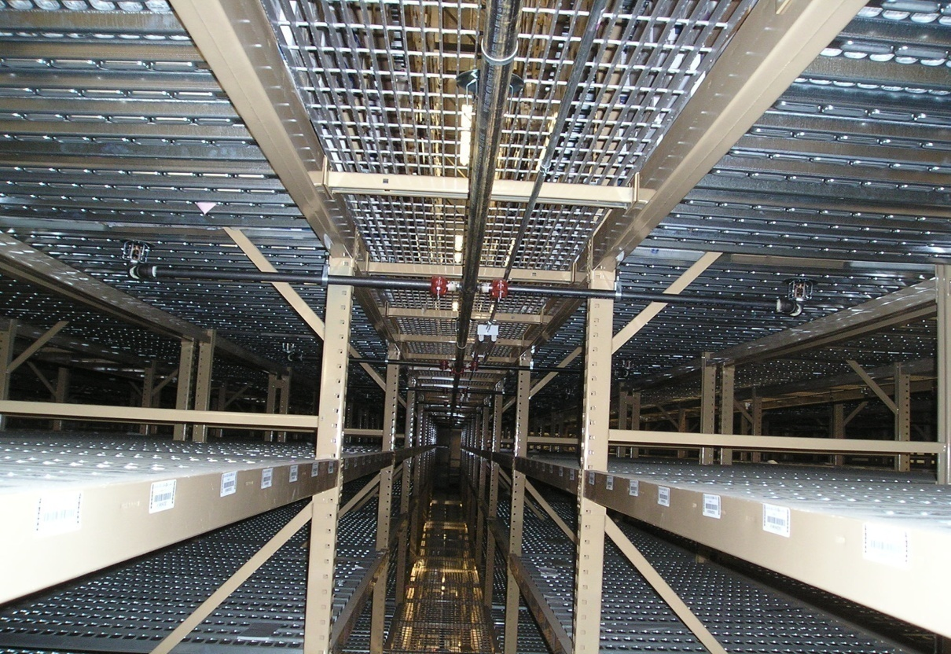
Cartoned Record Storage With Catwalk Access (20.5)
Catwalk sprinklers
Transverse flue sprinklers
Notes:
A.20.5.6.3.5
An example of the locations of sprinklers under the catwalk & at the transverse flu spaces. Just a representation of a few of the specific rules for protecting these facilities.
The ceiling sprinkler discharge is also prescriptive and taken from Table 20.5.6.2

Slide 195
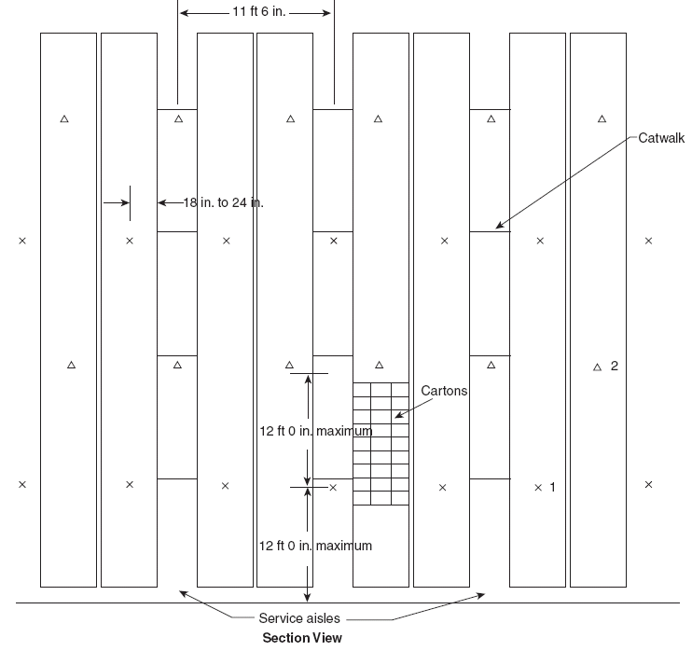
20.5 Carton Records Storage

Slide 196
Ceiling Sprinkler Design Criteria for Carton Record Storage
Table 20.5.6.2
 | Up to 25’ High Storage |  | Over 25’ High Storage
 | Ord Temp | High Temp | Ord Temp | High Temp
Density (gpm/ft²) | 0.33 | 0.29 | 0.3 | 0.4
Area (ft²) | 2000 | 2000 | 2000 | 2000
Hose allowance (gpm) | 500 | 500 | 500 | 500
Duration (hrs) | 2 | 2 | 2 | 2

Slide 197
SPECIAL DESIGN RULES FOR RECORD STORAGE
Compact record storage- defines a new device called a “compact record storage module” like those found in doctors’ offices & hospitals. Rolling cases with a movable aisle. May be protected as light hazard only if:
Limited to Class III commodity (may have up to 5% plastics)
Maintains 18” clearance from deflector & < 8’ high
Sprinklers shall be OT, QR Standard Spray upright or
pendent
Several other specific rules
Notes:
20.6
Compact record storage was defined earlier in 3.9.1.7
Compact record storage module was defined earlier in 3.9.1.8
These are typically the type record storage arrangements we see in doctors’ offices and such. Again, the requirements for this design are very specific and prescriptive in nature, giving specific requirements for the size of each module, what type sprinklers are allowed, requirements for barriers, etc.

Slide 198
Compact Storage
Storwell Storage Systems

Slide 199
Compact Storage
Pictures courtesy of Spacesaver
Notes:
An example of compact record storage. Supposedly the major manufacturers of these type devices have agreed to install them maintaining the 18” clearance to the sprinklers.

Slide 200
SPECIAL DESIGN RULES FOR RECORD STORAGE
High Bay Record Storage
  Provides an option for protecting both fixed and
  mobile high bay record storage
  Allows for ceiling only protection of Class III
  commodities over 12’ up to 34’ in height
  The option is only available using ESFR k-25.2
  sprinklers and about 10 additional requirements
Notes:
20.7
These optional rules are set out for both mobile & fixed storage bays. The rules are very specific and prescriptive. They require the use of k-25.2 ESFR sprinklers at a pressure of at least 40psi. There a number of requirements for the shelving, height of storage, clearances, etc.

Slide 201
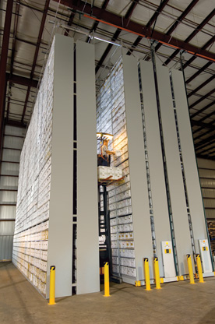
20.7 Fixed High Bay Record Storage
Courtesy of Spacesaver

Slide 202
High-Bay Record Storage (mobile) (20.7)
Notes:
An example of high bay record storage.

Slide 203
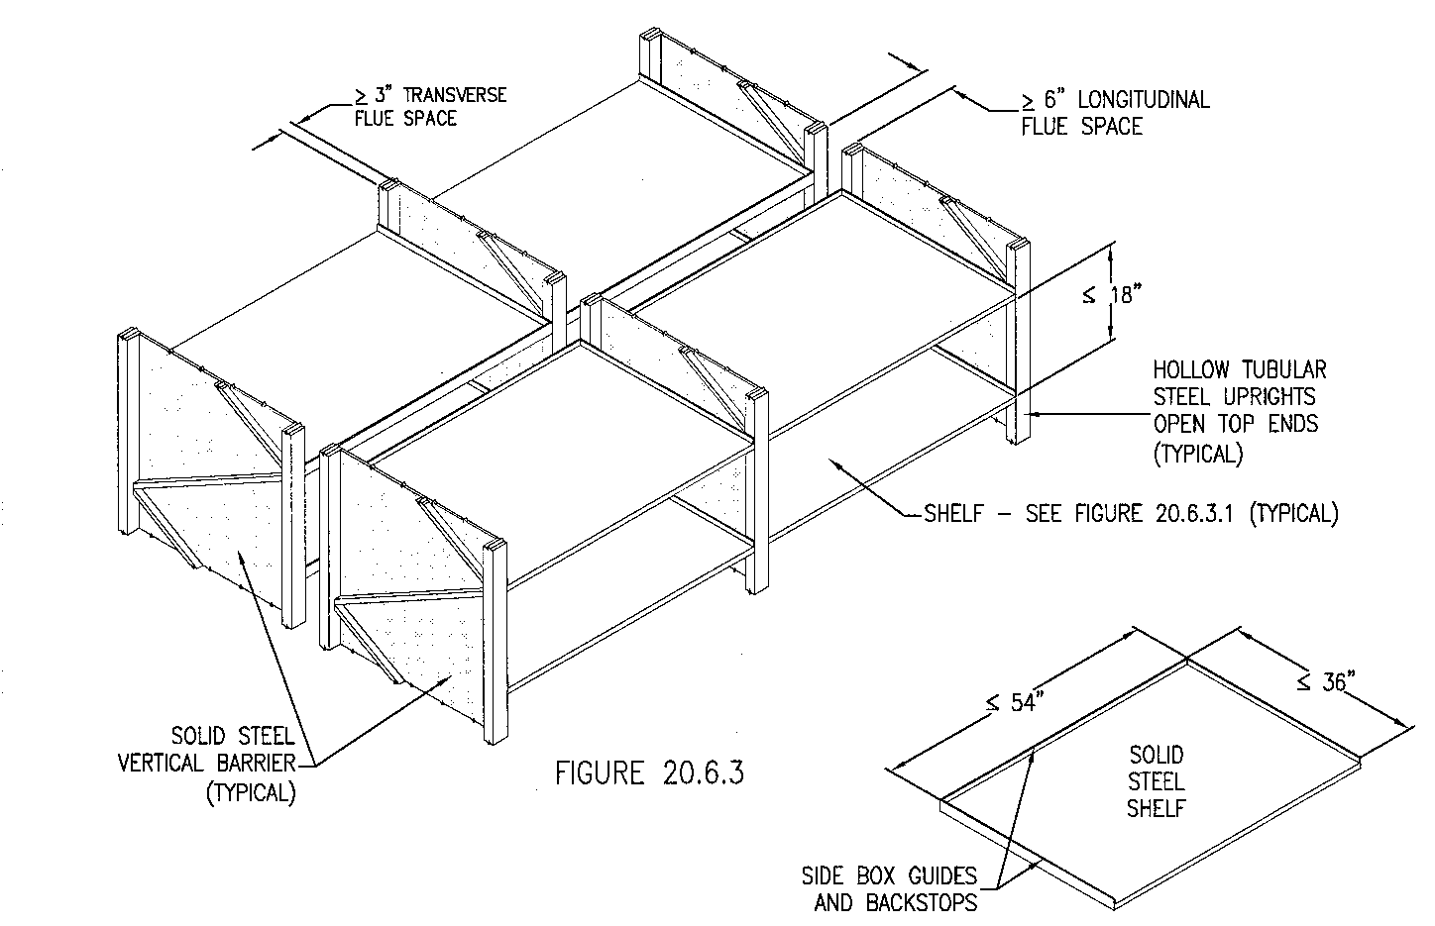
High-Bay Record Storage
Notes:
Figure A.20.7.1- a typical fixed high bay record storage structure. You can see how the construction of the module lends itself to meeting the requirements for flu spaces and such indicated by this section of the standard.

Slide 204
Chapter 21
Alternative Sprinkler Designs for Chapters 12 through 20

Slide 205
Chapter 21
New chapter was added to the standard for design criteria based on fire tests. The new chapter is intended to provide the user with alternatives to the other rules in Chapters 12 through 20 (storage occupancies). The user is not required to use Chapter 21, but can use the design criteria if they chose. The types of fire tests that the manufacturers will have to perform are spelled out in the chapter. The discharge criteria will be based on the number of sprinklers that open during the test(s) plus a safety margin. The sprinklers in Chapter 21 are standard spray and extended coverage CMSA (spray-type) sprinklers. The design areas go down as small as six sprinklers.

Slide 206
Thank you!

