Slide 1
Inspection, Testing, and Maintenance for Fire Pumps
Understanding, Applying and Enforcing NFPA 25
National Fire Sprinkler Association

Slide 2
Copyright and recording
This presentation is protected by US and international copyright laws. Any reproduction, recording, distribution, display, or use of the presentation without written permission of the National Fire Sprinkler Association is prohibited.
©National Fire Sprinkler Association 2021

Slide 3
Learning objectives
1
Describe key terms used in the enforcement of NFPA 25
2
Describe the role and responsibilities of building owners or their designated representatives
3
Utilize the appropriate tables to identify the appropriate sections of NFPA 25 that apply to administrative and enforcement requirements for system inspection, testing and maintenance

Slide 4
Learning objectives
4
Recognize the difference between internal inspections and obstruction investigations and identify the need for each.
5
Identify the various steps in the Impairment Procedures for systems.
6
Utilize the appropriate Tables to determine procedures necessary to return a system to service

Slide 5
Housekeeping
Fire Alarm / Exits
Breaks / Lunch
Pagers & Cell Phones
Attendance
Homework

Slide 6
Seminar Outline
Scope of NFPA 25
Key Definitions
General Requirements & Owner’s Responsibilities
How to Use the Tables for and Annex A
Internal Inspections & Obstruction Investigations
Impairment Procedures
Special Requirements
Administrative Issues
Exercises
Notes:
This is the outline for the seminar. It is important to note that, rather than simply parrot the rules of NFPA 25, this seminar focuses on how to properly use the document. It will lead the participants through the key parts of the document, how to properly use the various Tables, and explain how the rules are written.
It will also demonstrate how to determine if something is or is not within the scope of NFPA 25, and how to deal with it.
We will discuss how rules vary depending upon circumstances and what preventive measures we have built in to the system when it was installed. (for example, alarmed/locked valves only have to be inspected monthly, but plastic sealed valves must be inspected weekly)
We will also discuss the procedures required when a system is impaired, and how to use the component replacement tables for restoring a system to service.
There are enough exercises to make the seminar longer or shorter and can be used to adjust to the time allotted. If it is a very knowledgeable group that gets through the normal material, you can use more exercises. If the group needs more explanation earlier in the day, the exercises can be reduced.

Slide 7
Module 1
Introduction and Scope

Slide 8
Basic ITM Questions
Will the system work?
How do I know?
Who is responsible?
Why NFPA 25?
Notes:
When it comes to fire protection systems there are some of the fundamental questions that an AHJ wants to know.
These questions drive the entire process of inspection, testing and maintenance.

Slide 9
Will the System Work?
Sprinkler System Success Rate
Public Assembly – 96%
Educational – 93%
Health Care – 96%
Residential – 98%
Store / Office – 96%
Manufacturing – 93%
Storage – 79%
All Structures – 95%
Notes:
These are the sprinkler system statistical success rates divided into occupancy classifications.
Note that the Storage occupancy rate, while significantly lower than others does not dramatically impact the overall success rate.
One possible explanation of the lower success rate for storage occupancies is that these occupancies are more likely to be protected by dry pipe sprinkler systems which require greater care and attention and have more working parts that may be subject to failure.

Slide 10
When Sprinklers Are Ineffective
Source: U.S. Experience With Sprinklers, NFPA report, 2017
Notes:
This slide depicts when sprinklers operate but are ineffective. Note that there may be a number of contributing factors to “water did not reach the fire” including a closed valve or obstructed piping.
Ineffective does not mean that the system did not operate…it means that it did not achieve fire control or what it was designed to do.

Slide 11
When Sprinklers Fail to Operate
Source: U.S. Experience With Sprinklers, NFPA report, 2017
Notes:
This slide is data when sprinklers fail to operate at all.
The overwhelming issue relating to water not reaching the fire and manual intervention when sprinklers failed to operate is a CLOSED VALVE.

Slide 12
How Do I Know?
Inspection
Testing
Maintenance
Records

Slide 13
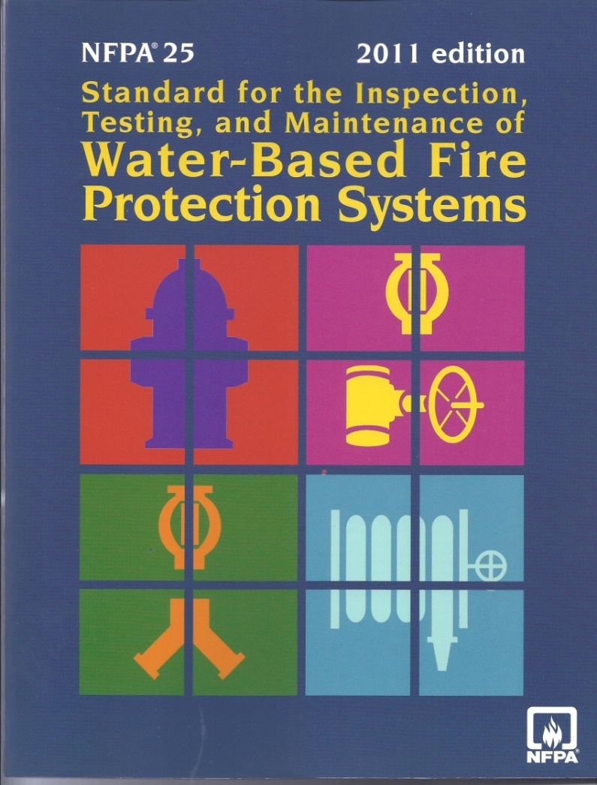
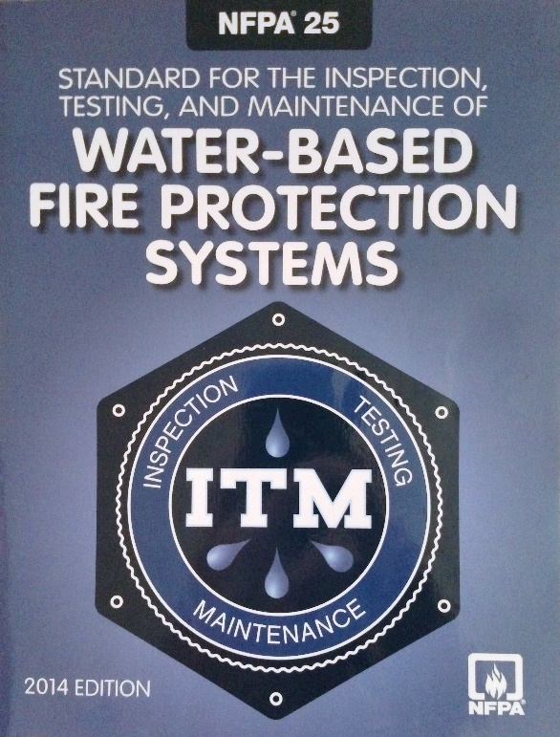
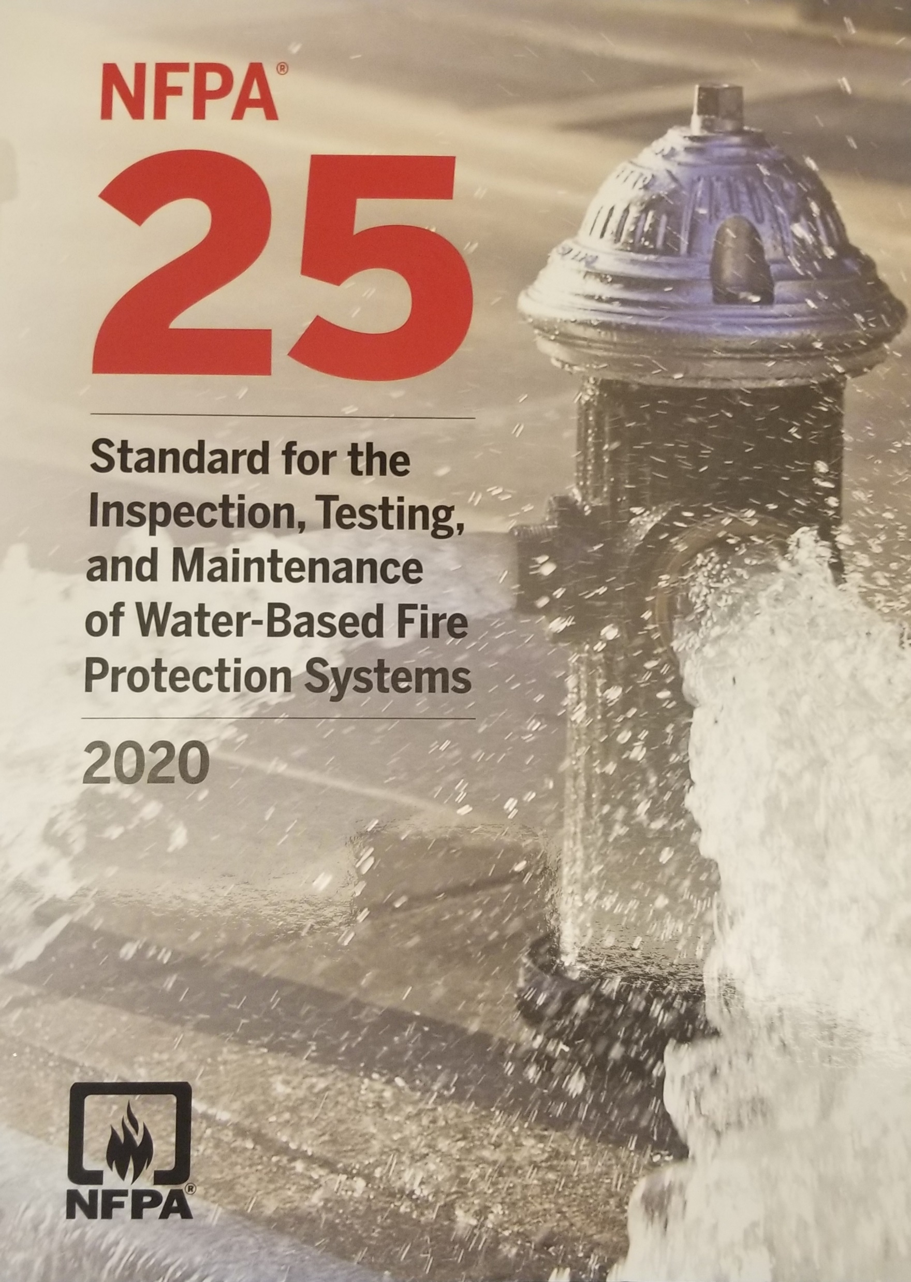
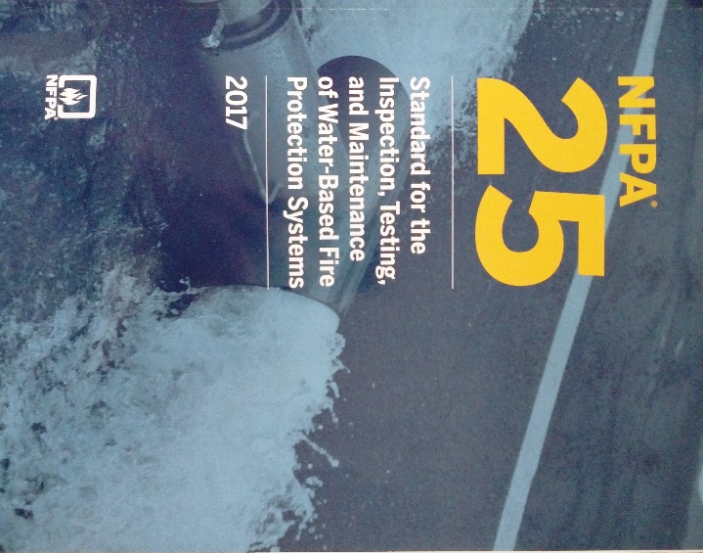
NFPA 25
Notes:
NFPA 25 is a referenced document in the IBC and IFC and NFPA 5000 codes as well as all of the installation standards for water-based fire protection systems.
Initially published in 1992 it is a compilation of the ITM requirements from numerous installation standards.
Extension of NFPA 13A and NFPA14A – Recommended Practice for Inspection, Testing, and Maintenance of Sprinkler Systems and Standpipe Systems
Incorporated procedures from standards and practices developed in Australia and New Zealand
Driven by codes requiring sprinklers in most structures to help insure the successful operation of water-based fire protection systems
Provide a reasonable degree of protection to life and property through minimum inspection, testing, and maintenance methods for water-based fire protection systems.” NFPA 25-2020(1.2)
The basic assumption of NFPA 25 is that the system was installed correctly when the building was occupied. It’s a referenced document in the IBC and IFC, and NFPA 5000 codes
Balanced Fire Protection
An integrated system of fire and smoke protection elements in the construction environment composed of detection, suppression and containment features designed to provide an acceptable level of protection for people and property.”
Detectors are used to activate fire alarms and notify building occupants and emergency responders
Fire sprinklers are designed to control small and medium fires and to prevent spread beyond the typical water design area of about 1,500 square feet
Compartmentation, achieved through fire-resistance-rated construction, mitigates the spread of more severe but less frequent fires by limiting building areas, subdividing the building with fire-resistance-rated construction, based on hourly ratings

Slide 14
Contents
Administration
Referenced Publications
Definitions
General Requirements
Sprinkler Systems
Standpipe & Hose Systems
Private Fire Service Mains
Fire Pumps
Notes:
This is the table of contents for the standards.
The administrative chapters (red) will be the focus of this overview

Slide 15
Contents
Water Storage Tanks
Water Spray Fixed Systems
Foam-Water Sprinkler Systems
Water Mist Systems
Valves, Valve Components and Trim
Internal Piping Conditions &
Obstruction Investigation
15. Impairments
16. Special Requirements

Slide 16
Annexes
A – Explanatory Material
B – Forms and Reports
C – Possible Causes of Fire Pump Problems
D – Obstruction Investigation
E – Hazard Evaluation Form
F – Connectivity and Data Collection
G – Color Coded Tagging Program
H – Informational References

Slide 17
Scope
To what does the standard apply
Just as importantly, to what does it NOT apply
Notes:
We are going to discuss not only what the standard does address, but what is does not address as well.

Slide 18
Scope
Establishes minimum requirements for periodic inspection, testing & maintenance
Requires coordination with NFPA 72 requirements
Addresses the types of systems covered
Assumes the system has been properly installed
Notes:
Bullets: 1.1, 1.1.1, 1.1.2, 1.1.3
The scope of NFPA 25 covers the administrative requirements for the periodic inspection, testing, and maintenance of water-based fire protection systems. In addition to the scope and purpose of the standard, Chapter 1 provides guidance on the application of the standard and explains how units are expressed throughout the document. Note that the most important point when using NFPA 25 is that the purpose of the standard is to verify the operational status of a system and to provide a reasonable degree of certainty that the system will perform when needed.
The scope of NFPA 25 is intended to help users determine if they are using the correct standard. As noted, NFPA 25 contains the minimum requirements for the inspection, testing, and maintenance of a water-based system to ensure the system performs properly. The minimum requirements must be met in order for a system to comply with this standard. Nothing in the standard is intended to prevent more frequent inspection, testing, and maintenance activities if the level of safety or performance of the system is at stake. Also, Section 4.6 permits alternative means of compliance that may result in less frequent inspection, testing, and maintenance activities.
Inspections required by NFPA 25 are not intended to reveal installation flaws or code compliance violations. It clearly is not the intent of this standard to evaluate a system for compliance with an installation standard. Issues such as piping pitch should be verified during commissioning of the system. The installation standards typically are not retroactive; therefore, inspecting a system for compliance to the original installation or design criteria would require extensive research and knowledge. For example, inspecting sprinklers for compliance with requirements that protect against obstruction of sprinkler spray patterns would require the inspector to know what obstruction rules were in effect and enforced at the time of the original installation. In addition, it is virtually impossible to identify obstruction deficiencies from the floor. In order to manage the cost of the inspection while providing a reasonable degree of protection, NFPA 25 assumes that if no changes were made to the building or hazard and the original installation was accepted by all applicable authorities having jurisdiction (AHJs), then it would still be considered acceptable.

Slide 19
Scope
Not intended for addressing design deficiencies
Requires corrective action in accordance with the appropriate design standard
Does not apply to 13D systems
  Exception in Chapter 16
The purpose is to provide a reasonable degree of protection through minimum I,T & M
Notes:
Bullets 1.1.3.1, 1.1.4, 1.1.5, 1.2.1

Slide 20
Scope
May use other type ITM programs
  Provide equivalent level of performance
  Approved by the AHJ
Notes:
Bullets 1.3.1
Application

Slide 21
Scope
What is Not in the Standard
  Requirement for Engineering Judgment
  Requirement for Hazard Analysis
  Requirement for System Certification
Notes:
It is important to note that the scope of an inspection or test is not for the technician to provide an engineering judgment as to the systems design, only to determine if the system is functioning.
Similarly it is not the job of the technician to determine if the hazard classification within the building is within the design parameters of the system. That requires a judgment that is left to an engineer or authority having jurisdiction.
Inspection, Testing and Maintenance does not certify system design, it is a process to
determine that the system is functioning.
In order to manage the cost of the inspection while providing a reasonable degree of protection, NFPA 25 assumes that if no changes were made to the building or hazard and the original installation was accepted by all applicable authorities having jurisdiction (AHJs), then it would still be considered acceptable.

Slide 22
Module 2
Definitions
Notes:
Explain importance of definitions (words matter)

Slide 23
Chapter 3 Definitions
General rules for definitions
    Use of Miriam-Webster’s Collegiate dictionary
NFPA Official Definitions
General Definitions
Notes:
3 types of definitions found in NFPA

Slide 24
Definitions
Official Definitions
  Approved
  Authority Having Jurisdiction
  Listed
  Shall / Should
  Standard
Notes:
Found in Chapter 3 all NFPA standards have this terminology defined. Cover the definitions.

Slide 25
Key Definitions
Sprinkler System
Adjust/ Clean
Rebuild/ Remove
Repair/ Replace
Inspection
Test/Testing
Frequencies
Valve status test/ Valve status test connection
Maintenance
ITM Service
Qualified
Deficiency (Critical / Non-Critical)
Impairment (Emergency / PrePlanned)
Notes:
Bullets: Sprinkler System (3.6.4) Adjust/Clean(3.3.1/3.3.7) Rebuild/Remove(3.3.37/3.3.39) Repair/Replace(3.3.40/3.3.41) Inspection (3.3.23), Test/Testing (3.3.47/3.3.48), Frequencies(3.7.1) Valve Status Test/Valve Status Test Connection(3.3.49/3.3. 50) Maintenance (3.3.27), ITM Service (3.3.25), Qualified (3.3.36), Deficiency(Critical/Non-Critical(3.3.8/3.3.8.1/3.3.8.2) Impairment(Emergency/Preplanned)(3.3.22/3.3.22.1/3.3.22.2) These are the definitions that are specifically needed in the application of NFPA 25.
The NFPA official definitions listed in Section 3.2 are used throughout NFPA codes and standards for consistency.
It is most important that the AHJ fully understand the definition and intent of these key terms used in the standard.

Slide 26
Definitions
Definition of sprinkler system extracted from NFPA 13
3.6.4* Sprinkler System. A system that consists of an integrated network of piping designed in accordance with fire protection engineering standards that includes a water supply source, a water control valve, a waterflow alarm, and a drain and is commonly activated by heat from a fire, discharging water over the fire area. The portion of the sprinkler system above ground is a network of specifically sized or hydraulically designed piping installed in a building structure, or area, generally overhead, and to which sprinklers are attached in a systematic pattern. The system is commonly activated by heat from a fire and discharges water over the fire area.
Notes:
Important because of requirements such as alternating internal pipe inspections in buildings with multiple systems or multi-story buildings.

Slide 27
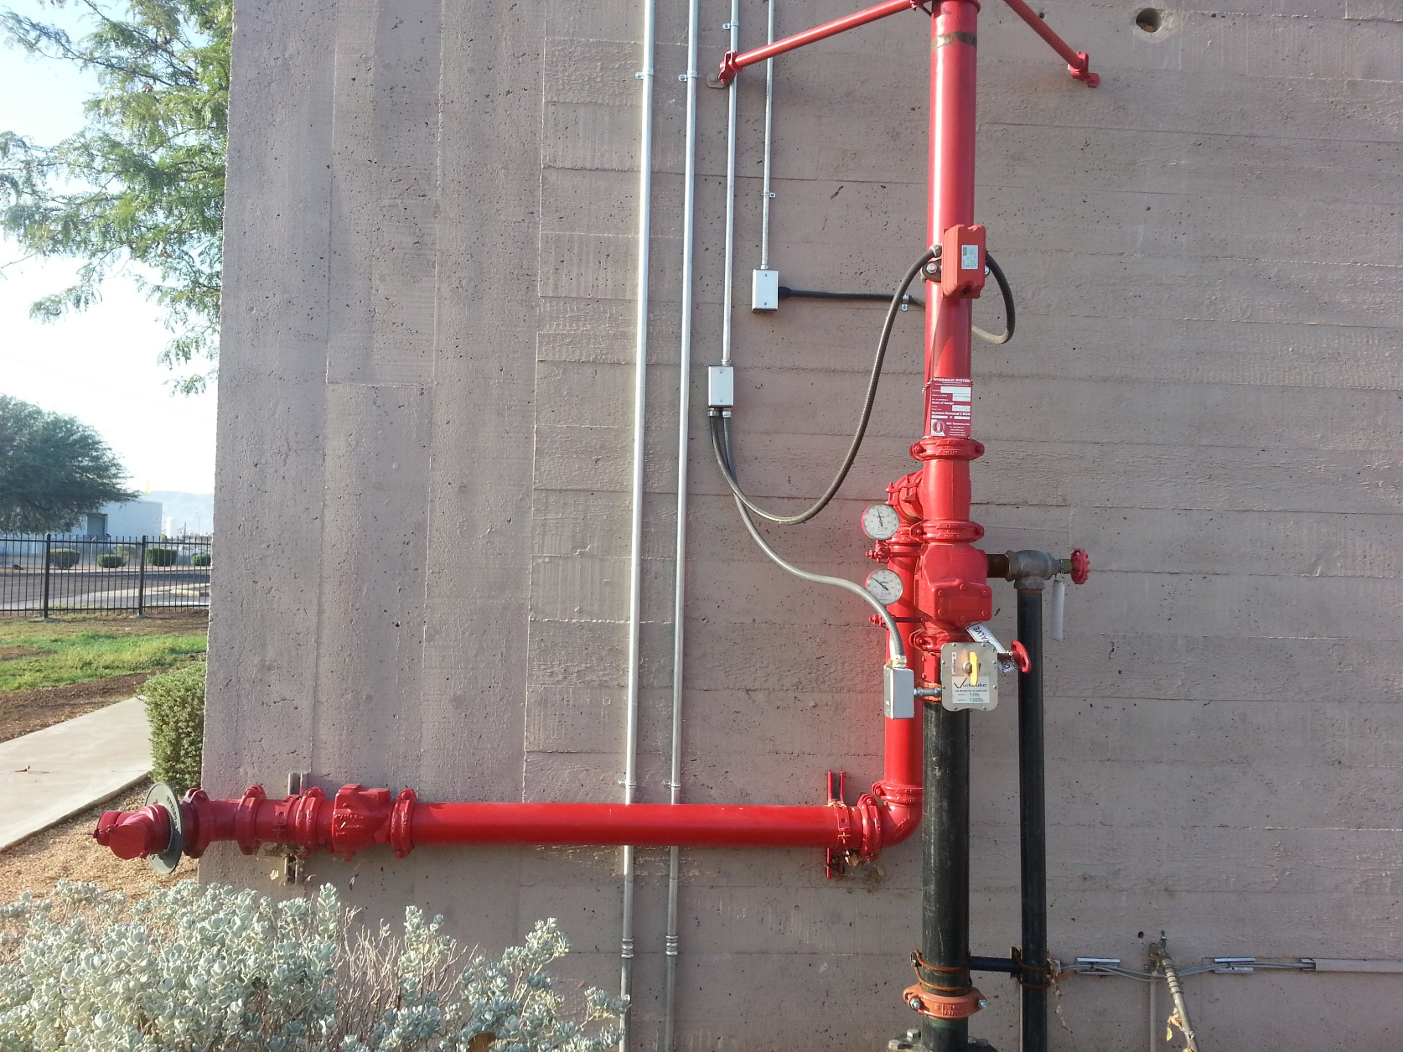
Inspection
Inspection
Notes:
3.3.24 Inspection. A visual examination of a system or portion thereof to verify that it appears to be in operating condition and is free of physical damage.
An inspection is a visual examination of a system or component to verify that the system or component is in apparent working order. The intent of the inspections described in NFPA 25 is to look for obvious signs of damage or wear and, most importantly, to verify that water control valves are open. Inspections are the most frequently required activity in the standard and provide a minimum assurance that the system and components are in operating condition. The testing and maintenance activities verify that the system and its components are functioning.
The term evaluation or evaluate is not defined in any NFPA code or standard, and thus, the user should refer to Merriam-Webster’s Collegiate Dictionary, which defines the word evaluate as: “to determine the significance, worth, or condition of by careful appraisal and study.”
An evaluation of a system is more thorough than a visual examination to verify the operating condition or freedom from physical damage. Evaluation may examine the design criteria or the system’s compliance to installation standards and should be conducted by a registered design professional, a licensed contractor, or other qualified individual.

Slide 28
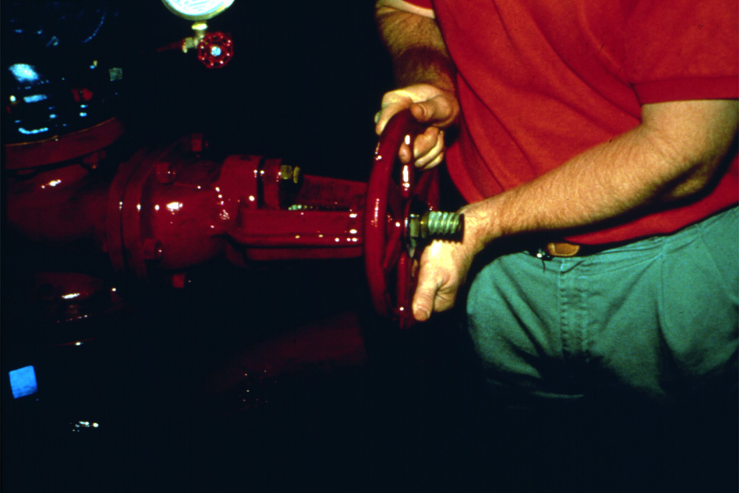
Definitions
Test: The operation of a device to verify that it is functioning correctly or the measurement of a system characteristic to determine if it meets requirements.
Testing: A procedure used to determine the operational status of a component or system by conducting periodic physical checks, such as water flow tests, fire pump tests, alarm tests, and trip tests of dry pipe, deluge, or preaction valves.
Notes:
3.3.47 The operation of a device to verify that it is functioning correctly, or the measurement of a system characteristic to determine if it meets requirements.
Different from the definition of TESTING which is: A procedure used to determine the operational status of a component or system by conducting periodic physical checks, such as waterflow tests, fire pump tests, alarm tests, and trip tests of dry pipe, deluge, or preaction valves.
3.3.48* Testing. A procedure used to determine the operational status of a component or system by conducting periodic physical checks, such as water flow tests, fire pump tests, alarm tests, and trip tests of dry pipe, deluge, or preaction valves.
A.3.3.48 Testing. These tests follow up on the original acceptance test at intervals specified in the appropriate chapter of this standard.

Slide 29
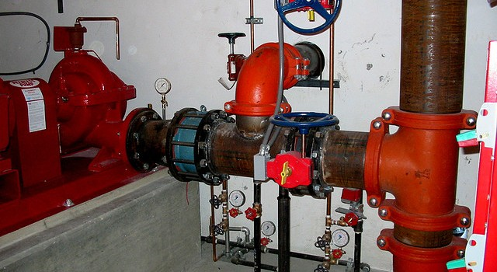
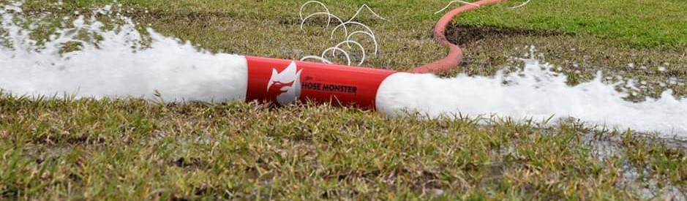
Testing

Slide 30
Frequencies
Daily frequency- occurring every day
Weekly Frequency - once per calendar week.
Monthly Frequency - once per calendar month.
Quarterly Frequency - four times per year with a minimum of 2 months, maximum of 4 months.
Semiannual Frequency - twice per year with a minimum of 4 months, maximum of 8 months.
Notes:
3.7.1
Committee Statement: The language was changed to make the weekly and monthly requirements easier apply. It is not the intent that where a weekly ITM event is missed to conduct two tests the following week.
¼ ly 2 months
Semi 2 months

Slide 31
Frequencies
Annually- Once per year with a minimum of 9 months, maximum 15 months.
3 years – Once every 36 months, with a minimum of 30 months and a maximum of 40 months.
5 years – Once every 60 months with a minimum of 54 months and a maximum of 66 months.
Notes:
3.7.1
Annual 3 months
3 yr 6 and 4
5 yr 6 months

Slide 32
Valve Status - Definitions
Valve Status Test
Flowing water to verify valves for a portion of the system are not closed
Valve Status Test Connection
A point in the system where water is discharged for purposes of performing a valve status test
Notes:
3.3.49/3.3.50
Valve Status Test Connection can include main drain, fire pump test header, backflow preventer forward flow test connection, fire hydrants, etc. Absent of any of these, an inspector’s test can be used. Separate from main drain test. Concept is to differentiate between main drain tests and valve status tests. Very different in scope and purpose.
Main drain test is designed to gauge the amount of water and determine if any changes have taken place. Valve status test simply confirms whether valves are closed or not (no pressure measurement). When is a valve status test required? When a valve is returned to service. In each system chapter, the main drain test requirement has been changed to valve status test for when valves have been operated

Slide 33
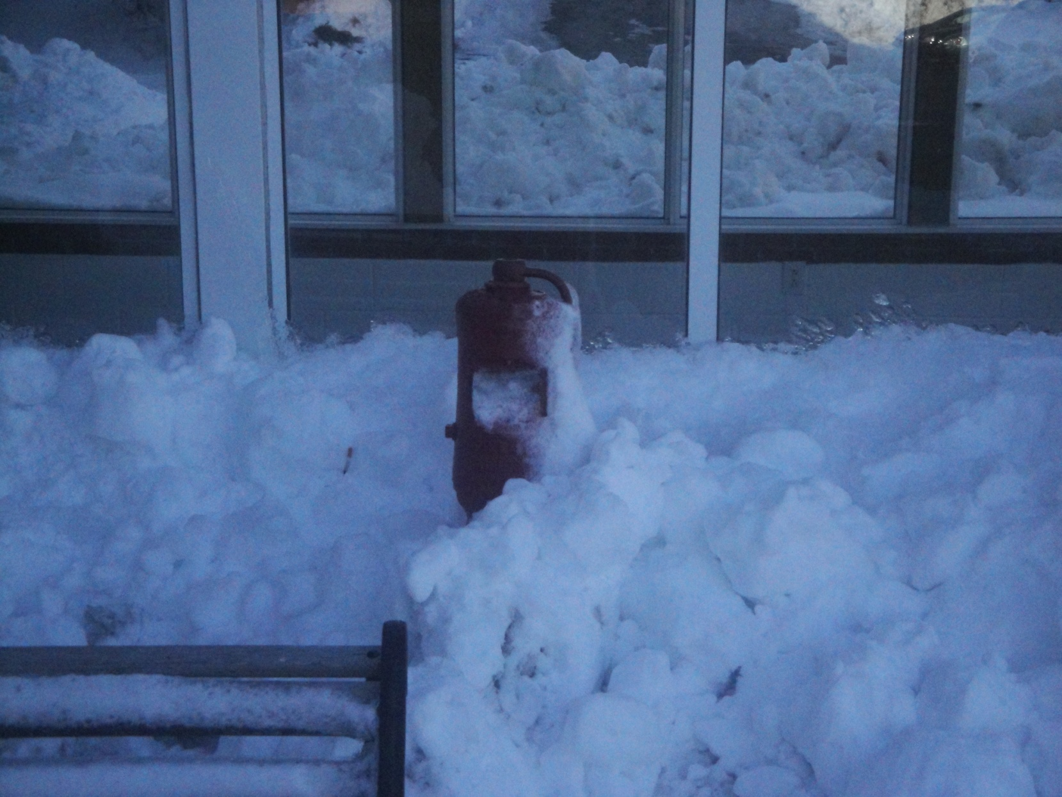
Maintenance
Notes:
3.3.25 Maintenance. In water-based fire protection systems, work performed to keep equipment operable.
Maintenance includes not only the required functions in the standard, but also practices and procedures recommended by the manufacturer.
Maintenance is not always directly related to the physical components of the system. It also includes the day-to-day operations necessary to ensure that the system is accessible.

Slide 34
ITM Service
Inspection, Testing, and Maintenance Service
  A service program provided by a qualified contractor or qualified property owner’s representative in which all components unique to the property’s systems are inspected and tested at the required times and necessary maintenance is provided.
Notes:
3.3.25* Inspection, Testing, and Maintenance Service. A service program provided by a qualified contractor or qualified property owner’s representative in which all components unique to the property’s systems are inspected and tested at the required times and necessary maintenance is provided.
It is important to note that, even if an owner contracts with a contractor to provide an ITM service, which includes the retention of records, that does not relieve the owner of the responsibility of maintaining the records as we will see in Owner’s responsibilities (4.3.3).

Slide 35
Qualified
Qualified.
  A competent and capable person who has met the requirements and training for a given field acceptable to the AHJ. [96, 2017]
Notes:
3.3.36 Qualified. A competent and capable person who has met the requirements and training for a given field acceptable to the AHJ. [96, 2017]
The use of the term qualified in the standard is intended to be general in nature. It is the intent of the standard that the owner or the owner’s designated representative(s) perform many of the required inspections. For example, the owner (or just about any representative) could be trained to a level acceptable to the AHJ and therefore qualified to perform the monthly inspection to verify that the system control valve(s) are open. A facility maintenance person could be trained to inspect pressure gauges, exterior conditions of water storage tanks, accessibility of fire hydrants, and so forth.
NFPA 25 does not require licensing of the individual or company performing the work, because many jurisdictions do not require licensing and because licensing laws vary considerably from one jurisdiction to the next. As a result, NFPA 25 requires an inspector or service provider simply to possess the appropriate knowledge and experience needed to perform the work specified herein. It is important to note that many licensing laws specifically require that an individual who is engaged in the business of providing this service for a fee must be licensed. This stipulation means that for properties that have a qualified maintenance staff, licensing is not necessarily needed for work that is done “in house.” Before engaging in the business of performing any inspection, testing, or maintenance work, an individual should
contact the local or state fire marshal’s office or the state contractor’s licensing board for any licensing requirements.

Slide 36



Qualified
Notes:
Some of the various state agencies around the country that administer licensing requirements.

Slide 37
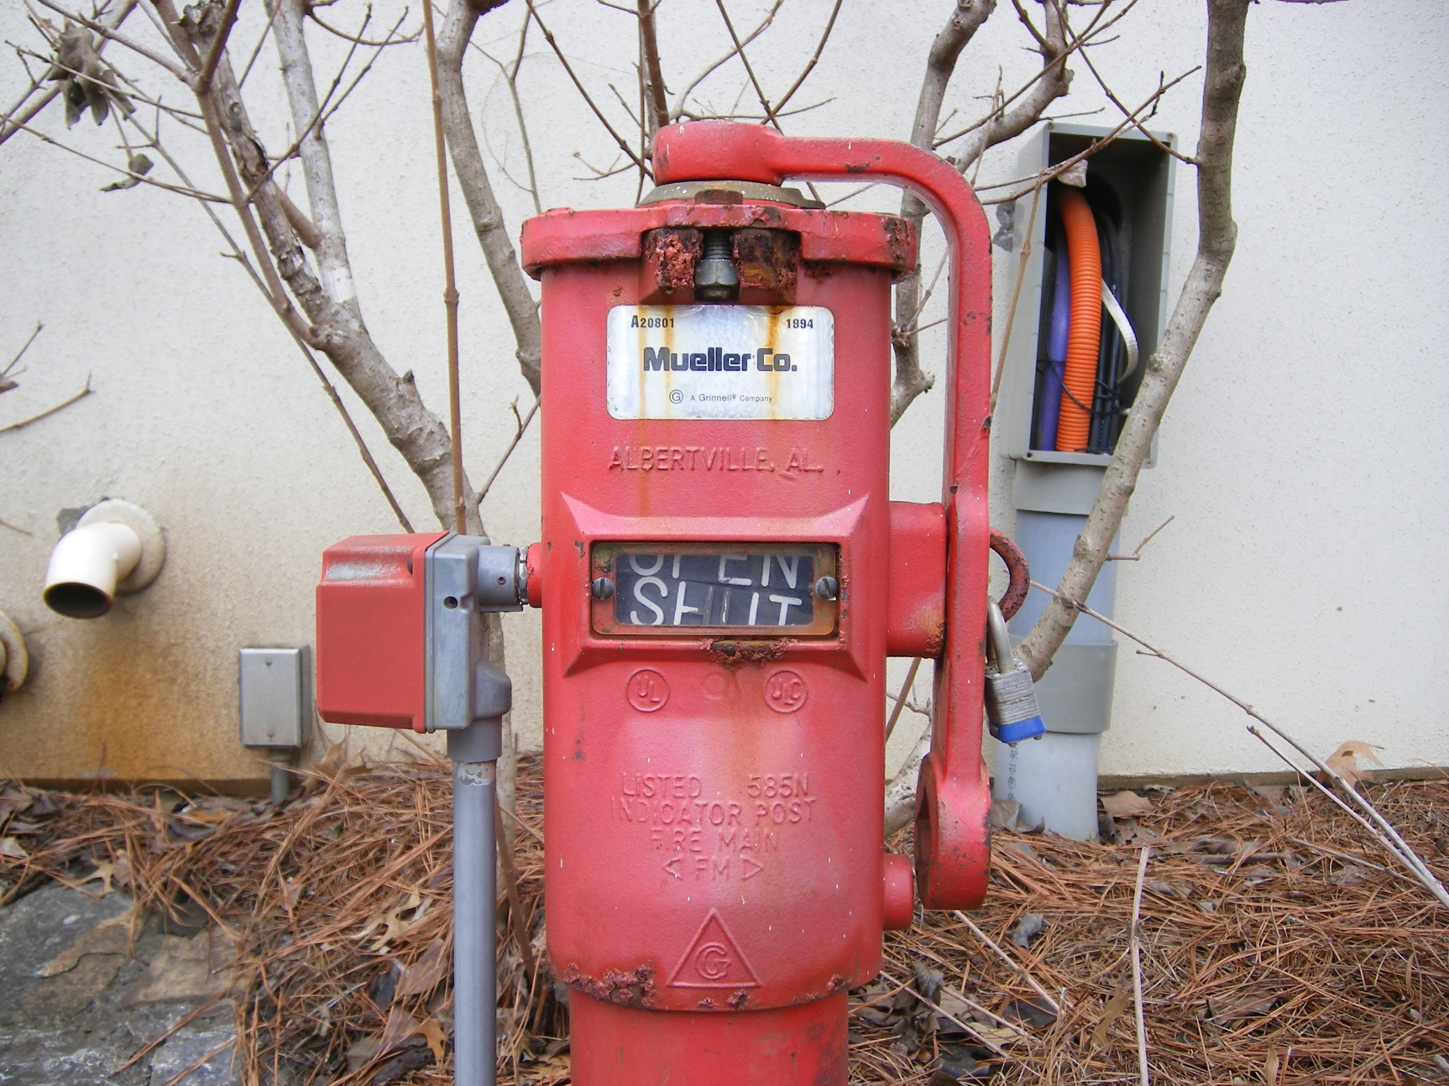
Impairment
Notes:
3.3.21* Impairment. A condition where a fire protection system or unit or portion thereof is out of order, and the condition can result in the fire protection system or unit not functioning in a fire event.
A.3.3.21 Impairment. Discusses what a “unit” is. ….Temporarily shutting down a system as part of performing the routine inspection, testing, and maintenance on that system while under constant attendance by qualified personnel, and where the system can be restored to service quickly, should not be considered an impairment. Good judgment should be considered for the hazards presented. This valve is locked but is says “SHUT”

Slide 38
Impairment
Preplanned Impairment
A condition where a water-based fire protection system or a portion thereof is out of service due to work that has been planned in advance, such as revisions to the water supply or sprinkler system piping.
Emergency Impairment
A condition where a water-based fire protection system or portion thereof is out of order due to an unplanned occurrence, or the impairment is found while performing inspection testing or maintenance activities.
Notes:
3.3.22.2 Preplanned Impairment. A condition where a water-based fire protection system or a portion thereof is out of service due to work that has been planned in advance, such as revisions to the water supply or sprinkler system piping.
Any system impairment can lead to the danger of a shut valve. As previously noted an overwhelming majority of system failures can be attributed to shut valves, it was not apparent whether the valve was shut due to maintenance (preplanned or emergency impairment) or from willful or unintentional neglect. Either way, during an impairment, it is essential to ensure that a fire prevention program is in place and that valves are left opened completely after the recommissioning of each system. A programmed approach to monitoring system valves through a lockout/tagout program can ensure that no valve is left completely or partially closed.
3.3.22.1 Emergency Impairment. A condition where a water-based fire protection system or portion thereof is out of order due to an unplanned occurrence, or the impairment is found while performing inspection testing or maintenance activities.
An emergency impairment can be difficult to predict or plan for. However, some precautions can be taken to minimize system “downtime.” These precautions include the presence of spare sprinklers or nozzles, including pilot sprinklers, and repair kits for all valves, including alarm, dry pipe, deluge, preaction valves and backflow prevention devices. In addition, key personnel should be aware of the location and proper operation of control valves to limit damage. A reserve supply of foam concentrate is also essential to the timely recommissioning of a foam-water sprinkler or foam-water spray system.

Slide 39
Deficiency
Deficiency.
  For the purposes of inspection, testing, and maintenance of water-based fire protection systems, a condition that will or has the potential to adversely impact the performance of a system or portion thereof but does not rise to the level of an impairment.
Notes:
This can get somewhat subjective. For example, one painted sprinkler in a warehouse of 500 sprinklers may be considered a critical deficiency, but a painted sprinkler as the only sprinkler in a room may be considered an impairment.
3.3.8* Deficiency. For the purposes of inspection, testing, and maintenance of water-based fire protection systems, a condition that will or has the potential to adversely impact the performance of a system or portion thereof, but does not rise to the level of an impairment.
A.3.3.8 Deficiency. Was annex E in 2011, moved to annex A in 2014

Slide 40
Non-Critical or Critical
Critical Deficiency
A deficiency that, if not corrected, can have a material effect on the ability of a fire protection system or unit to function as intended in a fire event.
Noncritical Deficiency
A deficiency that does not have a material effect on the ability of the fire protection system or unit to function in a fire event, but correction is needed to meet the requirements of this standard or for the proper inspection, testing, and maintenance of the system or unit.
Notes:
Bullets 3.3.8.1, 3.3.8.2
Many jurisdictions have enacted differing reporting procedures, depending on the type or severity of the deficiency. Other jurisdictions treat all deficiencies with equal measure without regard to the type or severity. It was the intent of the Technical Committee on Inspection, Testing, and Maintenance of Water-Based Systems to define the differing levels of deficiencies in order to provide consistency in interpretation and enforcement. Examples of critical deficiencies include a painted or damaged sprinkler, a faulty pressure-reducing hose valve, or an inaccessible fire hydrant. Noncritical deficiencies include missing signs, a broken handle on an inspector’s test valve, or an inadequate number of spare sprinklers. Thus, a large number of painted sprinklers in a warehouse typically would be of more concern than a single painted sprinkler; damaged threads on a hose connection might require a more immediate response than a missing sign on a control valve. While all deficiencies must be corrected, it is expected that the type of deficiency will dictate the level of response.
The correction of some deficiencies might require the system or a portion of it to be taken out of service. Such an action would be considered a preplanned impairment. Chapter 15 of the standard addresses the actions needed for preplanned impairments, and a new Annex E has been developed to provide guidance for determining what corrective action must take place to bring the system back on line. However, it is expected that most noncritical and many critical deficiencies do not require measures such as fire watches, building evacuation, or standby fire protection during the time that the deficiency is being corrected.

Slide 41
Definitions
Pump Terminology
No Flow
Peak Load
Pressure
Rated Flow
Unadjusted Field Test Curve
Notes:
New definitions added in 2017.
Briefly go over
Terms were generally used, but not in 25

Slide 42
Module 3
General Requirements

Slide 43
Who is Responsible
Owner
Established by contract
Established by NFPA 25
Chapter 4
Contractor
AHJ
Does not exist unless established by some other legislation
Notes:
This slide describes the relationship and the inherent challenges of a contractor having a direct required relationship with the AHJ. NFPA 25 establishes a relationship between the owner and the AHJ. The contract establishes the relationship between the contractor and the owner. THERE IS NO RELATIONSHIP ESTABLISHED BETWEEN THE CONTRACTOR AND THE AHJ UNLESS IT HAS BEEN ESTABLISHED BY SOME OTHER LEGISLATIVE ACT.
What is the Owner responsible for?
What is the Contractor responsible for?
What is the AHJ responsible for?
NFPA 25 does not require that the contractor submit ITM records to the AHJ. However state law may (as in Florida) contain such requirements.
KNOW THE LAW!!!
Communicate that to the Owner!!!

Slide 44
General Requirements
Responsibility of Owner or Designated Rep
Manufacturer’s Corrective Action
Records
Water Supply Status
Inspection
Testing
Automated Inspection & Testing
Performance Based Compliance Programs
Maintenance
Safety
Notes:
Chapter 4 of NFPA 25 contains requirements that relate to the types of systems covered under the scope of the standard.
This chapter outlines the administrative guidelines for compliance with the standard,
which include such topics as changes in building use or occupancy, impairments, corrective action, record keeping, and essential safety requirements for those performing the work specified in Chapters 5 through 16.
The primary focus of Section 4.1 in this chapter is specifically on the property owner or designated representative.

Slide 45
Owner or Designated Rep.
System ITM
Adequate drainage
Freeze Protection
Accessibility
Notification of System Shutdown or Testing
Corrections & Repairs
Changes
  Occupancy, Use, Process, Materials, Water Supply
Changes in Hazard
Valve Location
Information Sign
Anti Freeze Information Sign
Impairments
Notes:
For the 2017 edition of the standard, Section 4.1 to clarifies that it is the owner or the designated representative who is responsible for all aspects of maintaining the systems addressed by the standard.
These responsibilities include changes to building contents, changes to building use, or renovations to interior building arrangement that can hinder the efficacy of the fire protection systems operation.

Slide 46
Inspection, Testing and Maintenance
Owner or Designated Representative is responsible for properly maintained a water-based fire protection system.
Notes:
Paragraph 4.1.1 clearly sets the tone for the enforcement of the standard by indicating that the property owner or designated representative is responsible for inspection, testing, and maintenance.

Slide 47
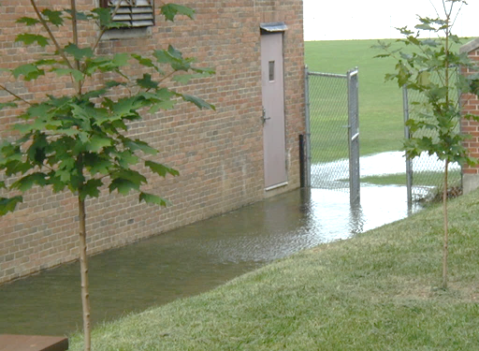
Adequate Drainage
Owner shall coordinate with entity that is conducting testing
Notes:
New section 4.1.1.2.1 Just brought the owner into the loop requiring that they coordinate with whoever is flowing the water.

Slide 48

Freeze Protection
Fuquahomes.com
Notes:
4.1.2* Freeze Protection The property owner or designated representative shall ensure that water-filled piping is maintained at a minimum temperature of 40°F (4.4°C) unless an approved anti freeze method is used.
The intent behind the requirement in 4.1.2 is that wet pipe sprinkler systems require an ambient temperature of 40°F (4.4°C) to prevent freezing, which can lead to broken pipes or fittings and subsequently an inoperable system.
During warm weather, freezing is seldom a problem, so problems with the building enclosure often g o unnoticed until the weather grows colder. Prior to the onset of cold weather, it is important to check for areas in the building where cold air could enter. Particular attention should be paid to unoccupied areas such as openings and closures, blind spaces, unused attics, and so on, because problems in unattended areas are most likely to go unnoticed. Heating equipment should also be inspected to ensure it operates as needed when cold weather arrives.
4.1.1.1.* Inspection, testing, maintenance, and impairment shall be implemented in accordance with procedures meeting those established in this document and in accordance with the manufacturer’s instructions.
As stated in Chapter 1, the requirements found in NFPA 25 are clearly minimum requirements. As such, any program meeting or exceeding these requirements is generally considered to be in compliance with this standard.
A.4.1.1.1 In order to ensure compliance, the owner should verify that windows, skylights, doors, ventilators, other openings and closures, concealed spaces, unused attics, stair towers, roof houses, and low spaces under buildings do not expose water-filled piping to freezing. This should occur prior to the onset of cold weather and periodically thereafter. REMOVED in 2020 edition

Slide 49
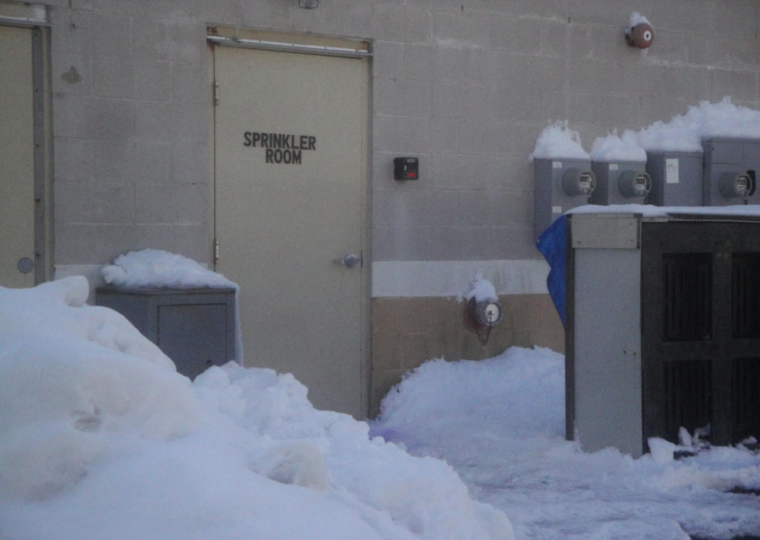
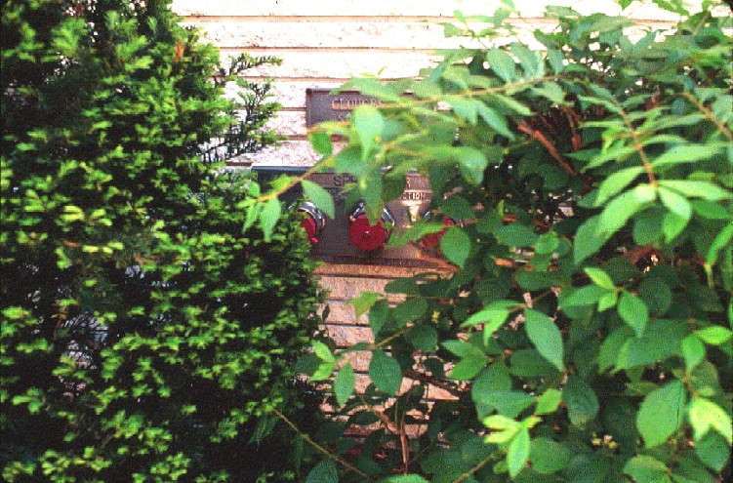
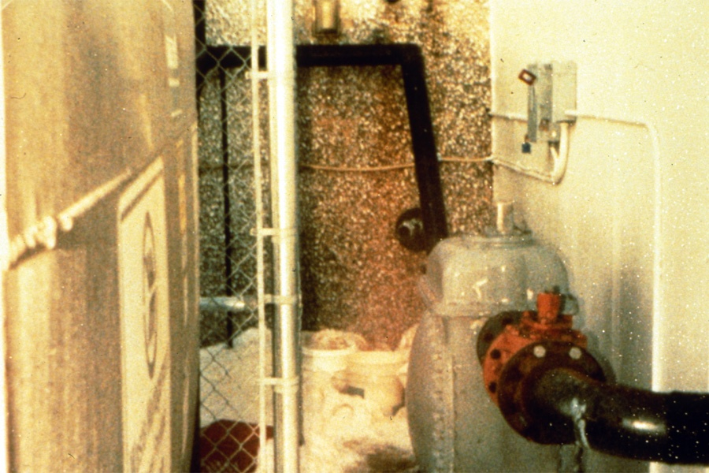
Accessibility
Notes:
4.1.3* Accessibility. The property owner or designated representative shall provide ready accessibility to components of water-based fire protection systems that require inspection, testing, and maintenance.
Check A.4.1.3 for guidance on what is considered accessible. The requirement in 4.1.3 for accessibility is intended to prevent the all-too-common practice of placing objects such as file cabinets or stock in front of sprinkler risers and other control equipment. This requirement is not limited to the interior of the building. Exterior components of the system must be kept accessible as well. Exhibit 4.1 shows a fire department connection that has been obstructed by shrubbery. Exterior components such as post indicator valves and fire department connections can also be blocked by dumpsters, outdoor storage, and even snow piles as a result of plowing. The property owner or the designated representative must maintain access to equipment for inspection, testing, and maintenance purposes. The standard refers to the property owner or designated representative throughout the standard to distinguish between the property owner and the owner of the contracting firm.

Slide 50
Notification of System Shutdown or Testing
Stakeholders
Authority Having Jurisdiction
Fire Department, if required
Alarm-Receiving Facility
Purpose of Shutdown or Test
Return to Service or completion of test
Notes:
4.1.4 Notification of System Shutdown. The property owner or designated representative shall notify the authority having jurisdiction, the fire department, if required, and the alarm-receiving facility before testing or shutting down a system or its supply.
Paragraph 4.1.4 establishes the requirement for notification when systems are removed from service. Testing a system without proper notification might — and often does — result in a false alarm. False alarms must be avoided, since they remove emergency services personnel from service at a time when their services may be needed for an actual emergency. In many jurisdictions, repeated false alarms can result in a fine or other penalty for property owners.
4.1.4.1 The notification of system shutdown or test shall include the purpose for the shutdown or test, the system or component involved, and the estimated time of shutdown or test.
4.1.4.2 The authority having jurisdiction, the fire department, and the alarm-receiving facility shall be notified when the system, supply, or component is returned to service.
The requirement in 4.1.4.2 assists the AHJ or alarm company in establishing a follow-up program to ensure that systems are properly returned to service.

Slide 51
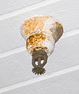


Corrections and Repairs
Notes:
4.1.5.1 The property owner or designated representative shall correct or repair deficiencies or impairments.
While NFPA 25 focuses on the specific requirements for inspection, testing, and maintenance of water-based fire protection systems, the ultimate goal of such a program is to maintain the operational status of a system. Paragraph 4.1.5.1 provides the enforcement tool to initiate corrective action to ensure that systems are functioning at all times. The standard does not provide specific guidance on how quickly corrections or repairs must be completed.
N 4.1.5.1.1* Upon discovery of any component and equipment under recall or replacement programs by the owner’s maintenance personnel, designated representative, or contractor, the owner shall be notified in writing.
N 4.1.5.1.2* The property owner or designated representative shall correct, remedy, repair, or replace components and equipment under recall or replacement program.
4.1.5.2* Corrections and repairs shall be performed by qualified maintenance personnel or a qualified contractor.

Slide 52
Changes
Occupancy
Use
Process
Materials
Notes:
4.1.6* Changes in Occupancy, Use, Process, or Materials. The property owner or designated representative shall not make changes in the occupancy, the use or process, or the materials used or stored in the building without evaluation of the fire protection systems for their capability to protect the new occupancy, use, or materials.
A.4.1.6 The inspections and tests specified in this standard do not address the adequacy of design criteria or the capability of the fire protection system to protect the building or its contents. It is assumed that the original system design and installation were appropriate for the occupancy and use of the building and were approved by all applicable authorities having jurisdiction. If no changes to the water supply or to the building or its use have transpired since it was originally occupied, no evaluation is required. If changes are contemplated, it is the owner’s responsibility to arrange for the evaluation of the fire protection system(s). Where the inspections and tests specified in the standard have been contracted to a qualified inspection provider or contractor, it is not the role of the inspector or contractor to determine if any changes have been made or the subsequent evaluation of the fire protection system. The evaluation of any building changes should be conducted before any proposed change is
incorporated and should utilize the appropriate installation standard and input from applicable authorities having jurisdiction.
Fire protection systems should not be removed from service when the building is not in use; however, where a system that has been out of service for a prolonged period (such as in the case of idle or vacant properties) is returned to service, it is recommended that a responsible and experienced contractor be retained to perform all inspections and tests.

Slide 53
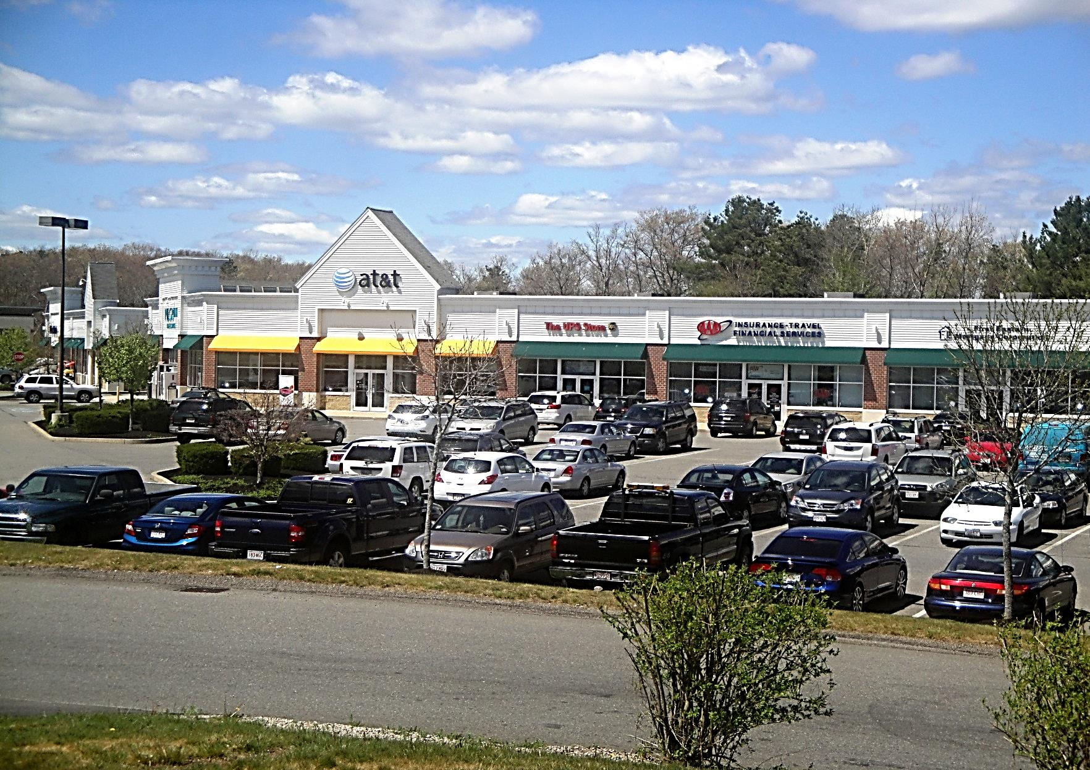
Changes in Occupancy
Notes:
Change in Occupancy

Slide 54
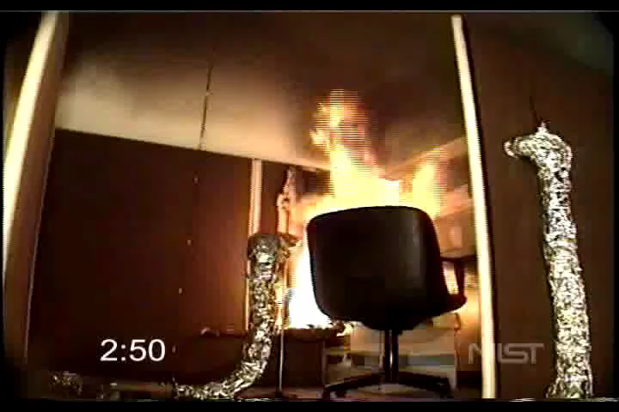
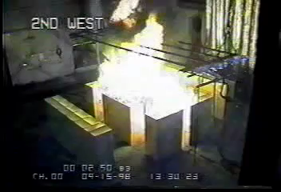
Light Hazard
Changes in Hazard
Ordinary Hazard

Slide 55
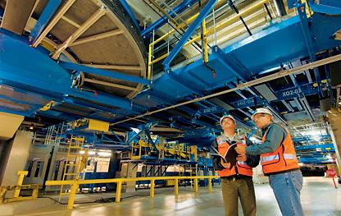
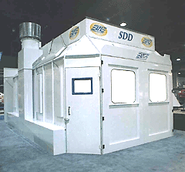
Changes in Process
Added enclosed booth
Courtesy of Parsons.com
Open area
Courtesy of AFC Finishing Systems
Notes:
Change in Process
Baggage Handling system at LAX with protection underneath…
New Paint Spray Booth…Protected????

Slide 56
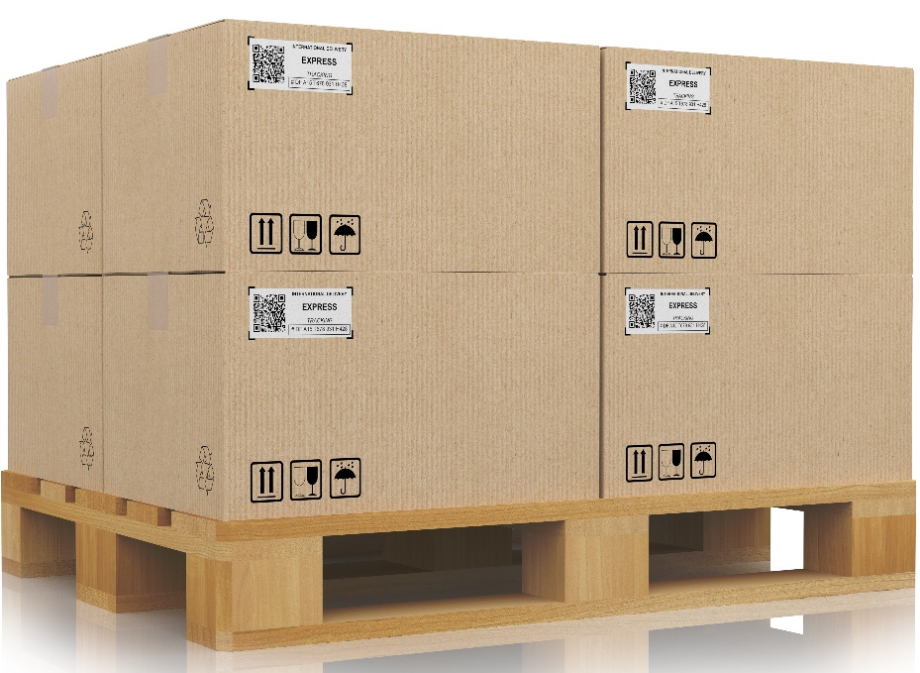

Changes in Storage Commodities
Plastic pallet
Wooden pallet
Notes:
Change in Storage configuration from piles to rack storage

Slide 57

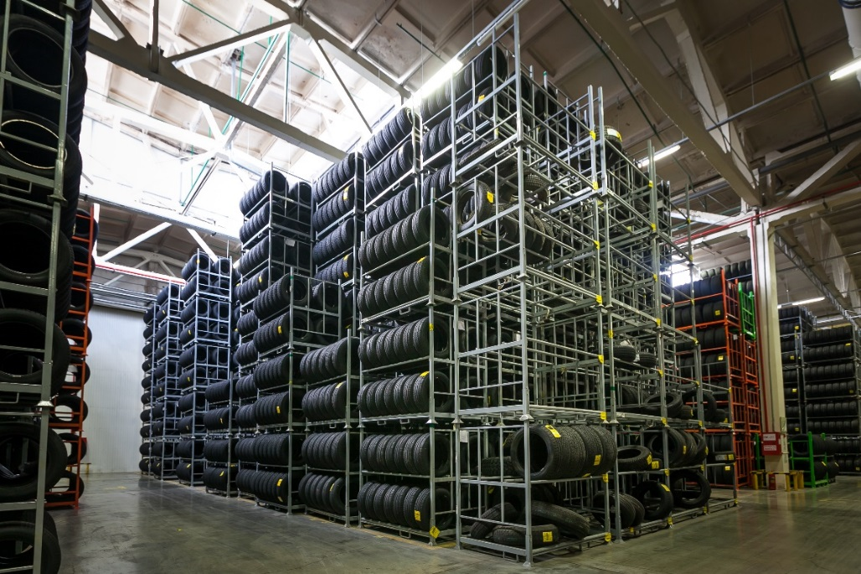
Changes in Storage Method
On tread on rack
On side on pallet

Slide 58
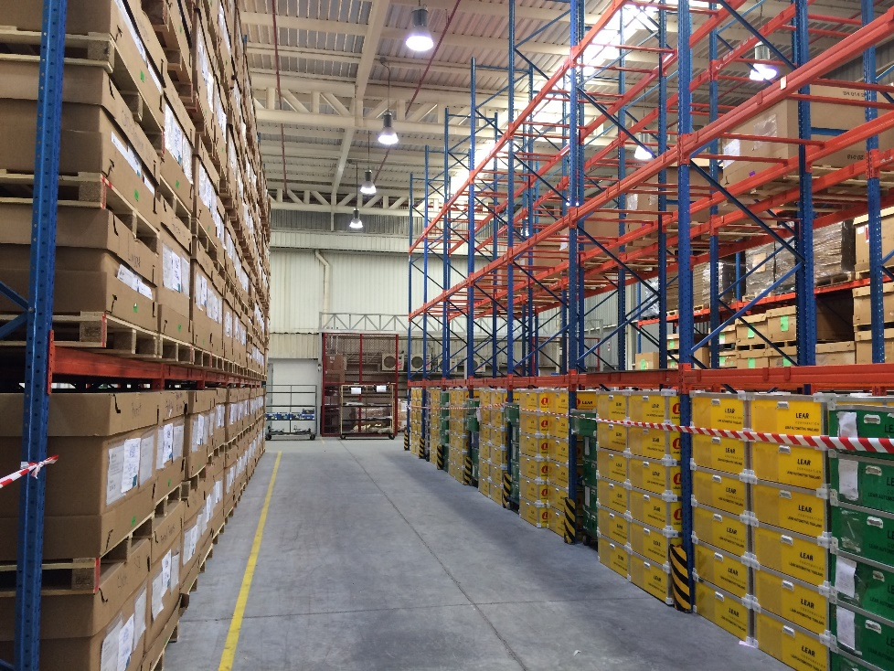
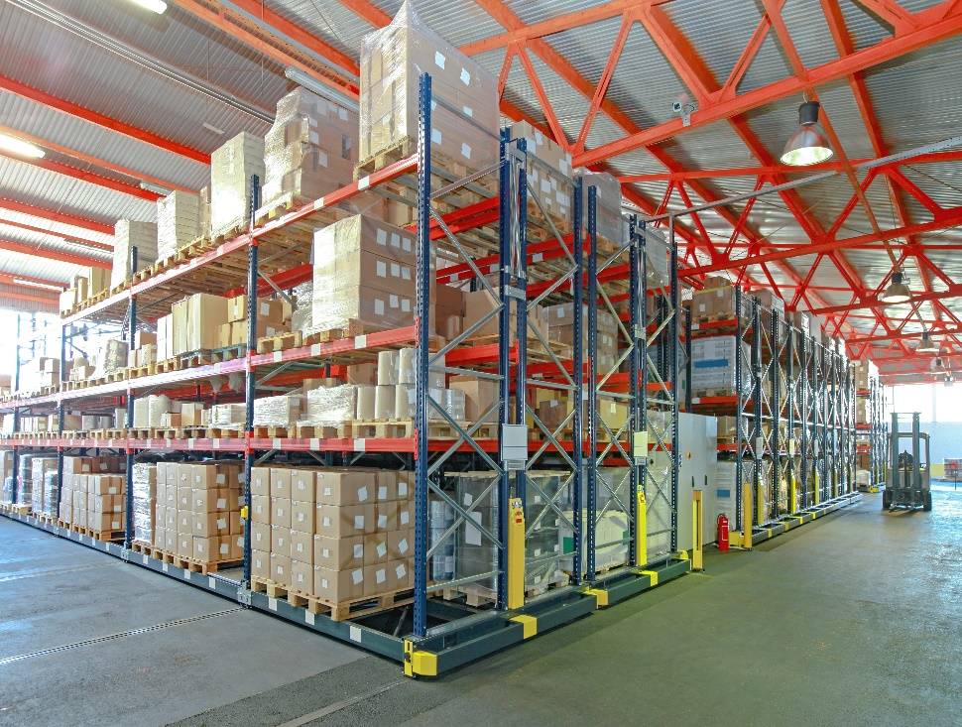
Changes in Storage Method
Multi row racks
Double row racks

Slide 59

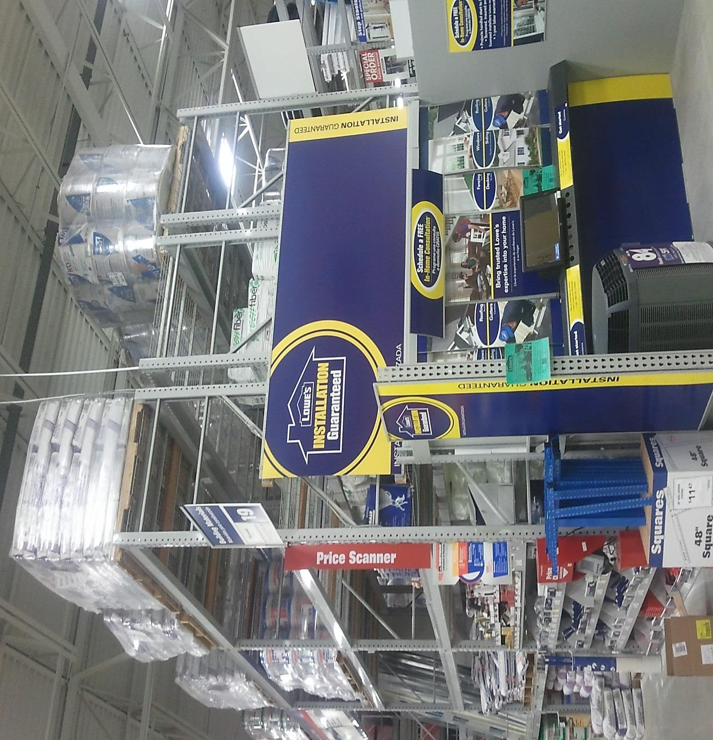
Changes in Height

Slide 60
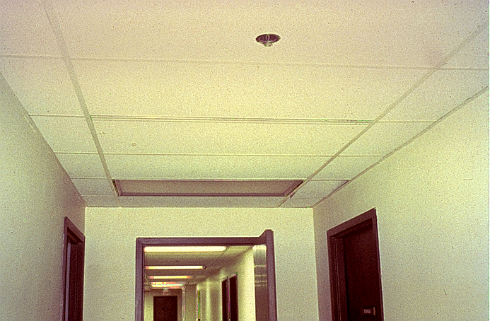
Owner Responsibility
(new cross corridor wall)
Notes:
Various examples that would come under Section 4.1, particularly 4.1.6-4.1.7.
This is a photo of a cross corridor wall that was installed after the building was complete. This wall has created a problem for sprinkler spacing away from a wall. The next sprinkler is actually just on the other side of the doorway. Count the tiles and this sprinklers is approximately 11 feet from the wall. This needs to be evaluated.

Slide 61
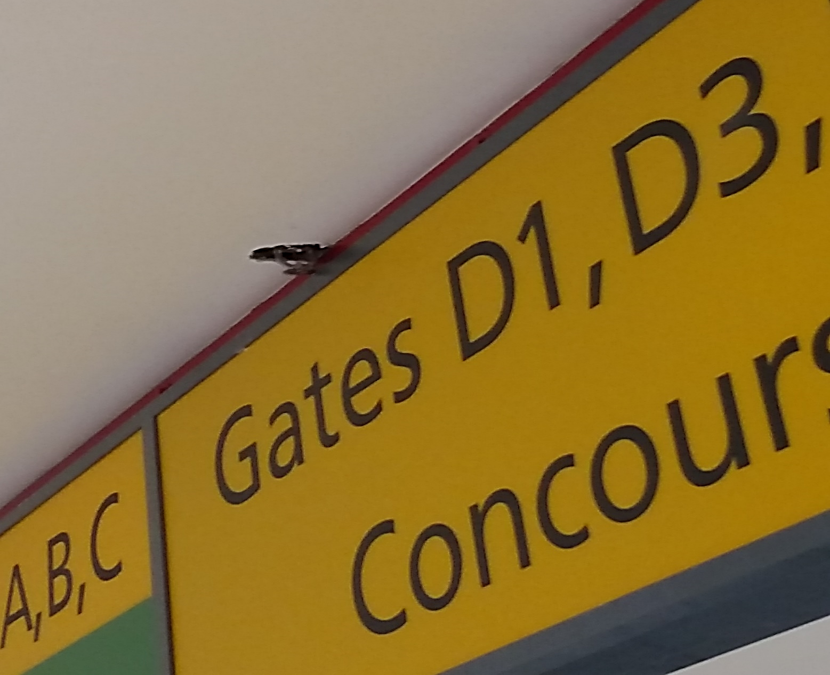
Building Revisions
Notes:
Section 5.2.1.2 deals with the minimum clearance required from sprinklers. However, as clarified specifically in section A.5.2.1.2, this clearance only applies to the 18” or 36” below the deflector. It does not apply to the beam rule, soffit rule or three times rule. These are design issues and are not expected to be enforced during a routine inspection. While it is information we would report to the owner and recommend someone make an engineering judgment, it is outside the scope of NFPA 25.

Slide 62
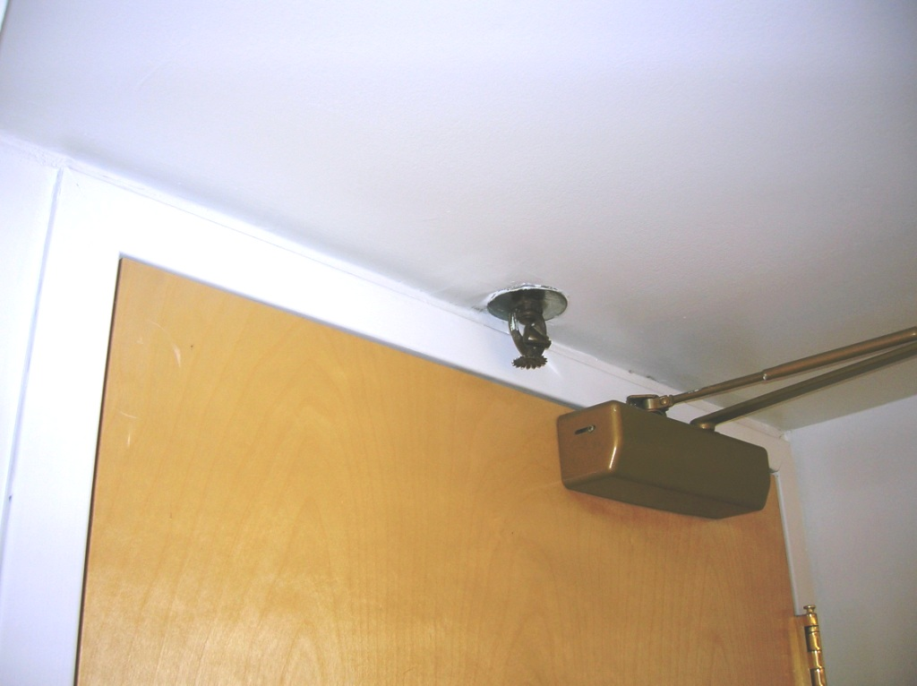
Owner Responsibilities retrofit of a new door
Notes:
Various examples that would come under Section 4.1, particularly 4.1.6-4.1.7. Retrofit of a door has produced a spacing problem and a potential damage hazard for the sprinkler.

Slide 63
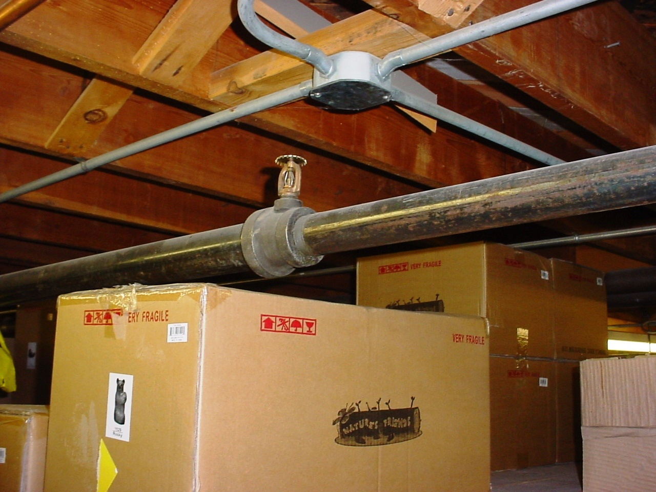
Storage new storage added to existing storage
Notes:
Various examples that would come under Section 4.1, particularly 4.1.6-4.1.7. This is actually a violation of 5.2.1.2 and could be cited by a contractor.
New storage added to existing piles of storage

Slide 64
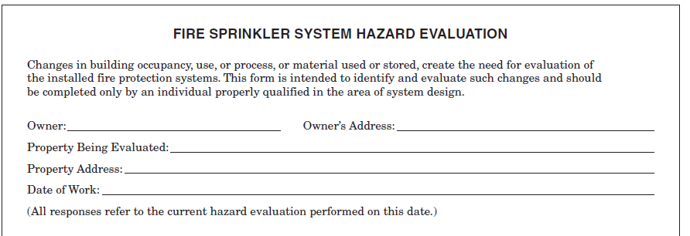
Changes in Hazard
Notes:
Annex E This was put into the standard to afford the owners a guide to evaluating a system when there has been a change in related to 4.1.7
4.1.7* Addressing Changes in Hazard.
A.4.1.7 See Annex E for an example of a hazard evaluation form. A hazard evaluation is not part of a system inspection.
4.1.7.1 Where changes in the occupancy, hazard, water supply, storage commodity, storage arrangement, building modification, or other condition that affects the installation criteria of the system are identified, the property owner or designated representative shall promptly take steps to evaluate the adequacy of the installed system in order to protect the building or hazard in question.
4.1.7.2 Where the evaluation reveals that the installed system is inadequate to protect the building or hazard in question, the property owner or designated representative shall make the required corrections.
4.1.7.3 Corrections shall be approved.
The material in this section has been revised to clarify for the parties involved in the evaluation of the adequacy of the system(s) when changes in the hazard are identified. The owner is not required to have the AHJ as part of the evaluation, but where a system is determined to be inadequate, the corrections must be acceptable to the AHJ. Annex F includes a sample evaluation form. It is critical that whoever conducts the evaluation is qualified to do so.

Slide 65
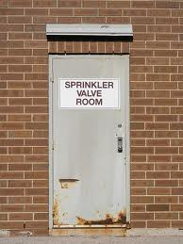

Valve Location
Notes:
4.1.8

Slide 66
Information Sign
A permanently marked metal or rigid plastic information sign shall be placed at the system control riser supplying an anti freeze loop, dry system, preaction system, or auxiliary system control valve.
Shall be secured with corrosion resistant wire, chain or other approved means & shall contain the following info:
  Location of area served by the system
  Location of aux & low point drains for dry and/or preaction systems
  Presence and location of any heat tape
Notes:
4.1.9

Slide 67
Anti-freeze Sign
Must show
  Manufacturer type & brand of
  the solution
  Concentration by volume
  Volume of the solution
Posted on anti-freeze system
main valve
Notes:
This is one of the few “new” requirements. Section 4.1.10 (in the owners requirements) now requires a sign to be at the main control valve for the antifreeze system listing details about the system.

Slide 68
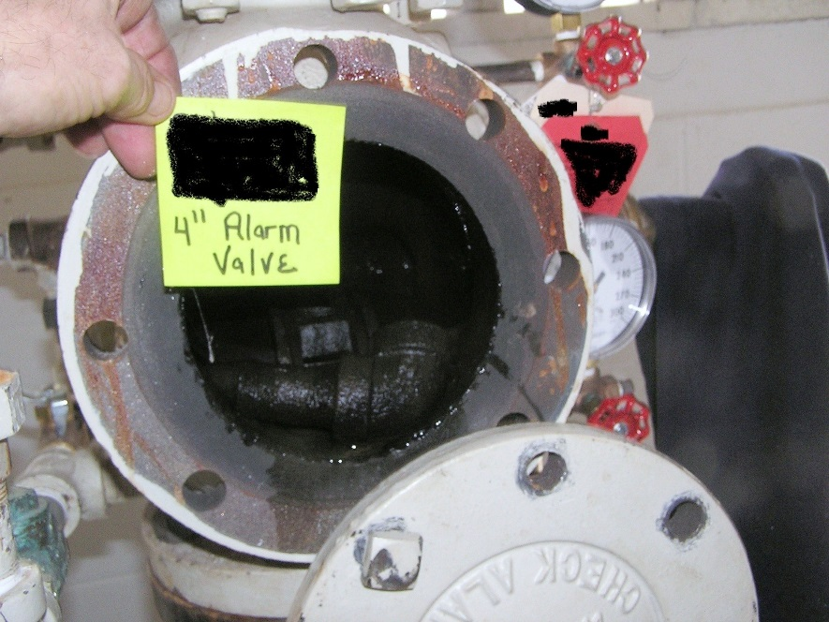
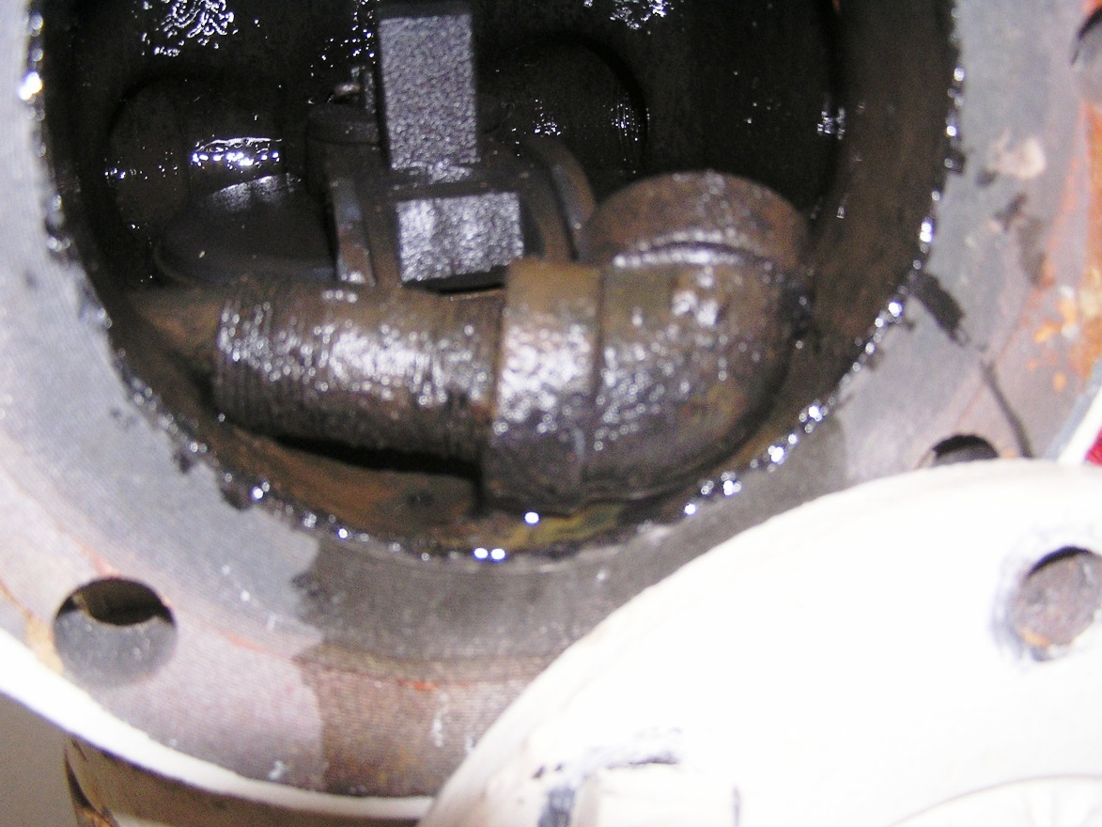
Impairments
Notes:
This slide builds. It shows a 4” alarm valve, then the closer view shows it obstructed by a pipe elbow. Found during a 5 year internal assessment of an alarm check valve.
4.1.11 See 4.4 when a temporary shutdown does not necessarily have to be treated as an impairment

Slide 69
Manufacturer’s Corrective Action
Manufacturers shall be permitted to make modifications to their own listed product in the field with listed devices that restore the original performance as intended by the listing, where acceptable to the authority having jurisdiction.
Notes:
4.2

Slide 70
Records
Inspections, Tests, Maintenance
Made available to AHJ upon request
Maintained by Property Owner
Original Acceptance Test Records
ITM Records
Notes:
4.3 Records
4.3.1* Records shall be made for all inspections, tests, and maintenance of the system and its components and shall be made available to the authority having jurisdiction upon request.
A.4.3.1 Inspection reports used for system inspections should contain an “Owner’s Section” as shown in Figure A.4.3.1 that the property owner or designated representative shall complete.
Typical records include, but are not limited to, valve inspections; flow, drain, and pump tests; and trip tests of dry pipe, deluge, and preaction valves.
Computer programs that file inspection and test results should provide a means of comparing current and past results and should indicate the need for corrective maintenance or further testing.
Acceptance test records should be retained for the life of the system or its special components. Subsequent test records should be retained for a period of 1 year after the next test. The comparison determines deterioration of system performance or condition and the need for further testing or maintenance.
4.3.2 The list of what records shall indicate.
Any form, whether produced commercially or developed independently, can be used to document inspection, testing, and maintenance activities, provided it details the activity sufficiently to verify compliance with NFPA 25.
4.3.3* Records shall be maintained by the property owner.
4.3.4 As-built system installation drawings, hydraulic calculations, original acceptance test records, and device manufacturer’s data sheets shall be retained for the life of the system.
4.3.5 Subsequent records shall be retained for a period of 1 year after the next inspection, test, or maintenance of that type required by the standard.
Compliance with 4.3.5 results in maintaining records for at least 1 year following each successive inspection, testing, or maintenance activity. This requirement for records retention is intended to provide evidence of trending. For example, a main drain test performed on an annual basis should result in a total of three test reports: the original test, results for the current year, and results from the prior year. The record for 2 years ago could be discarded at this time. With this information, fluctuations in the test results are shown and used for evaluating the operational condition of the system.

Slide 71
Records
Procedure or activity performed
Organization that performed the activity
Required frequency of the activity
Results and Date of the activity
Name & contact information of the qualified contractor or owner, including the lead person for the activity
Notes:
4.3.2

Slide 72
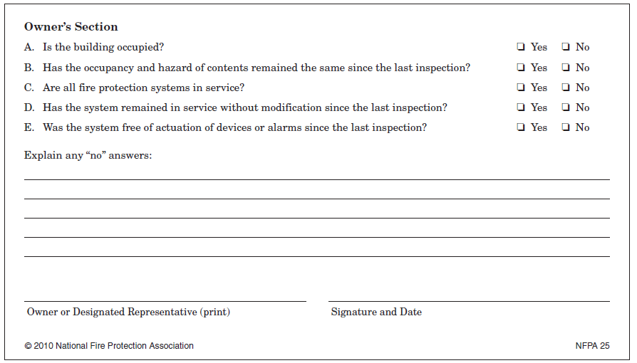
Records
Notes:
While the annex recommends that an owner’s section be included in the inspectional report, there is a lot of debate about that. For example, if you ask questions of the owner, what are you going to do with the answers? For example, what if the owner tells you he/she changed their occupancy or building,. While that is covered in section 4.1 of NFPA 25, it is outside of your scope. Have you incurred liability now that you have knowledge of a condition and did nothing with it.

Slide 73
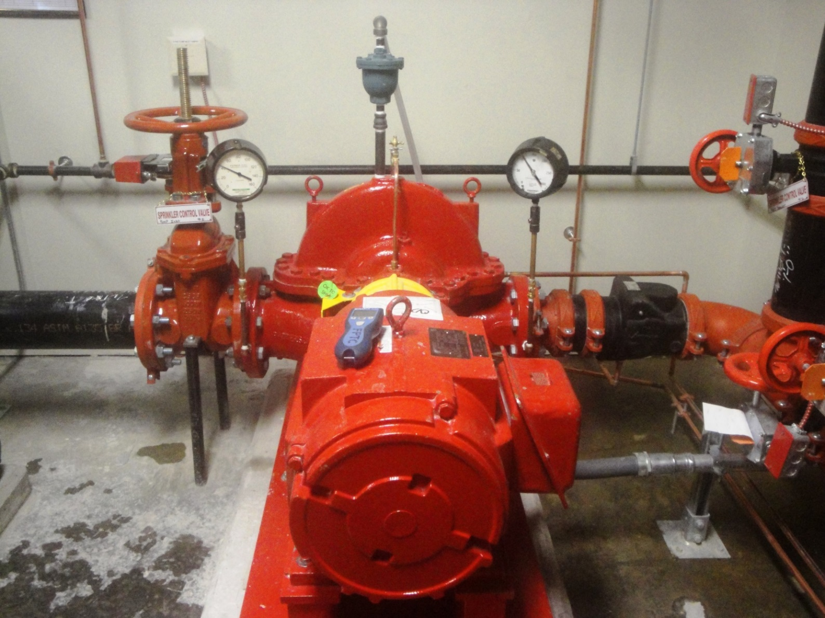
Water Supply Status
Notes:
4.4

Slide 74
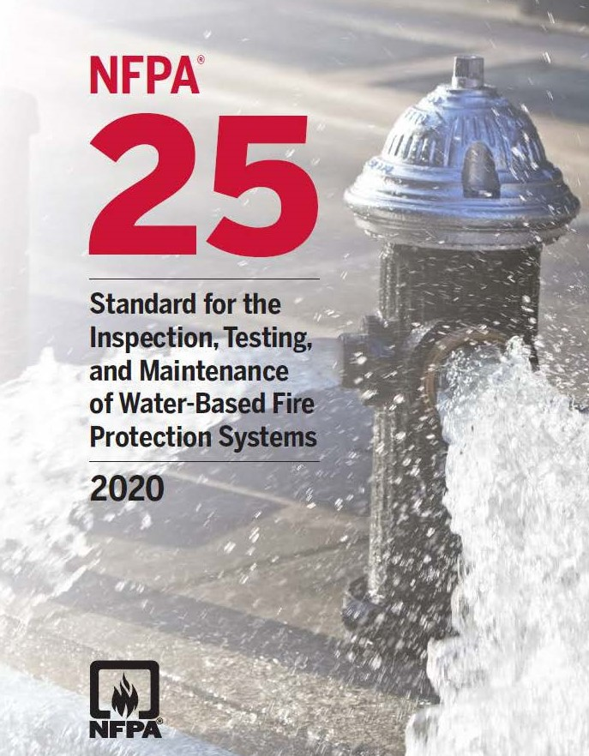
Inspection
Notes:
4.5* Inspection System components shall be inspected at intervals specified in the appropriate chapters.
A.4.5 Inspection and periodic testing determine what, if any, maintenance actions are required to maintain the operability of a water-based fire protection system. The standard establishes minimum inspection/testing frequencies, responsibilities, test routines, and reporting procedures but does not define precise limits of anomalies where maintenance actions are required.
Substandard conditions, such as a closed valve, subnormal water pressure, loss of building heat or power, or obstruction of sprinklers, nozzles, detectors, or hose stations, can delay or prevent system actuation and impede manual fire-fighting operations.

Slide 75
Testing
Notes:
4.6 Testing
4.6.1 All components and systems shall be tested to verify that they function as intended.
4.6.2 The frequency of tests shall be in accordance with this standard.

Slide 76
Automated Inspection & Testing
Separate rules for
  Automated inspection
  Automated testing
Notes:
4.6.6* Automated Testing. This section is all new in 2017 and lays out the requirements for automated inspection & testing
A.4.6.6 Some devices, such as waterflow alarm devices can be tested automatically. Some things to consider include the following:
Not all tests required by NFPA are suitable for automatic testing
Periodic visual inspection, including the use of video, should be performed

Slide 77

Automated Inspection
Automated inspections (i.e. cameras, transducers, temperature sensors, etc) permitted as long as:
  equipment used meets the intent of a required visual inspection
  Failure of automated
  eqpt shall result in a
  trouble signal in
  accordance with
  NFPA 72
  A record of all tests
  & inspections shall
  be maintained in
  accordance with 4.3.2
Courtesy of Wikipedia
Notes:
4.6.6.2, 4.6.6.9, 4.6.6.13

Slide 78
Automated Testing
Automated testing permitted if:
  Equipment produces the same action required by the standard to test a device
  Must discharge water where required by the standard
    May circulate water instead but must discharge visually at least every 3 years
  Where required, personnel shall observe & intervene if necessary
  Automated testing devices & eqpt must be listed for the purpose of the test being conducted
Notes:
4.6.6.3, 4.6.6.4, 4.6.6.4.1, 4.6.6.5, 4.6.6.6

Slide 79
Automated Testing cont
Automated testing permitted if:
  Failure of eqpt must not impair the operation of the system unless indicated by a supervisory signal in accordance with NFPA 72
    Any failure of eqpt. must send a trouble signal in accordance with NFPA 72
  Failure of any component to pass shall result in an audible supervisory signal
  Failure of a component or system creating an impairment shall require impairment procedures to be followed
  Frequencies shall be maintained
  A record of all tests & inspections shall be maintained in accordance with 4.3.2
Notes:
4.6.6.8, 4.6.6.10, 4.6.6.9, 4.6.6.11, 4.6.6.12, 4.6.6.13

Slide 80
Performance Based Compliance Programs Permitted
Must have clearly identifiable goals & how the program meets those goals
Compliance with an approved program shall be deemed to comply with the standard
Goals & goal achievement shall be reviewed at least every 3 years & ITM frequencies adjusted to reflect current conditions & historical record
Historical records shall be made available to the AHJ
Notes:
4.7 This all new in 2017.
4.7.1, 4.7.2, 4.7.3, 4.7.4

Slide 81
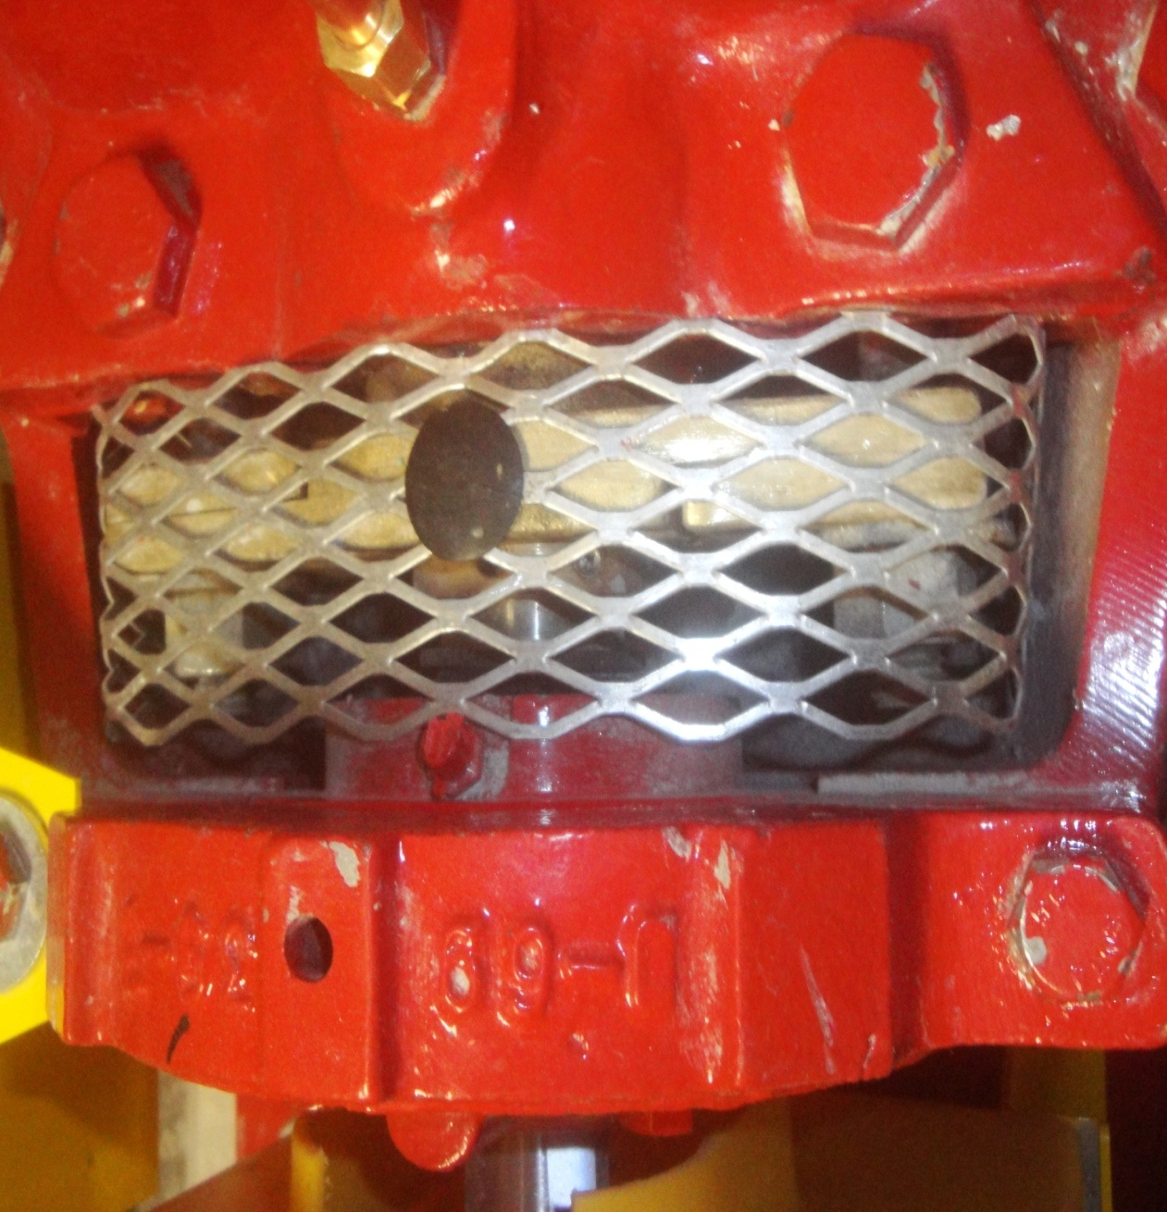
Maintenance
Performed to keep the system equipment operable
Notes:
This is a picture of the drip tray of a fire pump for catching water from the packing glands
4.8* Maintenance. Maintenance shall be performed to keep the system equipment operable

Slide 82
Safety
Generally follows existing laws & regulations
  General safety regs
  Site specific regulations
  Falls
Confined spaces
Hazards and/or hazardous materials
Electrical
Notes:
4.9.2 Confined Spaces. Legally required precautions shall be taken prior to entering confined spaces such as tanks, valve pits, or trenches.
4.9.3 Fall Protection. Legally required equipment shall be worn or used to prevent injury from falls to personnel.
Fall protection can include wearing safety harnesses, as well as the proper use of ladders, staging, and powered lifts. The inspector should be familiar with any regulations in effect governing this type of equipment.
4.9.4 Hazards. Precautions shall be taken to address any hazards, such as protection against drowning where working on the top of a filled embankment or a supported, rubberized fabric tank, or over open water or other liquids.
4.9.5* Hazardous Materials.
A.4.9.5 Most places using or storing hazardous materials have stations set up for employees where material safety data sheets (MSDSs) are stored. The inspector should be familiar with the types of materials present and the appropriate actions to take in an emergency.
4.9.5.1 Legally required equipment shall be used where working in an environment with hazardous materials present.
4.9.5.2 The property owner or designated representative shall advise anyone performing inspection, testing, and maintenance on any system under the scope of this document, with regard to hazardous materials stored on the premises.

Slide 83
Module 4
Use of Tables for Inspection, Testing & Maintenance Schedules

Slide 84
Use of ITM Tables
Every operational chapter except chapter 12 (water mist systems) has a frequency Table for Inspection, Testing & Maintenance
These tables may be used as a quick guide to find appropriate sections as to when various functions are performed
Tables are limited in that they may not cover every circumstance, so the actual section referenced should be investigated
Notes:
We can stress that the most important use of the tables is to quickly find a referenced section that tells when things have to be performed. It is an easy method of finding the appropriate rule addressing that particular issue.
We should stress, however, that the Tables should be used only as a reference and not as a definitive rule. In many cases, the tables are not all inclusive of every circumstance. For example, Table 5.1.1.2 for sprinkler systems says nothing about sprinklers manufactured prior to 1920, but we would find that rule among the other referenced sections from the Table.

Slide 85
Table 5.1.1.2 Summary of Sprinkler System Inspection, Testing & Maintenance (excerpt)
Item | Frequency | Reference
Inspection
Control Valves |  | Chapter 13
Hydraulic nameplate | Annually | 5.2.5
Testing
Sprinklers- dry | At 15 yrs & every 10 yrs thereafter | 5.3.1.1.1.6
Gauges | 5 years | Chapter 13
Maintenance
Notes:
This only an excerpt from one of the Tables to illustrate how the Tables are read, and how to find appropriate sections. We can mention the fact that Tables also have a maintenance section. I did not expand on it here due to space.
We can also note that the table in Chapter 5 also contains a section labeled Investigation with the sub heading of Obstruction. The Table references Chapter 14, which actually deals with obstruction investigation and will be discussed later in this presentation.

Slide 86
Antifreeze Systems
Section 5.3.4
Annual Testing
Use & Type
Limitations
Concentrations
Grandfathering Existing Systems (only until 2022)
Notes:
5.3. I just put these in here as a guide since anti freeze is a continuing problem. Section 5.3.3 can be a bit confusing so this provides a sort of Cliff’s notes.

Slide 87
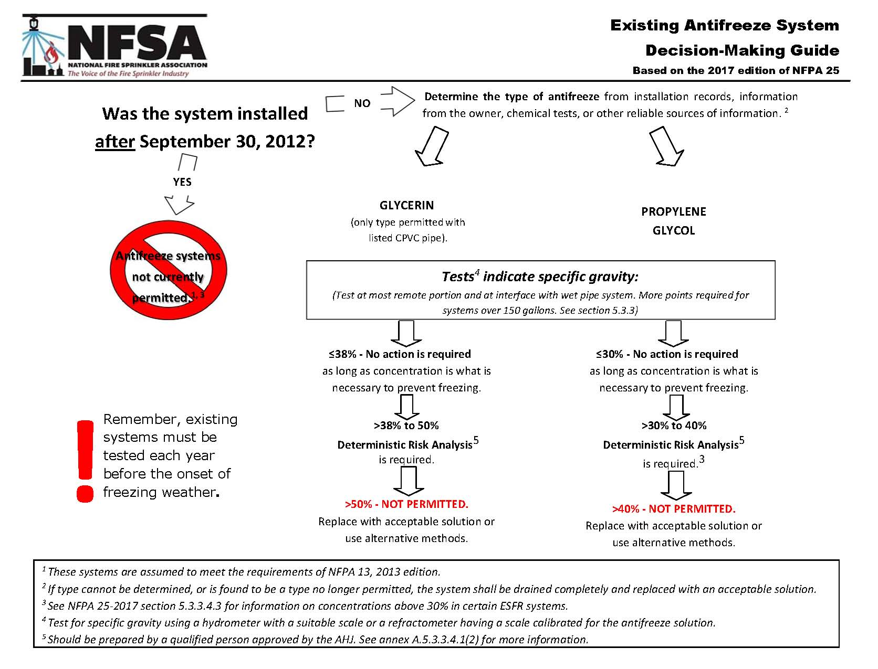
Antifreeze Guide

Slide 88
Use of Table A.3.3.7
Every operational chapter except chapter 12 (water mist systems) has a reference Table for violations of NFPA 25
These tables may be used as a quick guide to find appropriate sections as to what appropriate section of NFPA 25 applies to a specific condition
Tables are limited in that they may not cover every circumstance, so the actual section referenced, in addition to other possible sections, should be investigated
Notes:
We can stress that the most important use of the tables is to quickly find a referenced section that tells when things have to be performed. It is en easy method of finding the appropriate rule addressing that particular issue.
We should stress, however, that the Tables should be used only as a reference and not as a definitive rule. In many cases, the tables are not all inclusive of every circumstance. For example, Table 5.1.1.2 for sprinkler systems says nothing about sprinklers manufactured prior to 1920, but we would find that rule among the other referenced sections from the Table.

Slide 89
Use of Table A.3.3.7
Not a part of the requirements
Included for informational purposes only.
Notes:
Table A.3.3.7 is an example of classifications (e.g., impairment, critical deficiency, or noncritical
deficiency) of some of the needed corrections and repairs that are identified during the inspection,
testing, and maintenance of some systems. This table is not all-inclusive but is included
in this annex to provide some guidance in responding to needed corrections and repairs. The
table does not take into account the nature of the hazard or the life safety exposure of the
occupancy and should be used with good judgment.
In previous editions of NFPA 25, the inspection, testing, and maintenance requirements were
presented as pass/fail requirements, because no other options for identifying system status
were presented in the standard. In other words, the standard considered problems with a system
only in the context of passing or failing a requirement within the standard. In the 2008
edition, tables were added to each chapter to provide guidance on component replacement
action, but the standard still did not address when or if a certain violation of a requirement
within the standard would result in the system being impaired. As a result, some authorities
having jurisdiction (AHJs) treated any and all deficiencies as “impairments” and applied
the requirements of Chapter 15, Impairments. For example, some AHJs considered a system
“impaired” when minor problems were noted, such as a missing hydraulic nameplate or a
missing sprinkler in the spare sprinkler cabinet.
Guidance was needed in determining which deficiency would result in what level of operational
system status tagging, to reach consistency of interpretation and enforcement.
The solution was to develop sufficient guidance within the standard to clarify which deficiencies
result in systems that need to be fixed but are otherwise anticipated to function properly
in an emergency, and which deficiencies affect system operation or even rise to the level
of an impairment.
As a result, in the 2011 edition of NFPA 25, the definition of the term deficiency was
revised and two new definitions were added — critical deficiency and noncritical deficiency
— with the intent of providing clearer guidance for inspectors and AHJs in determining the
severity of violations and the subsequent corrective actions that are necessary. Annex E, Table
E.1 was developed to provide examples of classifications of some of the needed corrections
and repairs that are identified in the system chapters of NFPA 25. While Table E.1 is not all-inclusive,
it can help users determine the potential categories of deficiencies. These categories
are strictly advisory, but should add some degree of consistency in interpreting when a system
should be tagged as deficient or as impaired.

Slide 90
Table A.3.3.7
Item |  | Finding | Reference | Impairment | Critical Deficiency | Non Critical Deficiency
Chapter 8: Fire Pumps- Inspection
Pump house/room |  | Heat < 40⁰ | 8.2.2(1) | X
Chapter 8- Fire Pumps- Testing
Fire Pump test | Fire pump did not start automatically | Fire pump did not start automatically | 8.3.2.2, | X
Notes:
This is just an example of how to read the table in Annex E. we can explain that it is a great short cut to find specific references for things that are within the scope of NFPA 25. We can stress the fact that just because we may not find them in Annex E, that does not mean that they are not within the scope of NFPA 25. Like all Tables, this may not cover every possible circumstance, so we should always go to the referenced section to investigate. In some circumstances we may also find that other sections apply separate from what may or may not have been listed in Annex E.
For example, the section of Annex E dealing with Chapter 5- Sprinkler systems says nothing about recalled sprinklers, but they are referenced in section 4.1.4 (actually in A,4,1,4). We will see some other examples as we work through several exercises.
It is also extremely important to note that the disposition according to Annex E (impairment, critical or non critical deficiency, is completely subjective. It is intended as a guide only, and not as a definitive decision. This is completely explained in paragraph E.1 of Annex E. For example, the Table reference for chapter 5 indicates that a leaking pipe or fitting is an impairment. There are many who may disagree with this assessment dependent upon the amount of leakage, the location of the pipe or fitting, and other possible considerations.

Slide 91
Table 6.5.1 Summary of Component Replacement Action Requirements
Component | Adjust | Repair | Replace | Required Action
Water Delivery Component
Fire dept. Connection | X | X | X | See Chapter 13
Testing & Maintenance Components
Main Drain | X | X | X | Inspect for Leaks & residual pressure during main drain test
Notes:
This is just an excerpt from the component replacement action table from chapter 6 on standpipes. It is simply to use as an illustration as to how to read the Tables.

Slide 92
Which Table to Use
What question are we asking?
  How often are we required to do something
    The ITM Tables
  Is the circumstance we have encountered within the scope of NFPA 25
    Table A.3.3.7
  What actions are required in order to restore a system to service
    The Component Replacement Action Tables
Notes:
Depending on what we are specifically trying to determine, that will lead us to the appropriate Table. Again, it is imperative to explain that the tables are only guides, or “cliff’s notes” that can get us to a particular place in the standard quickly. They are not the end all be all for all circumstances and should not be treated as such.

Slide 93
Module 5
Internal Assessment
&
Obstruction Investigation
Notes:
Chapter 14 of NFPA 25 ensures continued operability of water-based fire protection systems by addressing the interior condition of the piping system. Metal piping systems can lose structural integrity due to corrosion and can potentially become obstructed due to corrosion by-products such as pipe scale. The periodic internal inspections of the piping system are intended to address this issue. Piping systems of any type can become inoperative when the pipe is filled with obstructing material. Sprinkler systems are no exception. Any maintenance program must include means for revealing potential obstructions and removing any obstructions that exist. Obstructions are addressed in this chapter by the list outlined in 14.3.1, which identifies potential causes of piping obstructions, and by requiring an obstruction investigation when any of those situations exist.
Because of the structure of Chapter 14 in previous editions of NFPA 25, there was considerable debate and misinterpretation regarding the activities that are required at 5-year intervals. The cause of the debate was that two different activities, inspection of piping and obstruction investigation (14.2.1 and 14.3 in the 2011 edition), were both detailed in the same section in the previous editions under the title, “Obstruction Investigation and Prevention.”
In the 2011 edition of NFPA 25, the two activities have been separated into specific sections to clarify that internal inspection of piping is required at 5-year intervals, while obstruction investigations are required only when one of the 14 triggers listed in 14.3.1 occur.
We should note that the 2011 edition of NFPA 25 went a good bit further in clarifying that the internal piping inspection is something completely different from an obstruction investigation. We will point out the differences and the requirements for each in this module.

Slide 94
Chapter 14
Assessment of Internal Piping Condition
Obstruction Investigation and Prevention
Ice Obstruction

Slide 95
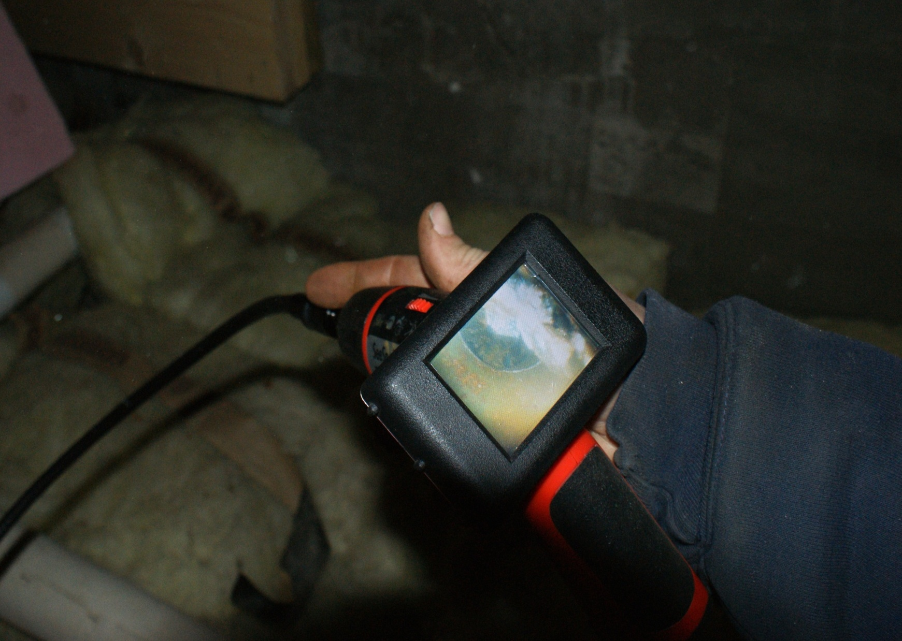
Assessment of Internal Condition
Every 5 years
  Or Established by Risk Analysis
Check for Foreign Organic or Inorganic Material
  Various options for assessing internal conditions
    See annex for recommendations
  A sufficient amount of “stuff” triggers
  an obstruction investigation
Allowance for nonmetallic pipe
Notes:
14.2. See A.14.2.1 for options on assessing internal conditions.
14.2.1.5

Slide 96
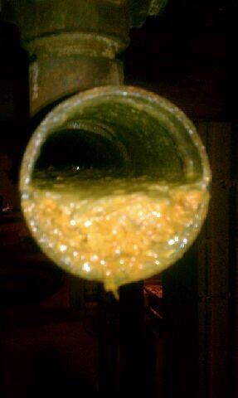
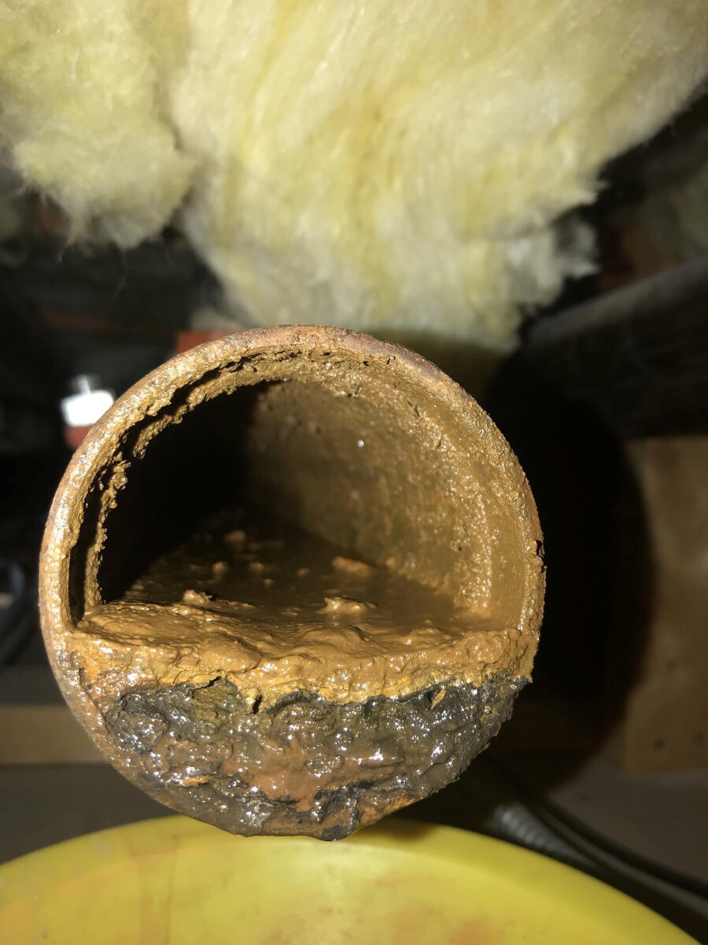
Sufficient Cause
Courtesy of
David Walencewicz PE
Owner P&J Sprinkler Co. in CT.
Notes:
14.2.1.4* If the presence of sufficient (SEE D.3.2 FOR GUIDANCE ON SUFFICIENT) foreign organic or inorganic material is found to obstruct pipe or sprinklers, an obstruction investigation shall be conducted as described in Section 14.3.
A.14.2.1.4 Most piping systems may contain some foreign material or other evidence of corrosion but not sufficient to trigger an obstruction investigation. Furthermore, an internal inspection is primarily an inspection for determining corrosion of the pipe, but it may result in finding the presence of material that would be an obstruction to piping or sprinklers. If such is found an obstruction investigation in Section 14.3 would be required.

Slide 97
Multiple Wet Pipe Systems
Alternate systems
Materials found require all systems inspected internally
What is a system?
Notes:
14.2.2* In buildings having multiple wet pipe systems, every other system shall have an internal assessment of piping every 5 years as described in 14.2.1.
A.14.2.2 In large warehouses, high rise buildings, and other buildings having multiple systems, it is reasonable to perform the internal assessment on half of the systems, and conclude that these are representative of all systems in the building. The systems in the building not assessed during one inspection cycle should be assessed during the next one. As long as there is no evidence of any foreign organic and/or inorganic material found in any of the systems being assessed, every other system would be inspected once every 10 years. However, if foreign organic and/or inorganic material is found in any system in the building during the 5 year assessment cycle, all systems must then be assessed during that frequency cycle.
14.2.2.1 During the next inspection frequency required by 14.2.1.1, the alternate systems not assessed during the previous inspection shall have an internal assessment of piping as described in 14.2.1.
14.2.2.2 If the presence of foreign organic and/or inorganic material is found in any system in a building during the 5 year internal assessment of piping, all systems shall be assessed.

Slide 98
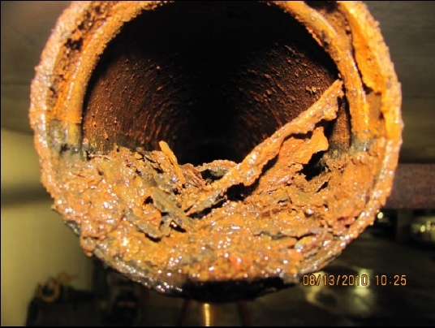
Obstruction Investigation
Notes:
14.3 Obstruction Investigation and Prevention
In the 2011 edition of the standard, the section on obstruction investigation and prevention was renumbered to emphasize that it is a different function from the internal inspection of piping.
Obstruction investigations do not have a specified frequency. Instead, obstruction investigations are warranted as a result of specific events that may occur either within the system itself or within the water supply infrastructure for the system. Section 14.3.1 contains a list of 15 events that would trigger an obstruction investigation.

Slide 99
Obstruction Investigation
Obstruction investigations are based on triggers
There is no predetermined time schedule for obstruction investigations
One obvious trigger is the discovery of a sufficient amount of “stuff” in the piping during a 5 year scheduled internal inspection
Notes:
There is a distinct difference between an internal inspection and an obstruction investigation. While internal inspections are timely, there is no time requirement at all for obstruction investigations. They are based solely on triggers.

Slide 100
Obstruction Investigation
1. Defective fire pump intake for pumps taking suction from open body of water | 9. A record of broken mains in the vicinity
2. Discharge obstructive material during routine water tests | 10. Abnormally false tripping of dry pipe valves
3. Foreign material in fire pumps, dry valves or in check valves | 11. System returned to service after extended shutdown (> 1 year)
4. Foreign material in water during drain tests or plugging inspector’s test connection | 12. Reason to believe a system contains sodium silicate or highly corrosive fluxes in copper pipe systems
5. Unknown materials heard in system piping during draining, refilling or otherwise flowing water through the system | 13. System supplied with raw water via FDC
6. Plugged sprinklers | 14. Pinhole leaks
7. The presence of sufficient organic/non organic material found in the pipe | 15. A 50% increase in the travel time of the water from a dry valve trip to the inspector’s test
8. Failure to flush yard piping or public mains after new installations
Notes:
14.3.1

Slide 101
Obstruction Investigation
Requires an internal inspection of the piping at 4 points
  System valve
  Riser
  Cross main
  Branch line
Non-destructive methods are allowed
Notes:
14.3.2.2 Internal examination shall be performed at the following four points:
(1) System valve
(2) Riser
(3) Cross main
(4) Branch line
The intent of 14.3.2.2 is for each of the main system components to be visually examined. If an obstruction is found in one of these main areas of the system, it would be good practice to open a few other areas of the system to verify that the obstruction is an isolated incident. For branch lines, the intent is to open a representative number of branch lines, rather than open every branch line in the system.
14.3.2.3 Alternative nondestructive examination methods shall be permitted.
14.3.3* If an obstruction investigation indicates the presence of sufficient material to obstruct pipe or sprinklers, a complete flushing program shall be conducted by qualified personnel.
A.14.3.3 For obstruction investigation flushing procedures, see Section D.5.
The flushing procedures outlined in Section D.5 (Annex D) are intended to be carried out
with water. However, in cases where severe MIC has resulted in the obstruction investigation, chemical scouring may be necessary. This process is highly specialized and should be attempted only by those thoroughly experienced in the procedure. Chemicals should not be added to water used for flushing without a determination of the possible effects on sprinkler and valve seats.

Slide 102
Obstruction Investigation
If an obstruction investigation indicates the presence of sufficient material to obstruct piping or sprinklers, a complete flushing program shall be conducted
  Must be done by qualified personnel
If the condition has not been corrected, or if it is such that it could result in obstruction despite prior flushing
  Must be re examined every 5 years
Notes:
Section 14.3.2.1 addresses conditions that could either continue to reoccur or are such that even though we flush the piping to clear any obstructions, conditions continue to exist that could cause a continued build up. If that is our case, then we must go a bit further than the normal 5 year internal inspection, and do it at the minimum 4 points listed in 14.4.3.2.2.

Slide 103
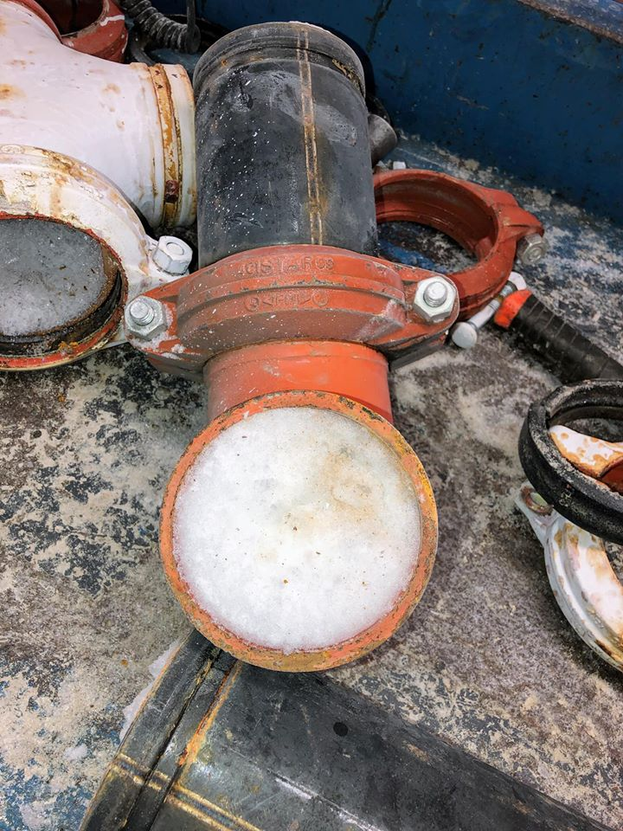
Ice Obstruction
Courtesy of Green Mountain Sprinkler
Notes:
14.4 Ice Obstruction
Dry pipe or preaction sprinkler system piping that protects or passes through freezers or cold storage rooms shall be inspected internally on an annual basis for ice obstructions at the point where the piping enters the refrigerated area.
The inspection described in Section 14.4 should be conducted regularly to ensure that piping is not obstructed with ice and that fittings are not fractured due to ice buildup.
14.4.1 Alternative nondestructive examinations shall be permitted.
The alternative nondestructive examination methods in 14.4.1 include the use of ultrasound,
x-ray, and remote video camera technology.
14.4.2 All penetrations into the cold storage areas shall be inspected and, if an ice obstruction is found, additional pipe shall be examined to ensure no ice blockage exists.

Slide 104
Obstruction Investigation
Special rules for dry and preaction system piping that protects or passes through freezers or cold storage rooms below 32°F (0°C)
  Piping shall be inspected internally every year where it enters the refrigerated area
  Non destructive methods are allowed
  If any blockage exists, additional piping shall be inspected to insure all blockage is removed
Notes:
Section 14.4 addresses specific circumstances where piping passes in to cold areas. The concern is that ice jams could render the entire system impaired. Therefore, the standard requires a scheduled annual inspection to determine the presence of ice jams and to require any ice blockage to be removed.

Slide 105
Module 6
Impairments

Slide 106
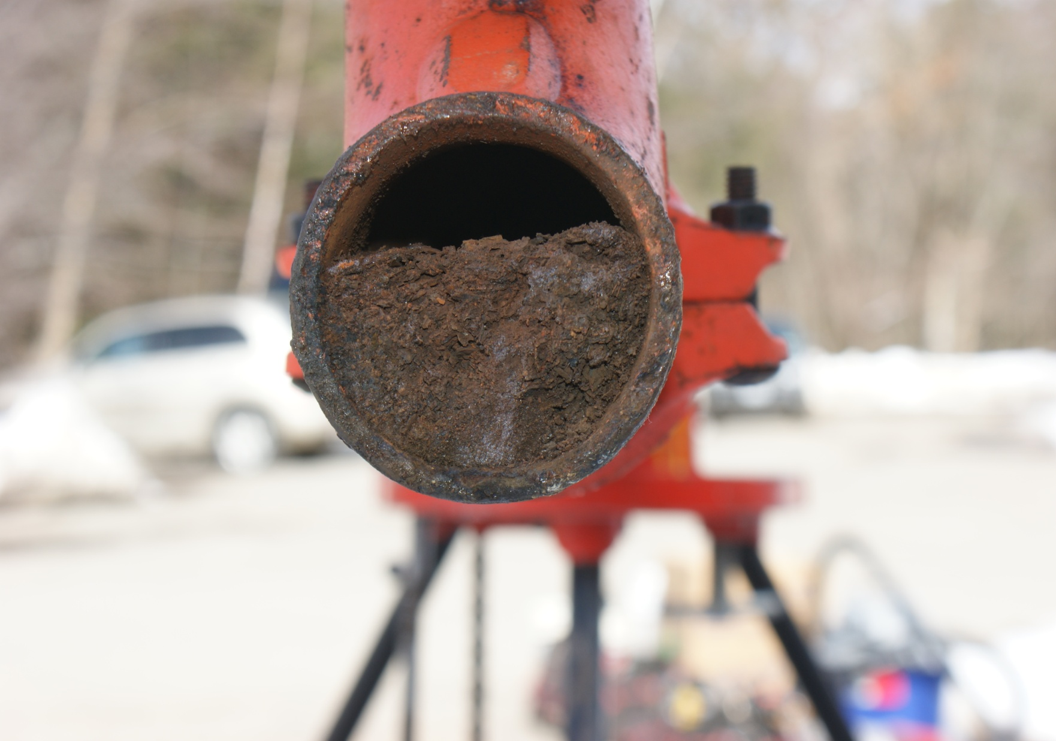
System Impairments

Slide 107
Impairment
Preplanned Impairment
A condition where a water-based fire protection system or a portion thereof is out of service due to work that has been planned in advance, such as revisions to the water supply or sprinkler system piping.
Emergency Impairment
A condition where a water-based fire protection system or portion thereof is out of order due to an unplanned occurrence, or the impairment is found while performing inspection testing or maintenance activities.
Notes:
3.3.21.2 Preplanned Impairment. A condition where a water-based fire protection system or a portion thereof is out of service due to work that has been planned in advance, such as revisions to the water supply or sprinkler system piping.
Any system impairment can lead to the danger of a shut valve. As previously noted an overwhelming majority of system failures can be attributed to shut valves, it was not apparent whether the valve was shut due to maintenance (preplanned or emergency impairment) or from willful or unintentional neglect. Either way, during an impairment, it is essential to ensure that a fire prevention program is in place and that valves are left opened completely after the recommissioning of each system. A programmed approach to monitoring system valves through a lockout/tagout program can ensure that no valve is left completely or partially closed.
3.3.21.1 Emergency Impairment. A condition where a water-based fire protection system or portion thereof is out of order due to an unplanned occurrence, or the impairment is found while performing inspection testing or maintenance activities.
An emergency impairment can be difficult to predict or plan for. However, some precautions can be taken to minimize system “downtime.” These precautions include the presence of spare sprinklers or nozzles, including pilot sprinklers, and repair kits for all valves, including alarm, dry pipe, deluge, preaction valves and backflow prevention devices. In addition, key personnel should be aware of the location and proper operation of control valves to limit damage. A reserve supply of foam concentrate is also essential to the timely recommissioning of a foam-water sprinkler or foam-water spray system.

Slide 108
Chapter 15 - Impairments
Impairment Coordinator
Tag Impairment System
Impaired Equipment (Special precautions for extended length of impairments)
Preplanned Impairments
Emergency Impairments
Restoring System to Service
Notes:
The requirements in Chapter 15 cover all important aspects of a suitable impairment program.
A formal impairment program establishes procedures for maintaining system control valves in their correct position. Furthermore, implementation of an organized impairment program can minimize the length of time that a system is out of service. This chapter provides the basic requirements for such an impairment program. The success of any impairment program is determined by the support it receives from those responsible for implementing it. Often, the best way to ensure that an impairment program is properly set up is to review it with the authority having jurisdiction (AHJ), which can be the fire department, the insurance company, or other officials. If any situations arise that are not covered by the impairment program, it is good practice to seek the advice of the AHJ.
An impairment is the shutdown of a water-based fire protection system or a portion thereof. This chapter deals primarily with preplanned impairments — those impairments in which the system or a portion thereof is out of service due to work, such as modifications to the water supply or sprinkler system piping, that has been planned in advance.
Rarely is a facility more exposed to a potentially catastrophic fire loss than when a fire
protection system or portion of a system is impaired or out of service. Many devastating fires
could have been mitigated had a proper impairment program been in place and adhered to.
Whether an impairment is preplanned or occurs in an emergency situation seems to have little bearing on its tendency to lead to catastrophe.
A major factor leading to large fire losses is failure to do the following:
■ Recognize the exposures created by the impairment
■ Establish a fire watch and provide backup fire protection
■ Control ignition sources and/or shut down hazardous processes
■ Expedite repairs
■ Ensure that fire protection is properly placed back into service

Slide 109
Impairment Coordinator
Property Owner
Designated Representative
Notes:
The impairment coordinator referred to in 15.2.1 is usually someone from the building maintenance department. In larger facilities, this coordinator might be a member of the safety or loss control department.
The impairment coordinator should be someone who is on site and who is thoroughly familiar with the building layout, operations, and systems. In addition, he or she should have the authority and means to initiate proper notification when a system impairment is planned.
This notification should include, but not be limited to, the fire department, insurance carrier, alarm company, property owner, property supervisors, and tenants.
Prior to removing a system from service, the impairment coordinator should ensure that the necessary tools, equipment, and replacement parts are on hand to minimize the duration of the impairment. This typically involves coordination with the contractor or service provider who is scheduled to perform the work that necessitates the shutdown of the system.

Slide 110
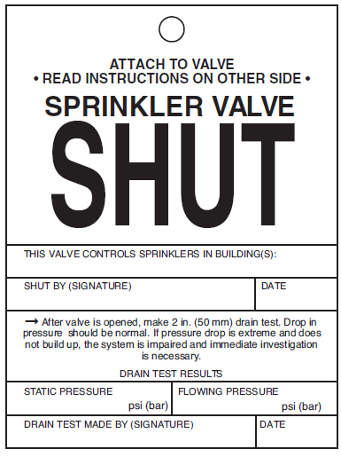
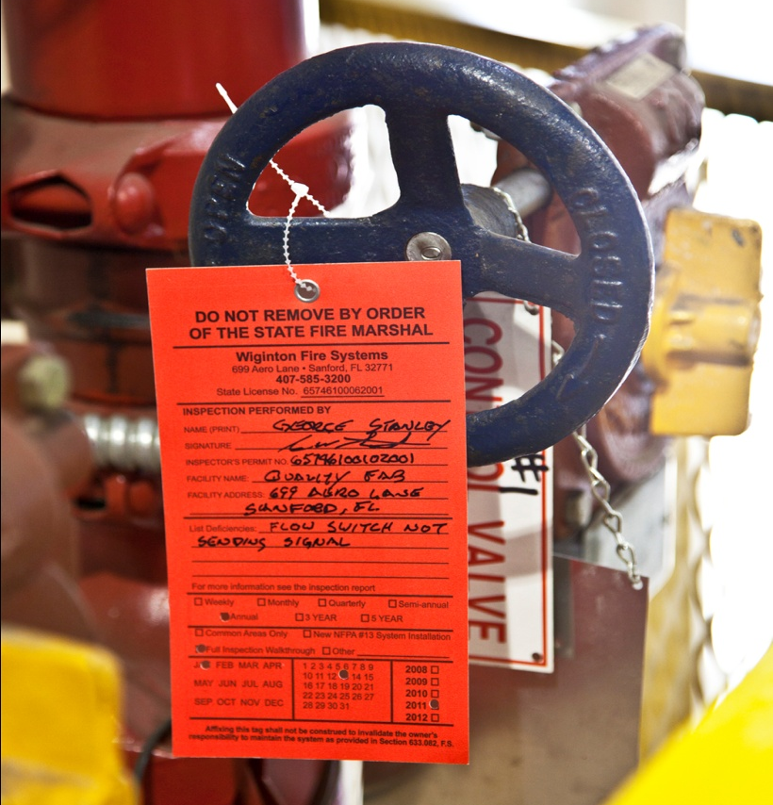
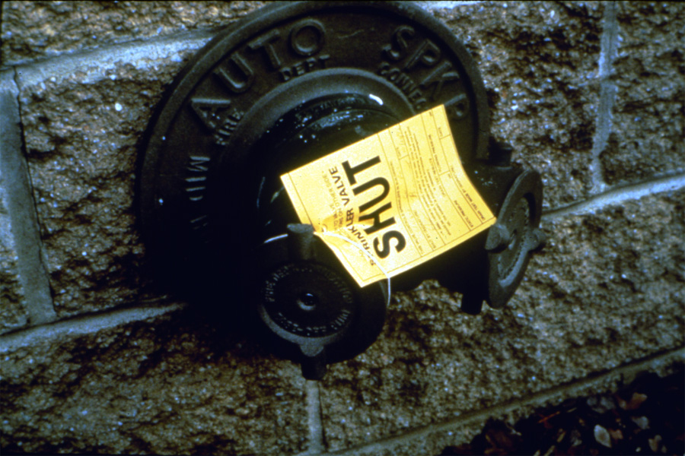
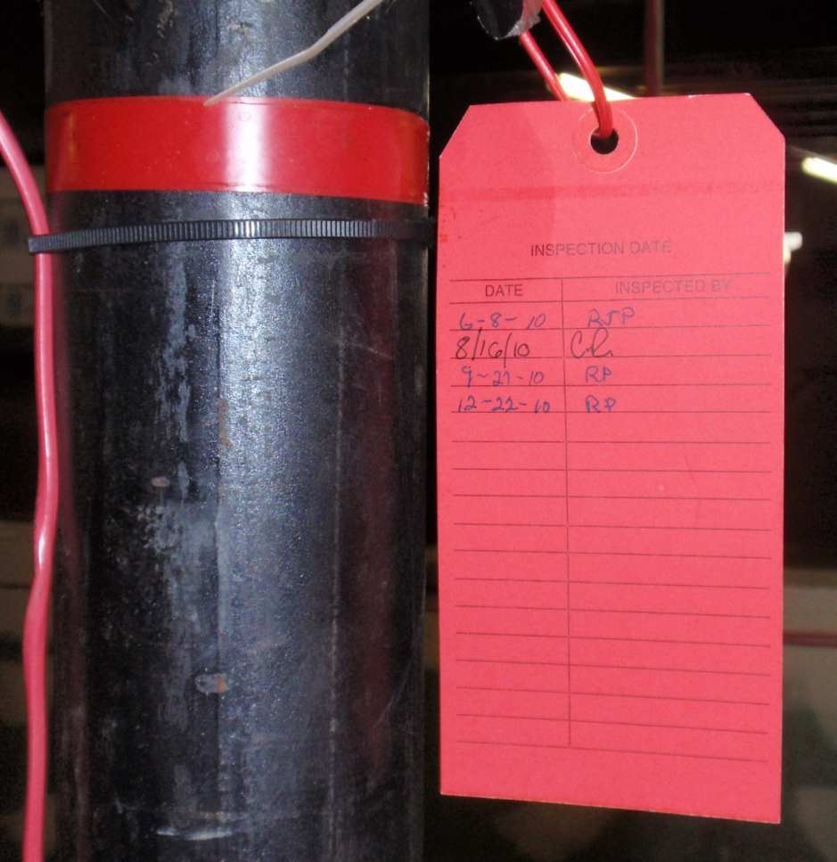
Tag Impairment System
Required
At the system control valve
FDC
Other locations required by AHJ
Notes:
NFPA 25 has no requirements for size, shape, color or wording on impairment tags
Many states have instituted requirements that establish a multilevel identification of the system’s operational status. Operational status tagging is related to, but not entirely the same as, the tag impairment system required by 15.3. Operational status tagging provides identification of system problems that is more closely related to issues around deficiencies as defined in Chapter 3.
Annex G has been added as a guide to tagging systems
Anyone shutting down a system should utilize tagging procedures even if the owner does not. Tags should also be itemized in a list to facilitate proper restoration of the system to working order. A tag, once retrieved, can also be used for verification that a valve or system has been restored to service.

Slide 111
Examples of Impaired Equipment
Sprinkler Systems
Standpipe Systems
Fire Hose Systems
Underground Fire Service Mains
Fire Pumps
Water Storage Tanks
Water Spray Fixed Systems
Foam-Water Systems
Water mist systems
Fire Service Control Valves
Water Supply
Notes:
15.4 Impaired Equipment
15.4.1 The impaired equipment shall be considered to be the water-based fire protection system, or part thereof, that is removed from service.
15.4.2 The impaired equipment shall include, but shall not be limited to, the following:
(1) Sprinkler systems
(2) Standpipe systems
(3) Fire hose systems
(4) Underground fire service mains
(5) Fire pumps
(6) Water storage tanks
(7) Water spray fixed systems
(8) Foam-water systems
(9) Water mist systems
(10) Fire service control valves
(11) Water supply

Slide 112
All Impairments
Extent and Duration
Determination of Increased Risk
Stakeholders Notified
Tag Impairment System Implemented
Tools and Materials Provided
Notes:
15.5.2 Before authorization is given, the impairment coordinator shall be responsible for verifying that the following procedures have been implemented:
(1) The extent and expected duration of the impairment have been determined.
(2) The areas or buildings involved have been inspected and the increased risks determined.
(3) Recommendations to mitigate any increased risks have been submitted to management or the property owner or designated representative.
(4) Where a required fire protection system is out of service for more than 10 hours in a 24-hour period, the impairment coordinator shall arrange for one of the following:
(a) Evacuation of the building or portion of the building affected by the system out of service
(b)* An approved fire watch
(c)* Establishment of a temporary water supply
(d)* Establishment and implementation of an approved program to eliminate potential ignition sources and limit the amount of fuel available to the fire
(5) The fire department has been notified.
(6) The insurance carrier, the alarm company, property owner or designated representative, and other authorities having jurisdiction have been notified.
(7) The supervisors in the areas to be affected have been notified.
(8) A tag impairment system has been implemented. (See Section 15.3.)
(9) All necessary tools and materials have been assembled on the impairment site.

Slide 113
Determination of Increased Risk
Duration of System Impairment
Greater than 10 hours in 24-hour period?
  Evacuation of Building
  Establish an approved fire watch
  Establish a temporary water supply
  Eliminate potential ignition sources
Notes:
15.5.2
(4) Where a required fire protection system is out of service for more than 10 hours in a 24-hour period, the impairment coordinator shall arrange for one of the following:
(a) Evacuation of the building or portion of the building affected by the system out of service
(b)* An approved fire watch
(c)* Establishment of a temporary water supply
(d)* Establishment and implementation of an approved program to eliminate potential ignition sources and limit the amount of fuel available to the fire

Slide 114
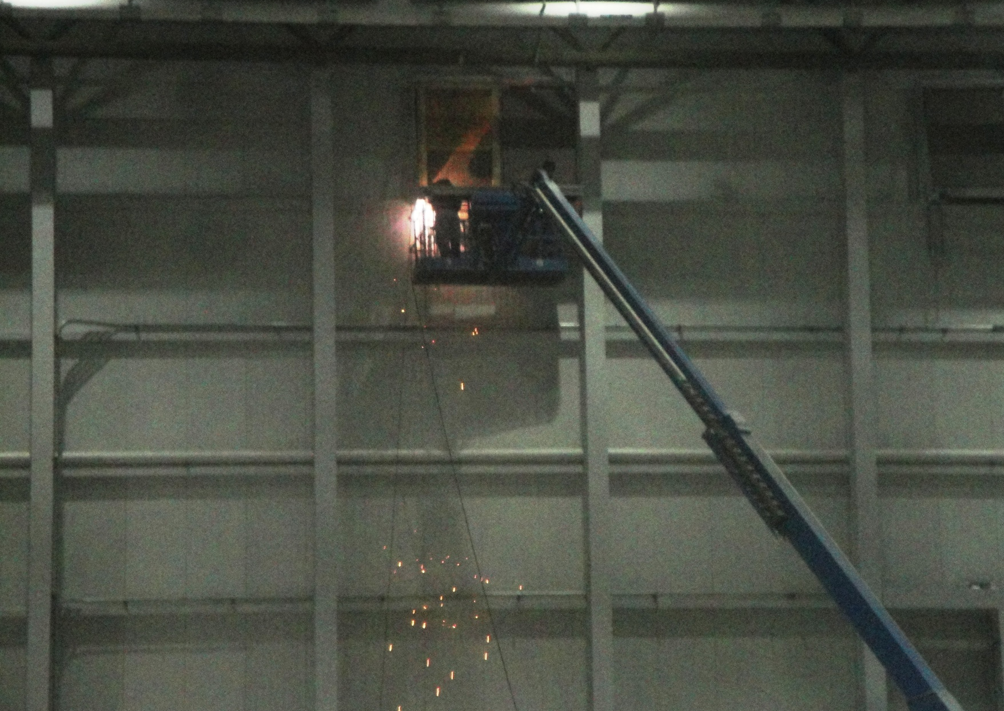
Fire Watch

Slide 115
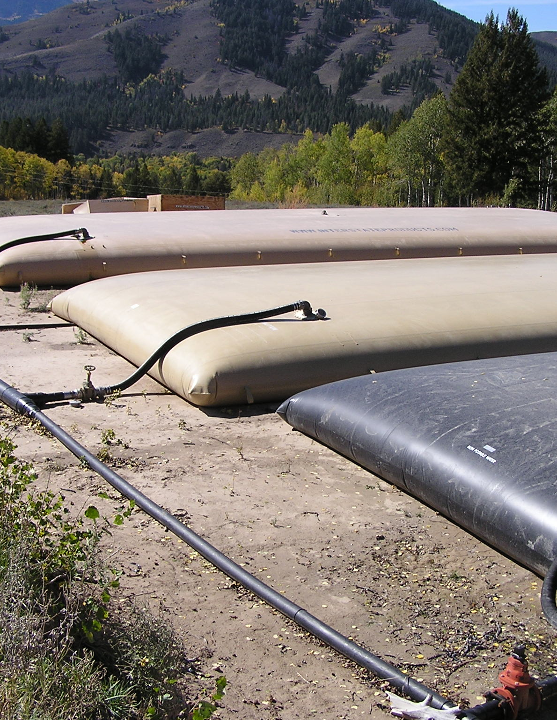

Temporary Water Supply

Slide 116


Emergency Impairment
Notes:
Sprinkler damaged and operated
15.6 Emergency Impairments
15.6.1 Emergency impairments shall include, but are not limited to, system leakage, interruption of water supply, frozen or ruptured piping, and equipment failure.
An emergency impairment is a condition in which the water-based fire protection system or a portion thereof is out of service due to an unexpected occurrence. Such an impairment may occur as the result of a successful system operation during a fire.
Following a fire, sprinklers that have operated must be replaced and the system must be returned to service. The replacement of sprinklers illustrates the importance of the sprinkler cabinet inspections required by Chapter 5, since the impairment time can be substantially reduced if replacement sprinklers are on site.
15.6.2 The coordinator shall implement the steps outlined in Section 15.5.
The impairment coordinator can use an emergency impairment notice, such as the one shown in Exhibit 15.3, to coordinate emergency repairs of a fire protection system.

Slide 117
Notifications
Stakeholders
Authority Having Jurisdiction
Fire Department
Alarm-Receiving Facility
Purpose of Shutdown
Return to Service
Notes:
15.5.2
There are also requirements for notifications laid out in 4.1.4
4.1.4 Notification of System Shutdown. The property owner or designated representative shall notify the authority having jurisdiction, the fire department, if required, and the alarm-receiving facility before testing or shutting down a system or its supply.
Paragraph 4.1.4 establishes the requirement for notification when systems are removed from service. Testing a system without proper notification might — and often does — result in a false alarm. False alarms must be avoided, since they remove emergency services personnel from service at a time when their services may be needed for an actual emergency. In many jurisdictions, repeated false alarms can result in a fine or other penalty for property owners.
4.1.4.1 The notification of system shutdown or test shall include the purpose for the shutdown or test, the system or component involved, the estimated time of shutdown or test, & the expected duration of the shutdown or test.
4.1.4.2 The authority having jurisdiction, the fire department, and the alarm-receiving facility shall be notified when the system, supply, or component is returned to service or when the test is complete.
The requirement in 4.1.3.2 assists the AHJ or alarm company in establishing a follow-up program to ensure that systems are properly returned to service.

Slide 118
Restoring System to Service
Verification of Operation
Inspection and Testing
Stakeholders Informed
Supervisors
AHJs
Property Owner or Designated Representative
Impairment Tags Removed
Notes:
15.7* Restoring Systems to Service
When all impaired equipment is restored to normal working order, the impairment coordinator shall verify that the following procedures have been implemented:
(1) Any necessary inspections and tests have been conducted to verify that affected systems are operational. The appropriate chapter of this standard shall be consulted for guidance on the type of inspection and test required.
The most common tests required following a system repair are the hydrostatic pressure test to verify that the piping system will not leak, and the valve status test to verify that all water supply control valves have been returned to their full open positions. Other tests, such as a running test for fire pumps and flow, or alarm tests to check the functioning of replaced components, are required when components are repaired or replaced.
(2) Supervisors have been advised that protection is restored.
(3) The fire department has been advised that protection is restored.
(4) The property owner or designated representative, insurance carrier, alarm company, and other authorities having jurisdiction have been advised that protection is restored.
All parties involved in the original impairment notification should be advised when protection is restored. See commentary following 15.5.2(5) for further information.
(5) The impairment tag has been removed.
Impairment tags are required to be removed and should be accounted for. As stated in the commentary following A.15.3.1, counting these tags can be a means of verifying that all system control valves have been returned to their proper operating position and the system is fully operational.

Slide 119








System Tagging
Notes:
NFPA 25 does not mandate system status tagging. Annex G has recommendations for color coded system status tagging.
Annex A.3.3.7 Provides recommendations as to categorizing deficiencies.
Florida has gone one step further. The FFSA developed recommendations contractors based on this table and distributed them.

Slide 120


Annex G
Color-coded tagging guidance
Intended to bring consistency
4-color system with “repair tags”
Notes:
Annex G- Just tagging guidance, not necessarily something for AHJ’s to “adopt”.

Slide 121
Module 7
Small Requirements From Other NFPA Documents

Slide 122

Chapter 16 – Special Requirements
Notes:
Small Residential Board and Care Occupancies are the only ones in this chapter so far.

Slide 123
Residential Board & Care
Chapter 16 was added to bring in ITM requirements from other NFPA standards
ITM requirements from NFPA 101 dealing with 13D systems in Small Res. Board and Care facilities are included
  Basically serves as an “exception” to the scope
Notes:
Chapter basically serves as an exception to section 1.1.5 in the scope stating that except for Chapter 16, NFPA 25 does not apply to systems installed according to 13D.

Slide 124
Module 8
Other Administrative Issues

Slide 125
Administrative Issues
Cite specific references in NFPA 25
Information
“the facts”
Owner
Outside the scope of NFPA 25
Notes:
Discuss how two different type reports are used to provide information to the owner. If it is within the scope of NFPA 25, then it is noted on an NFPA 25 inspection report.
If it is not within the scope of NFPA 25, then we are simply providing information regarding facts to the owner. This information IS NOT REQUIRED by NFPA 25. We are not making any judgment evaluation, we are not saying something is right or wrong. We are simply advising the owner of things we think should be investigated by the owner to see if they are correct.
The easiest rule of thumb is that if we cannot point to a specific section in NFPA 25 (with the exception of anything starting with 4.1) to reference, then it should not go on an NFPA 25 inspection report. It is simply informational or observational and should go on a separate and accompanying report.

Slide 126
Observation Report
Items listed below are not part of an NFPA 25 Inspection and are outside of the scope of the Inspection Agreement with the Company. The identification of these items does not constitute a design review or engineering analysis of your system. These items were noticed during an inspection of your fire protection system performed in accordance with NFPA 25 but are not part of the NFPA 25 inspection. XXXXXX Sprinkler Corporation makes no guarantee or assurance that any or all design or engineering defects or deficiencies have been detected.

Slide 127
Module 9
Try a Few

Slide 128
Storage within 18” of deflector
Notes:
Violation of 5.2.1.2.1

Slide 129

No Sprinklers in Corridor
Notes:
This is not a violation that a contractor can cite. While it is actually a violation of NFPA 13, it is a design issue and outside the scope of a contractor’s work. It could be submitted on an observation report.

Slide 130

Paint on Link
Notes:
5.2.1.1.1(6)

Slide 131

Loaded Sprinkler
Notes:
This is an opportunity to talk about the new subjective language in 5.2.1.1.1(2&5) which only addresses corrosion & loading if it is “detrimental to sprinkler performance. While this one is pretty easy, this call can get very subjective.

Slide 132

Damaged Concealer Plate
Notes:
NFPA 25 only addresses missing escutcheons or concealer plates. But since NFPA 13 (2019) (7.2.6.2 & 7.2.6.3) state that they are part of a listed sprinkler assembly, a clear argument could be made that this represents a damaged sprinkler. In addition, the damage could easily jam the concealer n a way that would prevent it from dropping off and activating correctly. Therefore it would violate 5.2.1.1.1(3)

Slide 133

Ceiling Has dropped
Notes:
Actually a very strong argument this violates 5.2.1.1.2 by being in the incorrect orientation. If you look at the cut sheet for a recessed sprinkler, it says that to be properly oriented, it must be flush against the ceiling.

Slide 134

Control Valve (90” above grade)
Notes:
See Annex note to “accessibility” A. 4.1.3 to see that this is accessible and not a violation.

Slide 135

Auxiliary Drain- No Identification
Notes:
No sign. Not a violation of NFPA 25. While NFPA 13 requires identification on all valves, NFPA 25 only enforces identification on CONTROL valves.

Slide 136

Dry Barrel Hydrant
Notes:
Inaccessible per 7.2.2.4(1)

Slide 137
Module 8
Exercises

Slide 138

Multiple risers
I have a warehouse with 4 wet systems & 2 dry systems. How many internal pipe assessments are required every 5 years?
Notes:
Assessments of internal piping conditions are required on the dry systems every five years in accordance with section 14.2.1.
For the wet systems, only every other one is required to have an assessment every five years according to section 14.2.2. therefore the answer is 4. Of course if any problems are encountered when inspecting the wet systems, then all of the systems must be assessed.

Slide 139

Painted Sprinklers
I had to replace 24 sprinklers due to paint on the sprinklers.
What tests and/or inspections are required?
Notes:
According to the Component Replacement Table 5.5.1 in chapter 5, replacing more than twenty sprinklers requires a hydrostatic test in accordance with NFPA 13.

Slide 140

Main drain with no means of drainage
The main drain for a system is piped into a storage room with no apparent drain. Am I required to do a main drain test?
Can I?
Should I?
Where is this covered in NFPA 25?
Notes:
Again, this situation presents an interesting scenario. Normally, one could take the position that the installation of the main drain assembly was accepted at original design, and is therefore outside the scope of NFPA 25. So, to answer the questions:
Are you required to do a main drain test? Yes per section 13.2.5
Can you? Yes, given that we will either require some way of disposing with the water, or by making a huge mess.
Would you? Certainly not without acknowledgement and consent of the owner. You could also make a very strong case that this situation is in fact within the scope of NFPA 25 by referencing section 13.2.4 that requires care to be taken to minimize any water damage during testing. It would be very difficult to comply with this requirement in this case. Since verification cannot be accomplished, this is in conflict with that section.
It is also referenced in 4.1.1.2.1 (drainage) but since that is in section 4.1 it would be outside the scope of a contractor’s work.
Could look at 4.6.1 (components are to be tested to verify they function as intended). NFPA 13 16.10.4.6 requires main drain test connections to be installed to permit flow tests of water supplies

Slide 141

Fire pump in service
Should the pump remain on during all tests?
Notes:
Yes according to section 4.4 unless we take very specific precautions. However, should we need to shut down a pump, or any other part of the system to perform specific tests, there is an allowance covered in 4.4 and A.3.3.22 (2nd paragraph) that specifies how to handle temporary shutdowns without needing to follow all of the Impairment requirements.

Slide 142
Records
How many sets of records are required to be maintained?
Notes:
There should be a minimum of three sets of records according to sections 4.3.4 & 4.3.5. The original acceptance records, the current cycle of records, and the previous cycle of those records. That way, we can use the prior records for comparative analysis to note any changes in the system

Slide 143
Records
?
What can an owner do if he/she has no records of anything?
Notes:
This becomes a very difficult and potentially very expensive problem. The standard simply requires that records be maintained according to section 4.3. It does not address the lack of records. Therefore, if the owner has no records, then they must be recreated. A complete Inspection, Testing & Maintenance program will have to be performed in order to establish base line records for comparison.
If the owner has none of the original records, and no riser tag is present, as required by section 5.2.5, then the problem gets even more complicated. How are we supposed to know? The owner is required to provide that information. Remember that we are operating under the assumption that the system was installed and accepted as correct. It is the owner’s responsibility to verify compliance with NFPA 25. The standard also addresses a situation where the system was pipe scheduled and does not require a hydraulic tag is not required. In those cases , a tag stating it is a pipe scheduled system is required (5.2.5.2). So no matter the original design, a sign is required. It is the owner’s responsibility to provide that information.

Slide 144

Standpipe flow test
How often am I required to conduct a flow test on a standpipe system, and what are the flow requirements?
Notes:
In accordance with section 6.3.1.1 a flow test is required every five years on all automatic standpipe systems at the hydraulically most remote outlet(s). The flow & pressure requirements, according to section 6.3.1.4, are the requirements under which the system was installed.

Slide 145

Storage too close to sprinkler
During the course of an inspection, the owner was made aware of storage encroaching into the 18” required clearance area to a sprinkler.
Without delay, the owner removed the storage, lowering the height to an acceptable level.
Is the owner still in violation of NFPA 25, section 5.2.1.2?
Notes:
While the situation is no longer in conflict with the standard, it would probably be prudent to cite the violation on the inspection report, and simply note that it was corrected on sight by the owner. In this manner, if the owner chooses to return the storage after we leave, the history is noted.

Slide 146
Recalled products
How am I supposed to deal with recalled products?
Notes:
While the term “recalled” is not specifically in the body of the standard, it is referenced in section 4.1.5 requiring repairs to a system for any deficiencies or impairments..
N 4.1.5.1.1* Upon discovery of any component and equipment under recall or replacement programs by the owner’s maintenance personnel, designated representative, or contractor, the owner shall be notified in writing.
N 4.1.5.1.2* The property owner or designated representative shall correct, remedy, repair, or replace components and equipment under recall or replacement program.
Annex sections (A.4.1.5.1.1 & 4.1.5.1.2) gives specific guidance for dealing with recalled products. It does not necessarily say that everything must be replaced immediately, but could be handled through entry into a scheduled replacement program

Slide 147

Recalled products?
How would I know if I have recalled products?
?
Notes:
The chain of distribution in the US, from manufacturer to distributor to installer, is controlled pretty tightly. Manufacturers of recalled products are able to notify distributors of recalled products. Distributors have records of their contractor customers and can notify them also. Contractors, with records of their installations, can identify locations where recalled products are installed.
It is also possible, at least for sprinklers, to identify recalled heads by inspecting the spare heads and comparing them to a list of recalled products. IN addition, the owner is required to have a copy of the original records, which would have that information.
NFSA product advisory page

Slide 148

Replace standpipe hose
What tests are required after replacing hose in a standpipe system?
Notes:
According to the Component Replacement table 6.5.1, there are no requirements after replacing standpipe hose under NFPA 25.

Slide 149

Fire flow testing
How often are we required to conduct a full flow test on a private fire service main?
What constitutes passing or failing?
Notes:
According to section 7.3.1 a full flow test shall be conducted every 5 years. 7.3.1.1 states that any deterioration of flow and/or pressure must be investigated to the satisfaction of the AHJ.

Slide 150

Dry barrel hydrant not draining
Notes:
Violation of 7.2.2.4. Appropriate action is required according to 7.2.2.4.1.

Slide 151
Repairs to dry barrel hydrant not draining
If a hydrant is repaired because it did not drain, what tests, if any, are required?
Notes:
According to Table 7.5.1 a hydrostatic test & a flow test, both in conformance with NFPA 24 are required, and we must inspect for proper drainage.

Slide 152


Pump packing leaking
Is excessive leakage from the pump packing gland within the scope of NFPA 25, and, if so, what action is required?
Notes:
Annex A.3.3.7 sends us to section 8.3.2.9(1). According to section 8.3.2.9 (1) (c) part of the pump testing procedure is to verify the pump packing gland has a SLIGHT discharge. While the standard does not exactly specify what “slight” means, the typical understanding in the industry is a discharge of anywhere from approximately 10 drops per minute to a drop per second. Usually it is better to leak a little too much than too little.

Slide 153

Fire pump tests
How many tests does NFPA 25 require for a fire pump?
Notes:
There are two different tests required for fire pumps and they answer different questions:
No Flow (churn)- Determines whether the pump will start if the system loses pressure. It does not answer any performance questions other than does the pump start and do readings appear to indicate the pump is running normally.
only answers the question as to “will the pump start if I lose pressure”
8.3.1.1-The weekly fire pump test for a diesel engine driven fire pump without recirculating water back to the pump suction unless established by an approved risk analysis
8.3.1.2 For electric pumps, the non flow (churn) test shall be performed monthly except for the following which shall be done weekly:
Fire pumps serving fire protection systems in hi rise buildings beyond the pumping capacity of the FD
Pumps with limited service controllers
Vertical turbine pumps
Pumps taking suction from ground level tanks or water source that does not provide sufficient pressure to be of material value without the pump.
The annual flow test for both electrics & diesels, addressed in section 8.3.3, tests the performance of the pump compared to its original acceptance criteria. It also answers the questions of how the pump performs compared to when it was new, does it still provide the required flow & pressure for the system, and does it meet acceptable criteria under section 8.3.7.

Slide 154

Weekly/monthly fire pump test
What is the minimum amount of time a pump should be run during the weekly/monthly test?
Notes:
According to section 8.3.2.3, an electric pump must run at least 10 minutes. This is to allow the motor to cool after starting.
According to section 8.3.2.4, a diesel pump must run at least 30 minutes. This is to insure the motor heats up to normal operating temperature. This will help to burn off any condensation in the motor, to use up some diesel fuel, and to allow all gaskets and seal to get properly lubricated.

Slide 155


Alignment
Angular Taper/Feeler Gages
Parallel Straight Edge
Is angular and parallel alignment covered under NFPA 25?
Notes:
alignment is covered under section 8.3.6.4. This issue is covered in chapter 8, but under section 8.3.6 dealing with other tests.

Slide 156

Fire pump performance criteria
What is the acceptable performance level for a fire pump?
Notes:
According to section 8.3.7, a pump is considered acceptable if it has not degraded more than 5% in pressure, at rated flow, from the original acceptance curve or from the data plate.
Electric motors must also have a voltage reading either within 5% below or 10% above the rated voltage on the name plate of the motor. BUT BE SURE TO CHECK TIA 17-2. IT STATES THAT WE ONLY TAKE THESE READINGS ON ELECTRIC MOTOR DRIVEN CONTROLLERS IF WE CAN GET THAT INFORMATION WITHOUT OPENINGTHE CONTROLLER.
8.3.7.1.3 speed and velocity pressure adjustments must be made to net pressure and flow data to determine compliance

Slide 157

Interior of a tank
How often am I required to inspect the interior of a tank?
Notes:
According to section 9.2.5, it depends on the type of tank and the interior coating. Steel tanks without corrosion protection must be inspected every 3 years. All other tanks shall be inspected internally every 5 years.

Slide 158

Wires not connected
If a butterfly valve is installed with the wires not attached, is that an issue within the scope of NFPA 25?
Could I put a chain & lock on it instead?
Notes:
As it now sits, Annex A.3.3.7 sends us to section 13.3.2.2, and we find that section 13.3.2.2(2) requires the valve to be supervised. It clearly is not and thereby violates NFPA 25.
Suppose the valve is chained in the proper position instead. Since the valve would then be supervised it would no longer be in violation.

Slide 159




Control valves
How often am I required to inspect control valves?
Notes:
As in many case, it depends. According to sections 13.3.2.1 & 13.3.2.1.1 & 13.3.2.1.2., if they are properly sealed with a plastic or lead wire seal (per NFPA 13), they are inspected weekly. Chained and locked, they are inspected monthly, electrically supervised then quarterly.

Slide 160

Externally reset dry valve
How often do we inspect the interior of a dry valve that can be externally reset?
Notes:
According to section 13.4.5.1.3, we must do so annually, even if it is the type that can be reset externally.
Note that this is different than the rules for preaction/deluge valves. Those that can be reset externally are only required to have an internal inspection every 5 years.

Slide 161


Air test for dry & preaction systems
Notes:
This is covered in sections 13.4.3.2.6 & 13.4.5.2.9. It is required every 3 years and a system must meet either of:
40 psi for 2 hours & not lose more than 3 psi OR
With the air source shut off at normal pressure and the low air alarm does not sound within 4 hours.

Slide 162

Dry valve tests
How many type tests are there for a dry pipe valve?
Notes:
There are 2 type tests for dry pipe valves. They are addressed in sections 13.4.5.2.2.3 (partial trip test) and section 13.4.5.2.2.2 (full flow trip test)

Slide 163


Obstructed Alarm Check Valve
What inspections/tests are required after I remove a pipe elbow from an alarm check valve?
Notes:
According to table 13.11.1, after repairing an alarm check valve, we must inspect for leaks at system pressure (per section 13.4.1), test all alarms & supervisory signals affected by the alarm valve & perform a valve status test.

Slide 164

Backflow Prevention Assembly
Am I required to perform a back flow test on a back flow preventer to insure there is no risk of cross contamination of the water supply?
Notes:
According to section 13.7.2.1, there is NO requirement to perform a back flow test on a BFP. The only requirement is to do a forward flow test, and that test is only a flow test, not a pressure test. There are other tests we use to gage pressure in the system. It is important to note that the water purveyor may require a backward flow test, but it is not a requirement of NFPA 25.

Slide 165

Retrofit backflow preventer
What if I have an older building that has been retro fitted with a backflow preventer, and does not have a means of testing at full system flow?
Courtesy of GoBackflow.com
Notes:
Section 13.7.2.3 addresses this common condition. It states that where a full flow is not permissible, the test shall be completed at the maximum rate possible. This may include using the main drain, backwards through the FDC, the inspector’s test connection, and any other possible connections to flow water through the BFP.

Slide 166

Damaged FDC
What tests are required if I have to replace an FDC that has been damaged?
Notes:
According to table 13.11.1, it depends on the type system where the FDC is installed. On all systems we are required to do a hydrostatic test for 2 hours. The difference occurs in the pressure we use. If it is a sprinkler system, we test at 150 psi. If it is any other type system, we test at 200 psi (or 50psi above normal working pressure, but a minimum of 200psi). We must also do a valve status test on all systems if replacing the FDC required closing a control valve.

Slide 167

Pressure reducing valves
How often are we required to inspect pressure reducing valves?
Notes:
PRV’s are addressed in Table 13.1.1.2. As is often the case, it depends where they are being used.
Sprinkler systems 13.5.1.1- quarterly (a fairly frequent time span, since these valves must operate without any human intervention, and the entire system (or section thereof) depends upon their performance.
Hose connections 13.5.2.1- annually. Since these valves, primarily designed for FD use, require manual activation, the time span can be a bit longer. They do not operate until someone actually operates the hose valve. In the event a valve does not operate properly, it does not compromise the entire system, but only that particular valve. It is possible another valve could be accessed to utilize.
Hose rack assemblies 13.5.3.1- annually. These valves, intended originally for building occupants, operate similarly as above, not operating until they are manually activated.
Master PRV’s 13.5.4.1- weekly. Since the failure of one of these valves would compromise the entire system (usually a standpipe system), the need for closer supervision is warranted.
Any PRV uses in a system other than those listed above are addressed in section 13.5.5.1 and inspected quarterly and governed under the same rules as those for sprinkler systems..

Slide 168

Obstruction investigation
How often am I required to conduct an obstruction investigation?
Notes:
According to section 14.3.1, obstruction investigations are only conducted based on the occurrence of triggers, and not time.

Slide 169


Impairment Tags
How many impairment tags are required when a system is shut down?
Notes:
Section 15.3.2 requires that an impairment tag be placed at the system control valve and at the FDC, indicating which system, or part thereof, has been removed from service.
Many states have instituted requirements that establish a multilevel identification of the system’s operational status. Operational status tagging is related to, but not entirely the same as the tag impairment system required by 15.3. Operational status tagging provides identification of system problems that is more closely related to issues around deficiencies as defined in Chapter 3. Annex G contains recommendations for colored coded tagging.
Anyone shutting down a system should utilize tagging procedures even if the owner does not. Tags should also be itemized in a list to facilitate proper restoration of the system to working order. A tag, once retrieved, can also be used for verification that a valve or system has been restored to service.

Slide 170
Notifications
What notifications are required when a system is returned to service?
Notes:
Basically, section 15.7 requires that everyone who was notified they system was shut down be notified that it is now back in service.

Slide 171
Responsibility
How can the owner transfer responsibility for the Inspection, Testing & Maintenance of a system to someone else?
Notes:
Section 4.1.1.3 allows for the owner to delegate authority for maintaining the system. However, that does not relieve the owner of the responsibility. Section 15.2.3 and Section A.4.1.1.3 discuss how responsibility can be transferred through leases, agreements, etc.

Slide 172

No sprinklers in room
During an inspection, I notice that a room in a completely sprinklered building does not have sprinklers. How is that addressed in NFPA 25?
Notes:
NFPA 25 does not require sprinklers in any particular room. That is a design issue and is therefore outside the scope of NFPA 25. This information would be included in an observation report, separate and apart from an NFPA 25 Inspection report, recommending that the owner have it evaluated.

Slide 173

Standpipe with hose removed
How does NFPA 25 deal with the fact that we are unable to inspect the hose in a standpipe system because it has been approved for removal by the local Fire Marshal?
Notes:
Annex A.3.3.7 (or Table 6.1.1.2) sends us to 6.2.5 for inspection issues. The fact that hose was removed by authority of the AHJ renders the inspection of the hose to be moot. The owner should be capable of providing evidence to that fact, but, assuming that evidence is available, then the situation is acceptable in accordance with 6.1.6.

Slide 174


Tank with Heating System
If I have a heating system on my water tank, and to prevent overheating the water in the tank, it is equipped with a high water temperature limit switch, how often must I test the limit switch?
Notes:
Table 9.1.1.2 sends us to section 9.3.4 which indicates that it must be tested prior to heating season is in service.

Slide 175

Condominium building
When inspecting a condo building, I am unable to get in to all of the individual living units. Is it OK to simply inspect the common areas? And where in NFPA 25 is this addressed?
Notes:
Section 5.2.1.1 requires that sprinklers be inspected. While there is an allowance for sprinklers inaccessible due to safety reasons, and allowances for sprinklers in concealed spaces, there are no allowances for sprinklers that are simply unavailable because access is denied. According to section 4.1.3 the owner is required to provide accessibility. In many of these situations, a master deed (or a lease in apartments) allows for management personnel to enter at reasonable times to perform maintenance tasks. Many such buildings give advanced notice and then provide access for inspection. In the event access is completely denied, this is an issue that should be noted on any inspection reports, and referenced according to section 5.2.1.1 that all sprinklers were not inspected due to lack of access.
It is important to note that we would not cite a violation of Section 4.1.3 since this section involves responsibilities of the owner, which only the AHJ is allowed to enforce.

Slide 176

Concern over recalls
A local fire marshal has read about an issue involving recalled sprinkler heads. In order to verify whether any exist in his/her jurisdiction, they are requiring a physical inspection of ALL heads, even those concealed, to ascertain if any subject to recall are present. Isn’t this outside the scope of NFPA 25 section 5.2.1.1.3?
?
Notes:
While this is the correct section for references dealing with sprinklers in concealed spaces, and it is outside the scope of NFPA 25, AHJ’s do have the right, specifically under section 1.2.2 to require methods beyond the scope of the standard if they believe there is a distinct threat to life and/or property. It should be noted that AHJ’s should be very careful in the use of “distinct hazard to life or property” and not use it indiscriminately.

Slide 177

Light hazard
During an inspection of light hazard occupancy, it was noted that standard response sprinklers are installed. NFPA 13 clearly states that quick response sprinklers are required in all light hazard occupancies. Does NFPA 25 require that these heads be replaced?
Notes:
Since the installation of sprinklers is covered in NFPA 13, and not NFPA 25, this is an issue beyond the scope of NFPA 25. It is a design issue not covered n the standard. First of all, quick response sprinklers were not required in light hazard occupancies until the 1999 edition of NFPA 13. Any installations prior to that time would be acceptable. Secondly, remember that we are allowed to assume the system was installed correctly and was approved as installed.

Slide 178

Signage
Where are signs or banners covered in NFPA 25?
Notes:
Section 5.2.1.2 deals with the minimum clearance required from sprinklers. However, as clarified specifically in section A.5.2.1.2, this clearance only applies to the 18” or 36” below the deflector. It does not apply to the beam rule, soffit rule, three times rule or any of the other obstruction rules. These are design issues and are not expected to be enforced during a routine inspection. While it is information we would report to the owner (on an observation report) and recommend someone make an engineering judgment, it is outside the contractor’s scope.

Slide 179
Testing sprinklers
What is the minimum number of sprinklers that must be tested?
Fuquahomes.com
Notes:
While this issue is not specifically addressed in Table 5.1.1.2, it does send us to section 5.3.1.1.1 dealing with the testing of sprinklers. Section 5.3.1.2 indicates that a representative sample can be either 1% of the number of sprinklers in the sample or 4 sprinklers, whichever is larger.

Slide 180




Valve signs
Section 4.1.8 simply states that the location of shutoff valves shall be indentified but it doesn’t say who is responsible. Who is?
Notes:
Section 4.1.8 starts with”4.1”. Section 4.1 is clearly titled “Responsibility of the Property Owner or Designated Representative.” Therefore, any subset of this section, meaning anything that starts with 4.1 is considered to be a further extension of the Owner’s or Designated Representative’s responsibilities. Enforcement of this section is completely within the purview of the AHJ, and should not be cited by a sprinkler contractor. If there is an issue with access where we cannot cite a specific rule other than a “4.1” rule, we should advise the owner of the situation in an observation report.

Slide 181

Antifreeze Testing
I have been hearing a lot of controversy about anti freeze. How do I find out what the latest requirements and decisions are related to anti freeze?
Notes:
All of the prior TIA’s have been compiled into new language in Section 5.3.4

Slide 182
Thank You
National Fire Sprinkler Association
www.nfsa.org
443 863-4464

Slide 183


Thank You for Your Time
Questions?
National Fire Sprinkler Association
www.nfsa.org
443 863-4464

